Slide 1
welcome

Slide 2
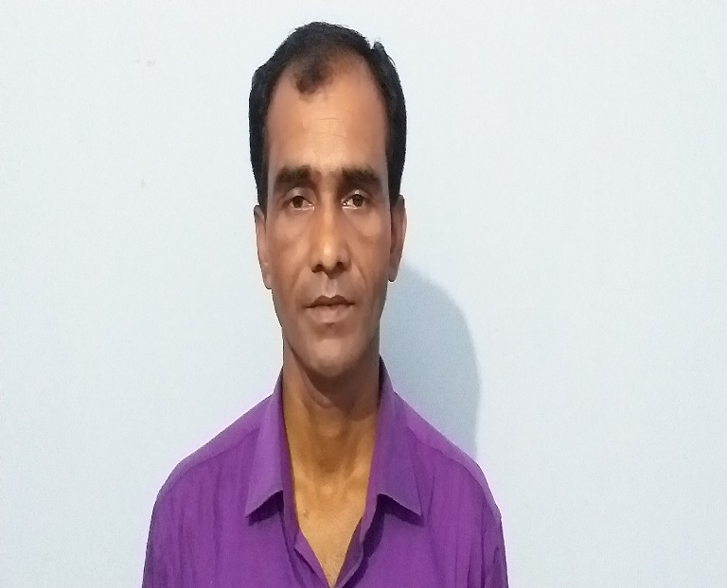
Teacher’s Introducing:
Md.Rashidul Islam
Head teacher
Nalukabari gps

Slide 3
Lesson Introducing
Class: Two
Subject: English
Unite:19
Lesson:1-3 Time: 45minutes

Slide 4
Learning outcomes:
Students will be able to:
1.1.1.become familiar with English sounds by listening to common English words.
1.1.2 Say simple words and phrases with proper sounds and tress.

Slide 5
What can we see in this picture?

Slide 6
Today will learn about….
Shapes

Slide 7
What is this?
Square

Slide 8
Square

Slide 9
What is this?
Circle

Slide 10
Cir
Circle
Cle

Slide 11
What is this?
Triangle

Slide 12
Tri
Triangle
Angle

Slide 13
What is this?
Rectangle

Slide 14
Rect
Rectangle
Angle

Slide 15
Square

Slide 16
Circle

Slide 17
Triangle

Slide 18
Rectangle

Slide 19
Cheking learning:
Read and Match:
Circle
Rectangle
Square
Triangle

Slide 20
Thanks to all

