Slide 1
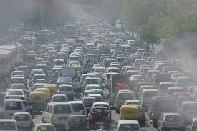
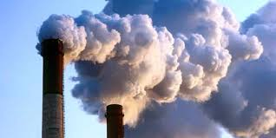
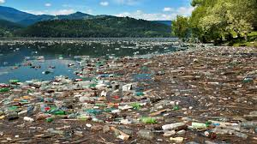
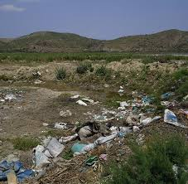
Look at the pictures and say about these.

Slide 2
Learning outcomes:
After we have studied the lesson,we will be able to:
* Know about the major sources of environmental pollution.
* Know about the bad effects of environmental pollution.
*Know about the ways of reducing various pollution.
* ask and answer the questions.

Slide 3
PPollution
Air Pollution
Soil Pollution
Water Pollution
Smoke from brickfields
Dust
Toxic smoke from Industrial plants
Use of polythin shopping bags
Throwing wastes into water
Over use of pesticides & fertilizers
Using chemicals into water

Slide 4
Single works | Group works
Write three major types of environmental pollution. | * Write the dangers of environmental pollution.
* Main causes of air pollution | * Two causes of water pollution

Slide 5
Evaluation
Question | Answer
* Ways of reducing air pollution?
* Ways of minimizing water pollution?
* Process of decreasing soil pollution?

Slide 6
Home work
Write a paragraph on environmental pollution.
Thanks to all my beloved students.
Md. Haris Rahman
Assistant Teacher (English)
Lamkain Wahedia Dakhil Madrasha
Gafforgaon,Mymensing.

