Slide 1

welcome

Slide 2
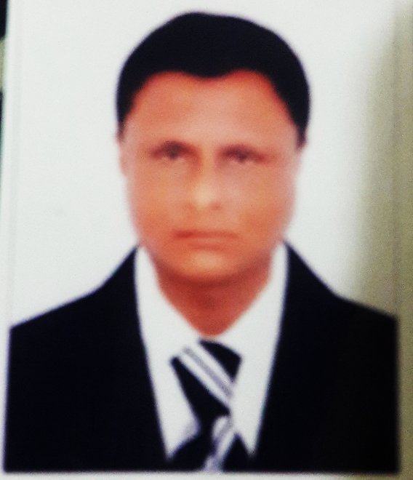
ITRODUCTION
K.M. Abdul Bari
Amoin GPS
Sherpur,Bogra
Sub:English
Class: Five
Lesson:9
Page: 36

Slide 3
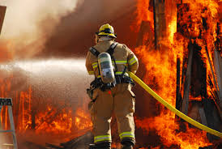
Creates emotion

Slide 4
Title of the lesson
Title:Occupation
Part of the lesson: A long time-----didn’t mind.

Slide 5
Learning outcomes
Listening:3.3.1student will able to understand question about objects around them.
Speaking:1.1.1 student will able to say words,phrases and sentences with proper sounds and stress.
Reading:1.5.1 student will able to read words,phrases and sentences in the text with proper pronunciation,stress and intonations.
Writing:9.1.1 student will able to take dictation of simple paragraph.

Slide 6
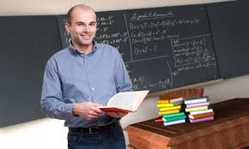
Teacher’s model reading
Put your finger under the lines and words look and listen carefully,the word I missed, you shout for that at page 34

Slide 7
Pronunciation drill
Firefighter
Quietly
Building
Joined
Panicked
Volunteer
Brigade
Department

Slide 8
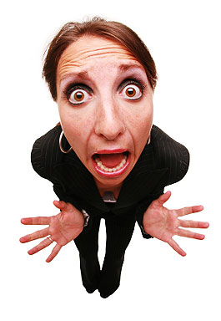
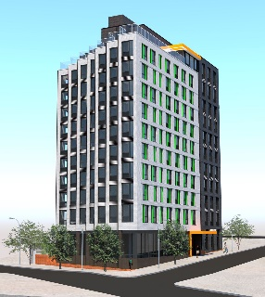
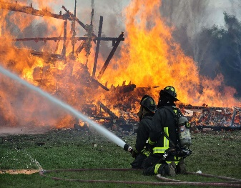

words meaning(WCW)
Panicked
Sudden anxiety.
A closed structure with wall & roof
Building
A person who put out fire.
Firefighter
Put out
To stop a fire.

Slide 9

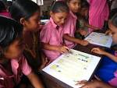

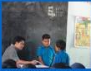
Group work(SGW)
Group 1
Group 2
Group 3
Group 4
One student will read by turn and others will listen.I’ll demonstrate by the ss if require.

Slide 10
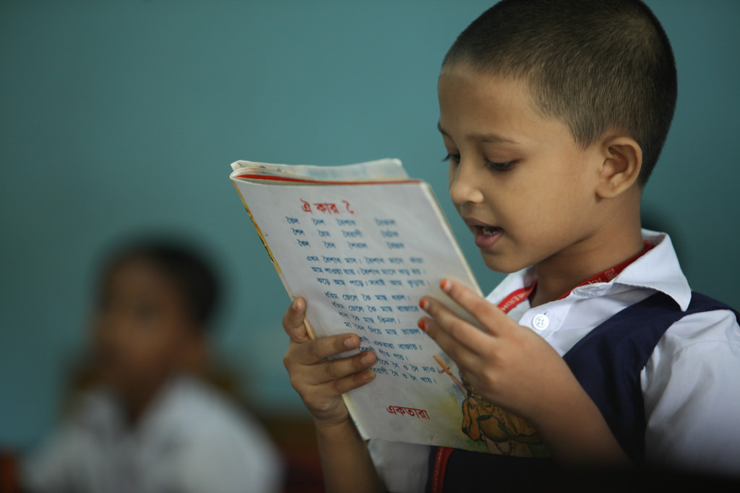
Student reading(WCW)
One student will read in front others will listen.I and others studends will help.

Slide 11
Task(IW-WCW)
Now ss ,write a short paragraph by answering the following question.
Where does the firefighter work?
What is his main job ?
What is the activity of a firefighter?
Whom does he train?
How is the profession?

Slide 12
Possible answer to the task.
A firefighter is a person who works at fire department.The main job of a firefighter is to putting out fire.He save people and protects their houses and property from fire related accident. A firefighter also trains young people to become firefighter. It is nobel profession.

Slide 13

A title
Nice
Avoid Overwriting

Slide 14

Individual work(IW)
Students will read the text silently.

Slide 15
Evaluation
Read the following lines(reading skill).
Firefighter is a Raju. Got panicked every one.A fire brigade soon came and the fire put out.

Slide 16
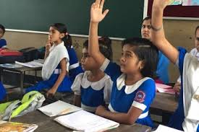
Better understand
I will tell(1/2) the text in Bangla to check whether they understand or not.

Slide 17
Answers questions drill
What does a firefighter do?
What is volunteer work?
What do you think about your job?

Slide 18

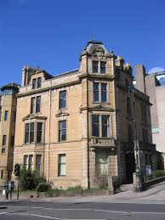

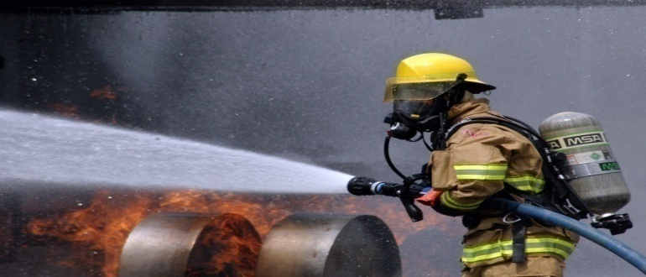
Say the following words and phrases.
Put out
Building
Fire
Firefighter

Slide 19
Creative Work(home task)
Think of a person who works in your area to help you live well. Write a paragraph on this person by answering the following question.
a) What does he/she do? b)What time does he/she start his/her work?
c) How does he/she do the work? d) Does he/she like the job? Why / Why not? e) What do you think about his/her job?

Slide 20

The End
TANKS

