Slide 1
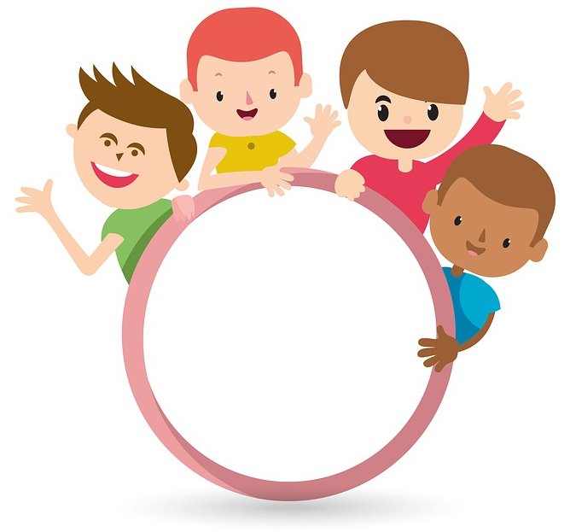

Slide 2
MD. KOWSER ALI
ASISSTANT TEACHER
DURLOVPUR GOVT. PRIMARY SCHOOL
HORINAKUNDU, JHENIDAH.
kowser.gps@gmail.com
Sub: English
Class: Two
Lesson : Numbers (8,9,10)
Parts of the lesson: Activity-B
Page No-12

Slide 3
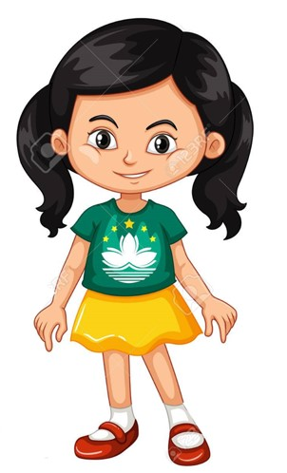
Safety environment by greetings song.
Hello! Hello! How are you?
I’m well, I’m good.
I’m great, I’m wonderful.
Hello! Hello! How are you?
I’m fine! I’m great today.

Slide 4
Checking homework and justify the previous lesson.

Slide 5
Our today’s lesson is too--
Numbers-8,9,10
Activity-B

Slide 6
LEARNING OUTCOMES
By end of the lesson students will be able to-------
Listening: 1.1.1 become familiar with English sounds by listening to common
English words.
Speaking: 1.1.1 repeat after the teacher simple words and phrases with proper
sounds and stress.
1.1.2 say simple words and phrases with proper sounds and stress.
Reading: 1.2.1 recognize and read cardinal numbers up to 30.
Writing: 1.2.1 write cardinal numbers up to 30 in figures.
1.2.1 copy numbers up to 10 in figures and in words.
1.2.1 write numbers up to 10 in figures and in words.

Slide 7
Teacher showing real objects.
Look, listen and say.
How many stick?
How many sticks?
Now repeat after me.

Slide 8
Open your English book at page-12 and see the Activity- B
Say, trace and write.
8
9
10
eight
nine
ten
Exchange your book and check the text of other.
Let’s practice on the board.

Slide 9
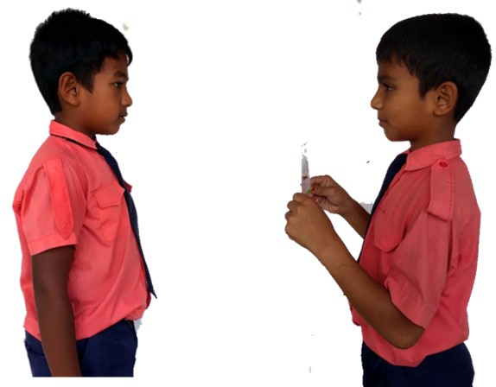
Pair work.
How many ----------?
One more.

Slide 10
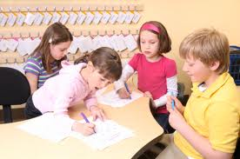
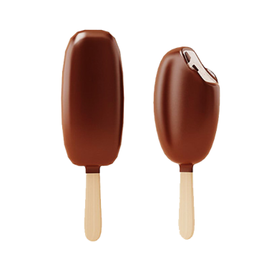
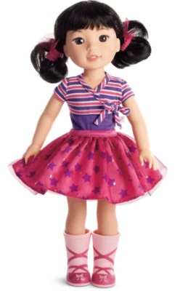
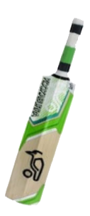
Group work
Count and write in figures and in words.
9
nine
---
------ice-cream
8
eight
---
-------girls
10
ten
---
-----bats
See again.

Slide 11
Read and say.
three
ten
four
two
eight
six
five
seven
nine
one
Identifying weak students and taking to cure.

Slide 12
One day one word
How many butterflies?
nine
নয়
Spell out the word - SGW

Slide 13
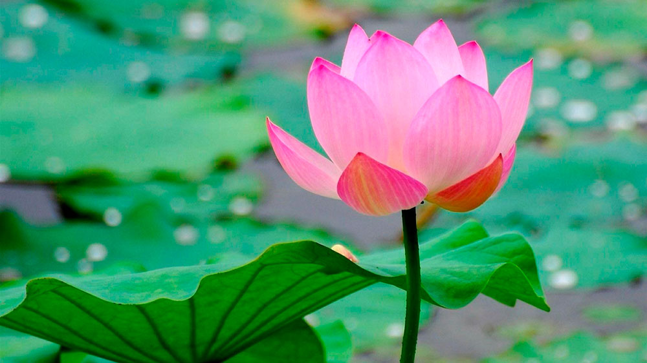
Find out the letters that are made by the word -----.
h
n
d
b
i
x
n
k
c
e
Find out the word------.
nien
nein
nine
nani
naen

Slide 14
Say the missing letter.
--ine
nin--
n--ne
ni--e
Write the word to your notebook.
Date-
/ /20
nine
নাইন
নয়

Slide 15
Home work
Page 11 will be well read and written.

Slide 16
That’s all for today. Goodbye. See you tomorrow.

