Slide 1
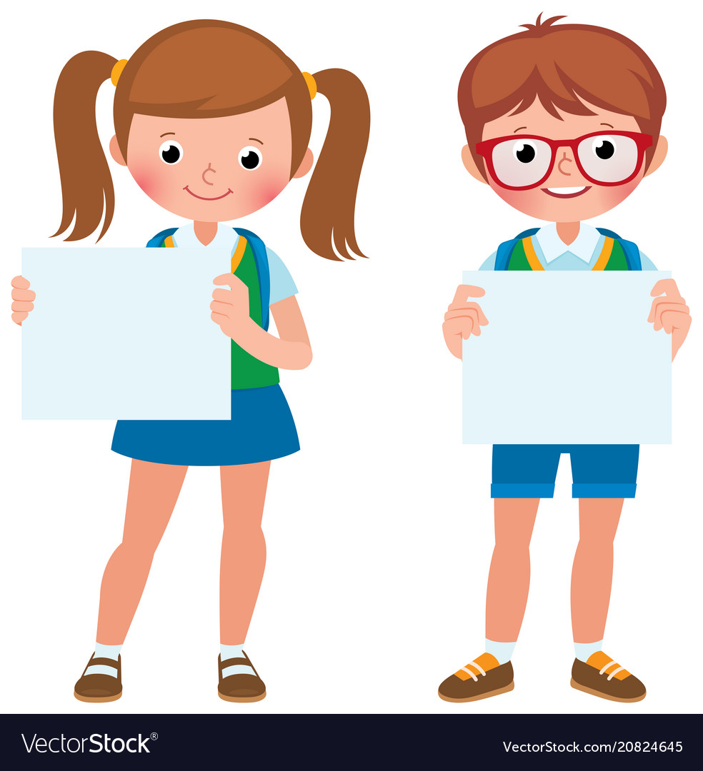


Slide 2
MD. KOWSER ALI
ASISSTANT TEACHER
DURLOVPUR GOVT. PRIMARY SCHOOL
HORINAKUNDU, JHENIDAH.
kowser.gps@gmail.com
Sub: English
Class: Two
Lesson : Alphabet
Parts of the lesson: Activity-B
Page No-13

Slide 3

Safety environment by greetings song.
Hello! Hello! How are you?
I’m well, I’m good.
I’m great, I’m wonderful.
Hello! Hello! How are you?
I’m fine! I’m great today.

Slide 4
Checking homework and justify the previous lesson.

Slide 5
Our today’s lesson is too--
Alphabet-Unite-6
Activity-B
This our revision class.

Slide 6
LEARNING OUTCOMES
By end of the lesson students will be able to-------
Speaking: 1.1.2 say simple words and phrases with proper sounds and stress.
Reading: 1.2.1 recognize and read the alphabet both small and capital (non-cursive)

Slide 7
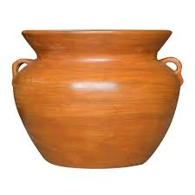
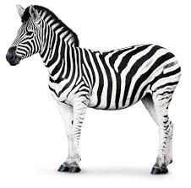
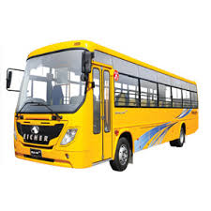


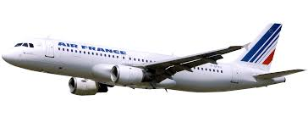
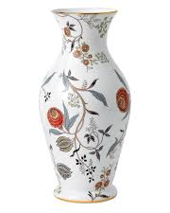
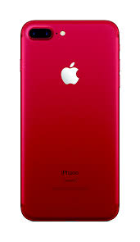
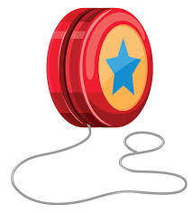
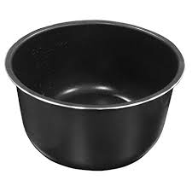
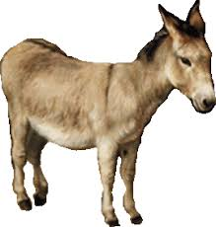
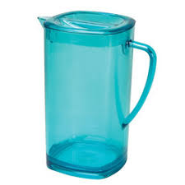
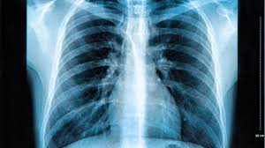
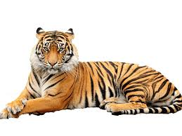
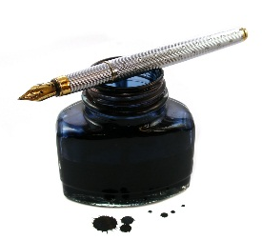
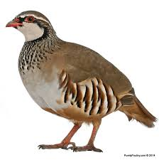
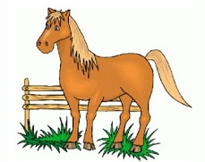
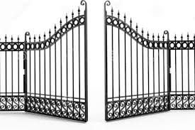
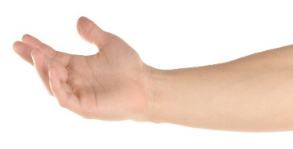
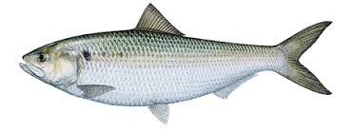
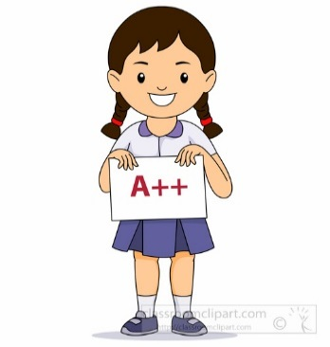

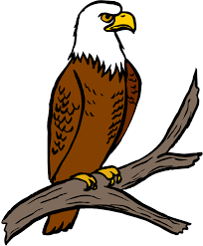


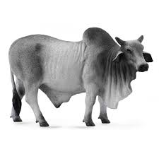
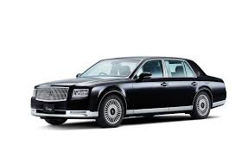

Say the names of the pictures.

Slide 8
Read and say.
ant
farmer
kite
pot
yo-yo
bat
girl
lion
quail
umbrella
tiger
hut
egg
rose
window
doll
igloo
net
sun
mango
x-ray
jeep
orange
zebra
vas
car

Slide 9
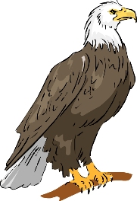

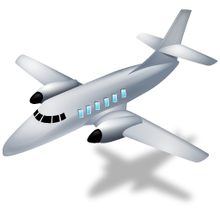

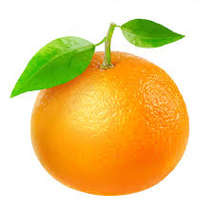
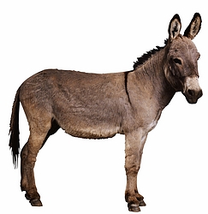
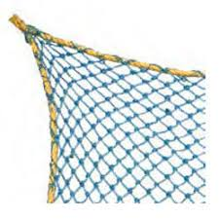

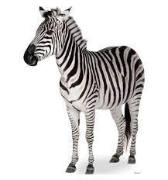
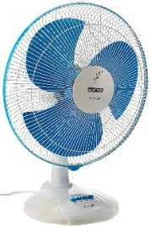
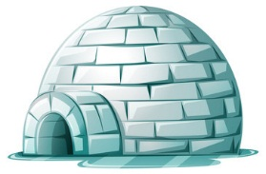
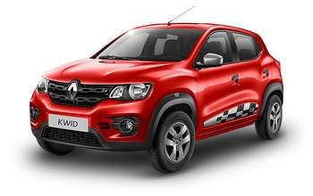
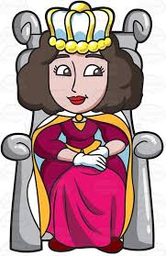
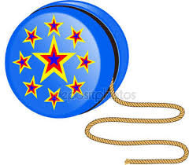
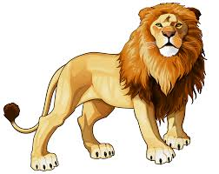
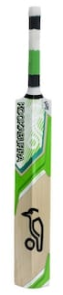
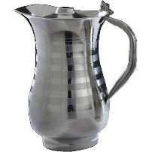
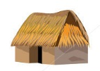
Name of the letter for each picture.
a
f
k
p
u
b
g
l
q
v
c
h
m
r
w
d
i
n
s
x
e
j
o
t
y
z

Slide 10
What’s the letter’s name?
R
I
M
G
Y
A
U
T
L
Q
D
E
P
K
S
H
N
J
C
V
F
O
W
Z
B
X
a
g
z
b
k
m
p
s
w
u
v
c
d
i
h
l
n
o
r
t
e
x
q
j
y
f
Identifying weak students and taking to cure.

Slide 11
One day one word
Read and say.
after
পরে
Spell out the word - SGW

Slide 12
Find out the letters that are made by the word--------.
a
w
f
t
c
d
e
k
r
u
Find out the correct word-------.
agtar
efter
after
aftere

Slide 13
Say the missing letter.
afte--
a--ter
af--er
aft--r
Write the word to your notebook.
Date-
/ /20
after
আফটার
পরে

Slide 14
Home work
Page 9 will be well read and written.

Slide 15

That’s all for today. Goodbye. See you tomorrow.

