Slide 1
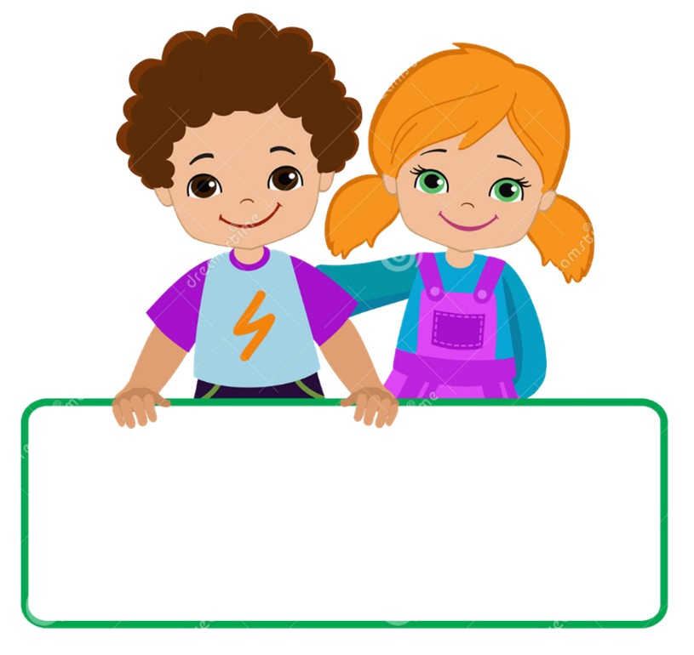

Slide 2
MD. KOWSER ALI
ASISSTANT TEACHER
DURLOVPUR GOVT. PRIMARY SCHOOL
HORINAKUNDU, JHENIDAH.
kowser.gps@gmail.com
Sub: English
Class: Two
Lesson : How old are you?
Parts of the lesson: (Activity-C)
Page No-14

Slide 3
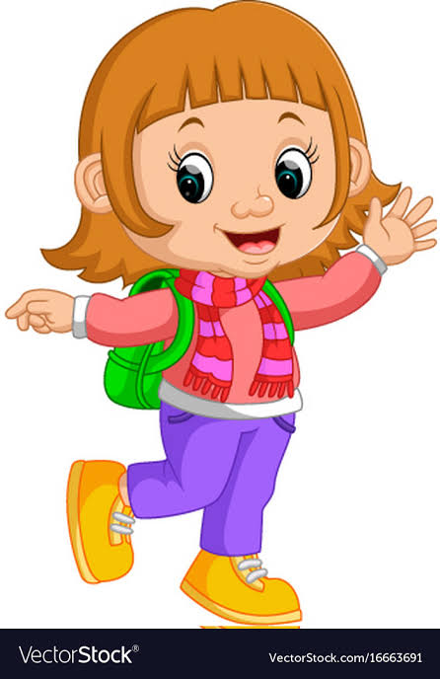
Safety environment by greetings song.
Hello! Hello! How are you?
I’m well, I’m good.
I’m great, I’m wonderful.
Hello! Hello! How are you?
I’m fine! I’m great today.

Slide 4
Checking homework and justify the previous lesson.

Slide 5
Our today’s lesson is too--
How old are you?
Activity-C

Slide 6
LEARNING OUTCOMES
By end of the lesson students will be able to-------
Listening: 3.1.1 understand simple questions and statements
about them.
Speaking: 3.1.1 ask and answer questions about themselves

Slide 7
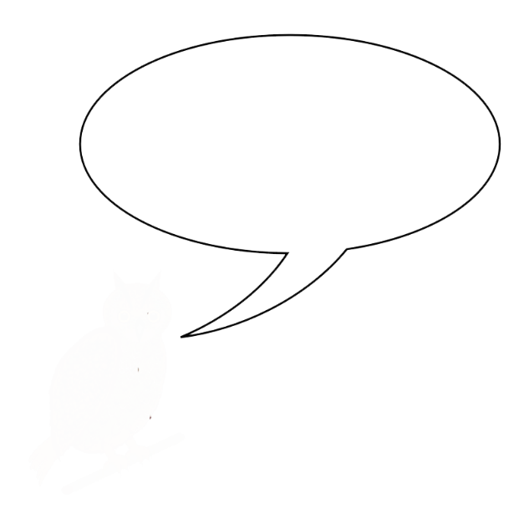
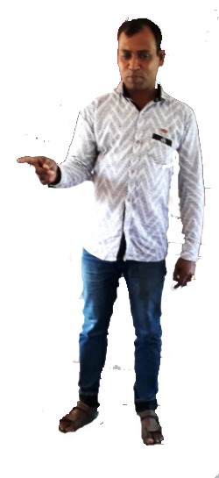
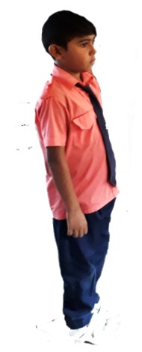
Teacher show up in reality.
‘Hi Ratul. Are you 7 years old?’
‘Yes,I am.
One more
Notes:
Teacher show up in reality

Slide 8
Teacher show up in reality.
I’m 40 years old.
How old are you sir?
One more
Notes:
Teacher show up in reality

Slide 9
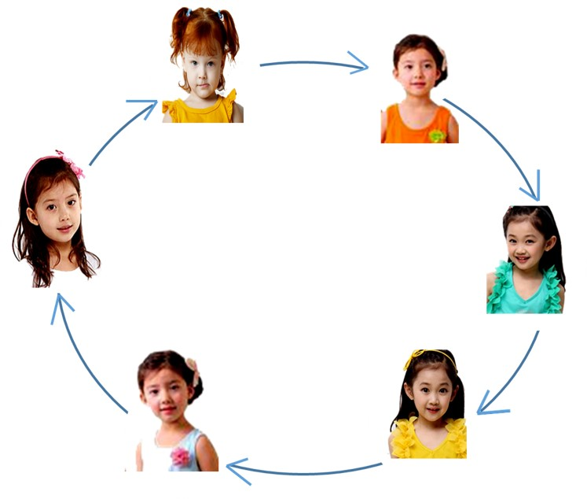
Chain drill.
Hi -------. Are you 7/8 years old?

Slide 10
Read and say.
How old are you?
I’m 7 years old.
Hi, Shuva. Are you 7 years old?
Yes I’m.
Hello Meena. Are you 7 years old?
No, I’m not. I’m 8.
Identifying weak students and taking to cure.

Slide 11
One day one word
Do you understand the picture?
body
শরীর
Spell out the word - SGW

Slide 12
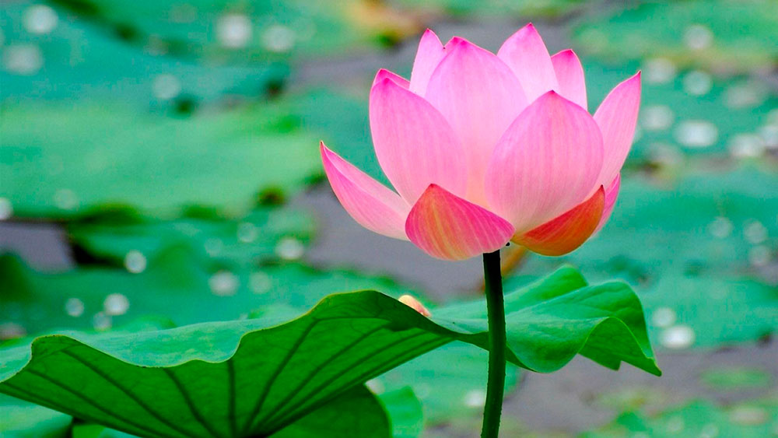
Find out the letters that are made by the word -----.
n
b
w
m
o
x
d
k
y
Find out the right word------.
bady
bedy
body
boody
bode

Slide 13
Say the missing letter.
bo-y
b-dy
-ody
bod-
Write the word to your notebook.
Date-
/ /20
body
বডি
শরীর

Slide 14
Home work
Page 7 will be well read and written.

Slide 15
That’s all for today. Goodbye. See you tomorrow.

