Slide 1
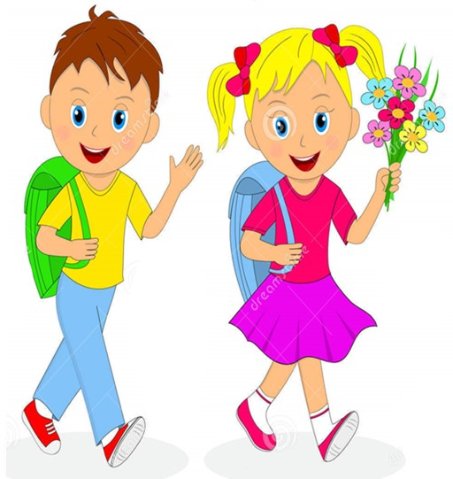


Slide 2
MD. KOWSER ALI
ASISSTANT TEACHER
DURLOVPUR GOVT. PRIMARY SCHOOL
HORINAKUNDU, JHENIDAH.
kowser.gps@gmail.com
Sub: English
Class: Two
Lesson : How old are you?
Parts of the lesson: (Activity-B)
Page No-14

Slide 3
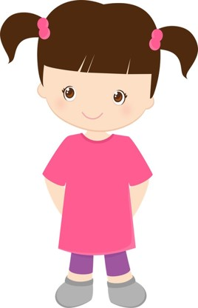
Safety environment by greetings song.
Hello! Hello! How are you?
I’m well, I’m good.
I’m great, I’m wonderful.
Hello! Hello! How are you?
I’m fine! I’m great today.

Slide 4
Checking homework and justify the previous lesson.

Slide 5
Our today’s lesson is too--
How old are you?
Activity-B

Slide 6
LEARNING OUTCOMES
By end of the lesson students will be able to-------
Listening: 3.1.1 understand simple questions and statements
about them.
Speaking: 3.1.1 ask and answer questions about themselves

Slide 7
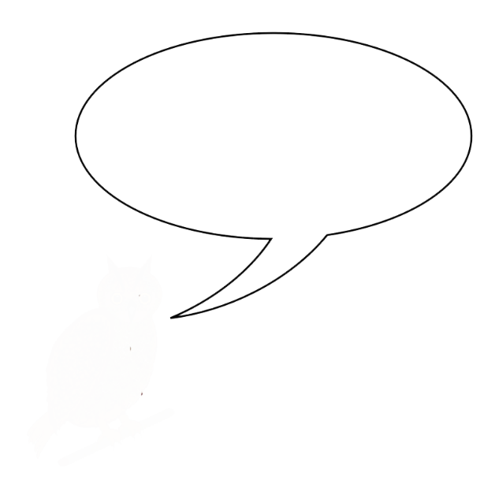
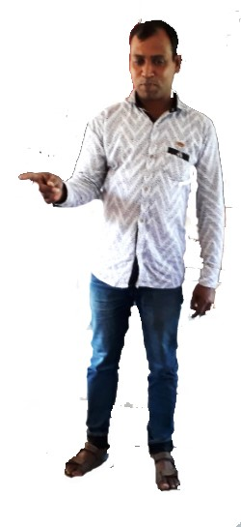
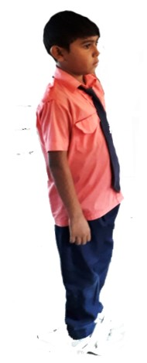
Teacher show up in reality.
‘Hi Sumon. Are you 7 years old?’
‘Yes,I am.
One more
Notes:
Teacher show up in reality

Slide 8
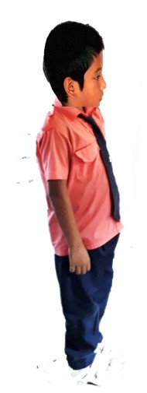
‘Hi Mamun. Are you 7 years old?’
‘No, I’m not. I’m 8
One more
Notes:
Teacher show up in reality

Slide 9
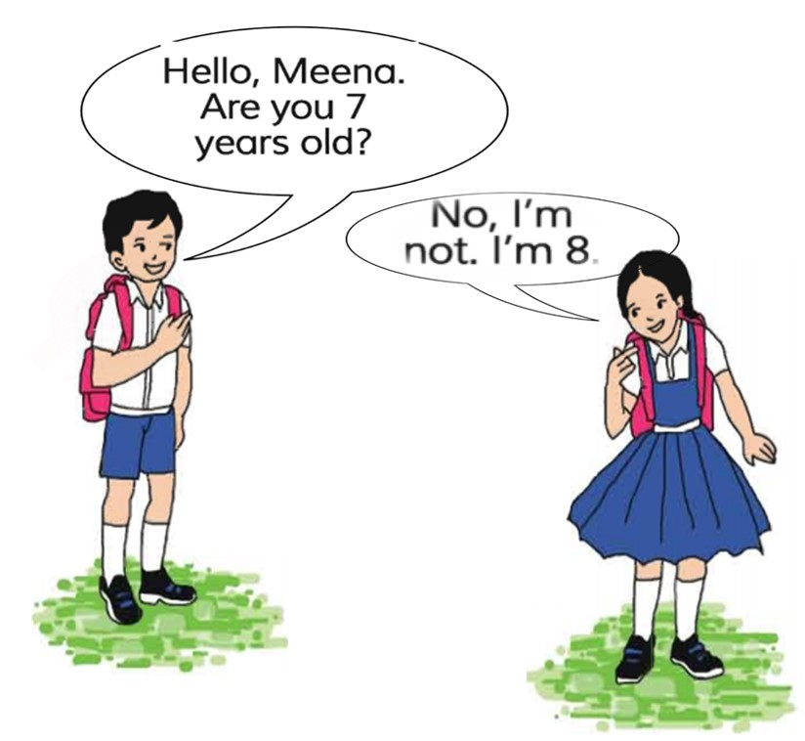
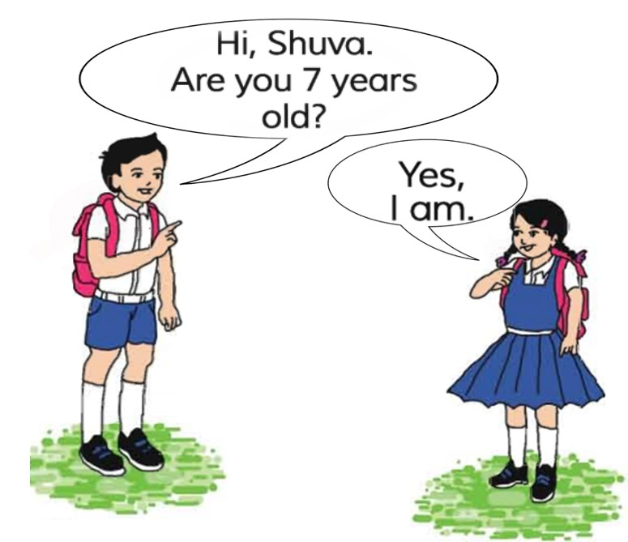
Open your English book at page-14 and see the Activity- B
Look, listen and say.
Now repeat after me.
Reading-SGW

Slide 10
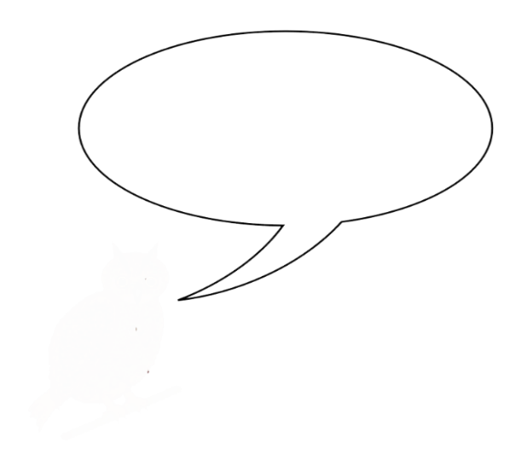
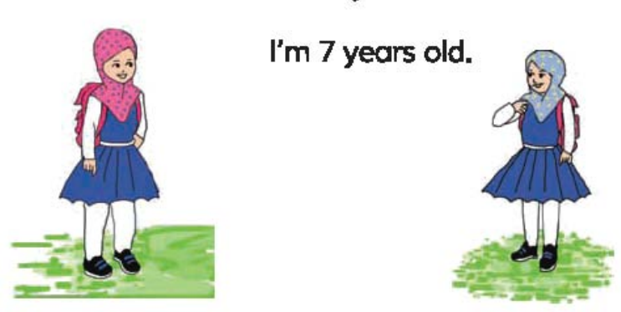
Pair work.
‘Hi Sumi. Are you 7 years old?’
‘Yes. I am.
Notes:
Students show up in reality.

Slide 11
Pair work.
‘No, I’m not. I’m 8
‘Hi Ety. Are you 7 years old?’
Notes:
Students show up in reality.

Slide 12
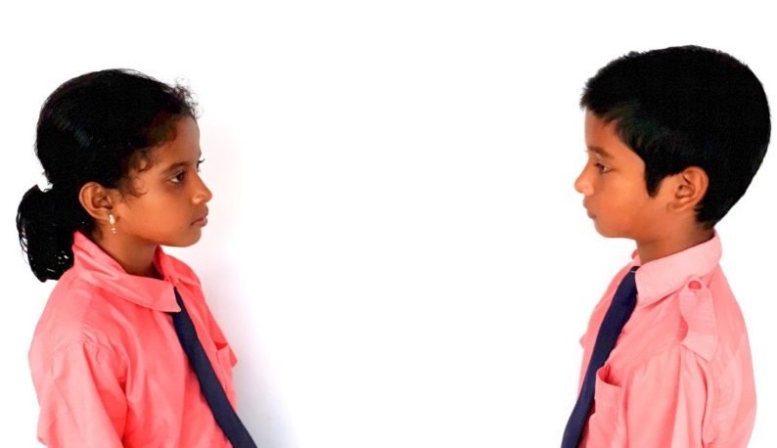
Pair work.
Say about themselves.
One more

Slide 13
Read and say.
Hi, Shuva. Are you 7 years old?
Yes I’m.
Hello Meena. Are you 7 years old?
No, I’m not. I’m 8.
Identifying weak students and taking to cure.

Slide 14
One day one word
Read and say.
no
না
Spell out the word - SGW

Slide 15
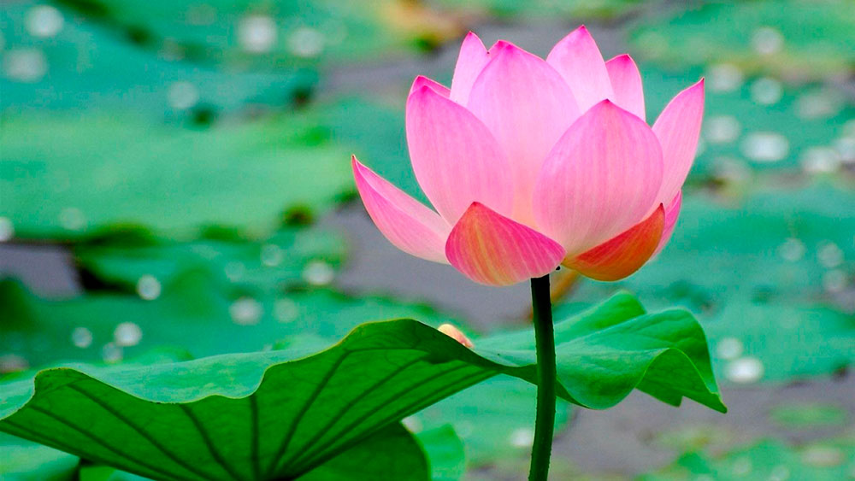
Find out the letters that are made by the word ------.
i
a
r
n
b
o
k
p
Find out the right word ------.
no
na
noo
noe

Slide 16
Say the missing letter.
n-
-o
Write the word to your notebook.
Date-
/ /20
no
নো
না

Slide 17
Home work
Page 6 will be well read and written.

Slide 18

That’s all for today. Goodbye. See you tomorrow.

