Slide 1
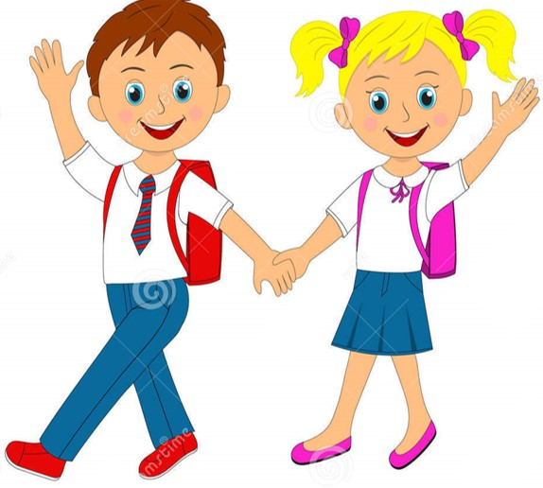

Slide 2
MD. KOWSER ALI
ASISSTANT TEACHER
DURLOVPUR GOVT. PRIMARY SCHOOL
HORINAKUNDU, JHENIDAH.
kowser.gps@gmail.com
Sub: English
Class: Two
Lesson : How old are you?
Parts of the lesson: (Activity-A)
Page No-14

Slide 3
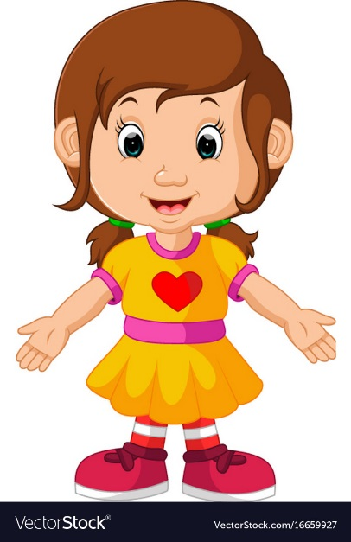
Safety environment by greetings song.
Hello! Hello! How are you?
I’m well, I’m good.
I’m great, I’m wonderful.
Hello! Hello! How are you?
I’m fine! I’m great today.

Slide 4
Checking homework and justify the previous lesson.

Slide 5
Dear students-
What’s your name?
How old are you?
Now try to say-
What can be the topic of our today’s lesson?

Slide 6
Our today’s lesson is--
How old are you?
Activity-A

Slide 7
LEARNING OUTCOMES
By end of the lesson students will be able to-------
Listening: 3.1.1 understand simple questions and statements
about them.
Speaking: 3.1.1 ask and answer questions about themselves

Slide 8
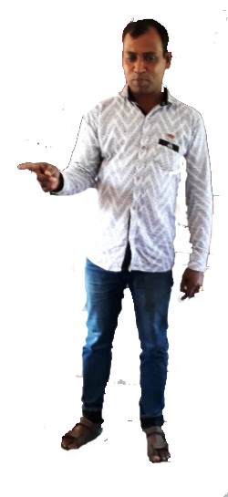
Look, listen and say.
How old are you?
I’m 7 years old.
One more
Notes:
Teacher show up in reality

Slide 9
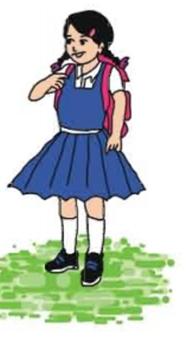
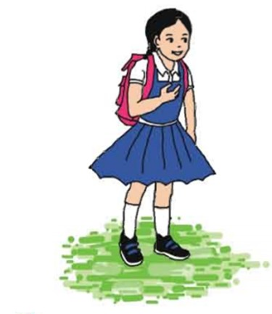
Open your English book at page-14 and see the Activity- A
Look, listen and say.
I’m 7 years old.
How old are you?
Now repeat after me.

Slide 10
Pair work.
How old are you?
I’m 7 years old too.
I’m 7 years old.
How old are you?
One more
Notes:
Students show up in reality.

Slide 11
Read and say.
How old are you?
I’m 7 years old.
Identifying weak students and taking to cure.

Slide 12
One day one word
Read and say.
yes
হ্যা
Spell out the word - SGW

Slide 13
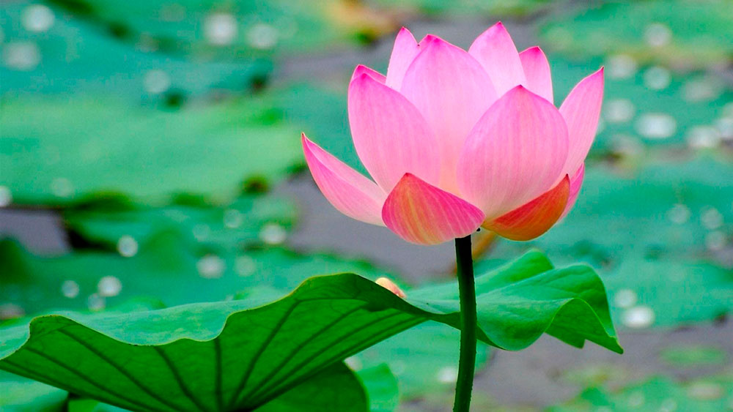
Find out the letters that are made by the word ------.
h
y
r
j
e
t
s
k
u
Find out the right word ------.
yas
yes
yese
yase

Slide 14
Say the missing letter.
-es
ye-
y-s
Write the word to your notebook.
Date-
/ /20
yes
ইয়েস
হ্যা

Slide 15
Home work
Page 5 will be well read and written.

Slide 16
That’s all for today. Goodbye. See you tomorrow.

