Slide 1
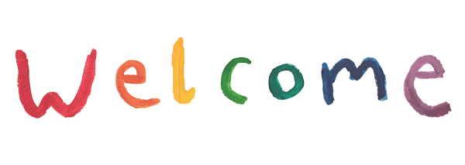

Slide 2
MD. KOWSER ALI
ASISSTANT TEACHER
DURLOVPUR GOVT. PRIMARY SCHOOL
HORINAKUNDU, JHENIDAH.
kowser.gps@gmail.com
Sub: English
Class: Two
Lesson : Alphabet
Parts of the lesson: (Activity-C)
Page No-15

Slide 3
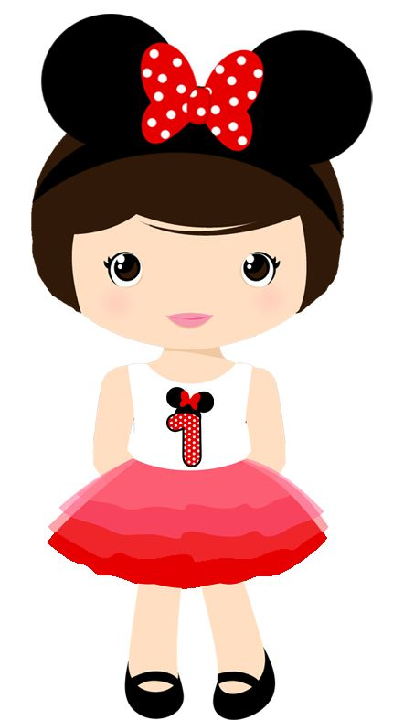
Safety environment by greetings song.
Hello! Hello! How are you?
I’m well, I’m good.
I’m great, I’m wonderful.
Hello! Hello! How are you?
I’m fine! I’m great today.

Slide 4
Checking homework and justify the previous lesson.

Slide 5
Our today’s lesson is too--
Alphabet-Unite-7
Activity-C
This is our revision class.

Slide 6
LEARNING OUTCOMES
By end of the lesson students will be able to-------
Writing: 1.2.1 write non-cursive capital letter.

Slide 7
Look, listen and say.
What is this?
Is it capital or small letter?
a
Who can write capital letter ‘a’ on the board ?
One more practice on the board.

Slide 8
Open your English book at page-15 and see the Activity- C
Exchange your book and check the text of other.

Slide 9
WCW
Now we will practice writing the letters in the air.

Slide 10
One day one word
Read and say.
copy
নকল
Spell out the word - SGW

Slide 11
Find out the letters that are made by the word -----.
n
c
z
m
o
x
p
k
c
y
Find out the correct word------.
capy
cepy
copy
coopy
cope

Slide 12
Say the missing letter.
cop-
co-y
c-py
-opy
Write the word to your notebook.
Date-
/ /20
copy
কপি
নকল

Slide 13
Home work
Page 4 will be well read and written.

Slide 14
That’s all for today. Goodbye. See you tomorrow.

