Slide 2
MD. KOWSER ALI
ASISSTANT TEACHER
DURLOVPUR GOVT. PRIMARY SCHOOL
HORINAKUNDU, JHENIDAH.
kowser.gps@gmail.com
Sub: English
Class: Two
Lesson : Alphabet
Parts of the lesson: (Activity-B)
Page No-15

Slide 3
Safety environment by greetings song.
Hello! Hello! How are you?
I’m well, I’m good.
I’m great, I’m wonderful.
Hello! Hello! How are you?
I’m fine! I’m great today.

Slide 4
Checking homework and justify the previous lesson.

Slide 5
Our today’s lesson is too--
Alphabet-Unite-7
Activity-B
This is our revision class.

Slide 6
LEARNING OUTCOMES
By end of the lesson students will be able to-------
Speaking: 1.1.2 say simple words and phrases with proper sounds and stress.

Slide 7
Look, listen and say.
What is this?
ant
What is the first sound of the word?
What is the last sound of the word?

Slide 8
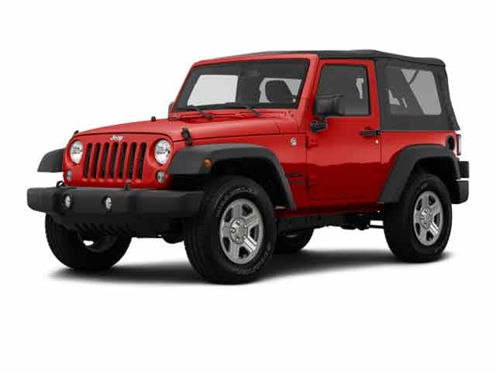
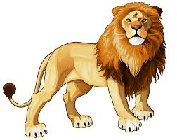
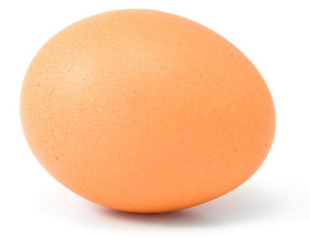
Say name of the pictures you saw the previous class.
Say the thing beginning with b.
bat
What’s the first sound of the word?
What’s the last sound of the word?

Slide 9
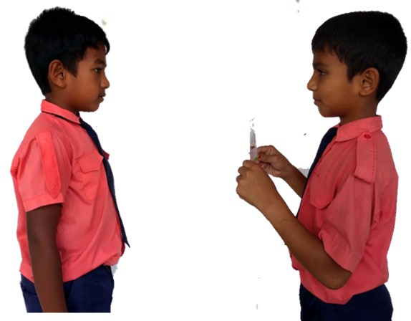
jeep
Pair work.
What is the first/last sound of the word?
One more

Slide 10
Read and say the first and last sound of the word.
bat
net
jeep
fan
lion
egg
kite
sun
doll
hut
bat
net
jeep
fan
lion
egg
kite
sun
doll
hut
Identifying weak students and taking to cure.

Slide 11
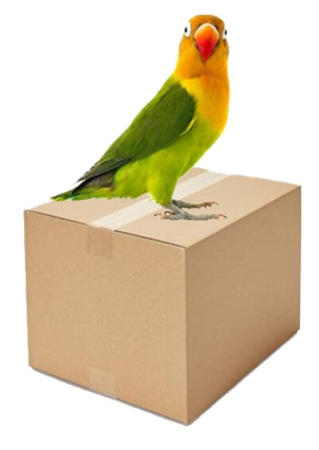
One day one word
Where is the bird?
above
উপরে
Spell out the word - SGW

Slide 12
Find out the letters that are made by the word--------.
a
w
b
o
a
z
v
k
e
d
Find out the correct word-------.
avobe
aovbe
abvoe
above

Slide 13
Say the missing letter.
abov-
a-ove
ab-ve
abo-e
Write the word to your notebook.
Date-
/ /20
above
এ্যাবোভ
উপরে

Slide 14
Home work
Page 3 will be well read and written.

Slide 15
That’s all for today. Goodbye. See you tomorrow.

