Slide 1
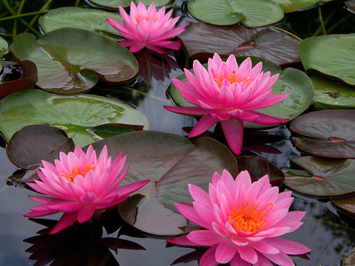
WELCOME TO ENGLISH CLASS

Slide 2
Identity 0f Teacher &Class
Farhana Akter
Assistant Teacher (ICT)
Jaria I.S.D madrasah
Fakirhat, Bagerhat
Class-six
Subject-English 1st Paper
Lesson-33
Time-30 Minute.

Slide 3
“Too much or Too little water”

Slide 4
Learning outcomes
Students will be able to …
1. tell the importance of water
2. Tell the disadvantages of much or little water
3. write a paragraph.

Slide 5
Let’s see some pictures

Slide 7
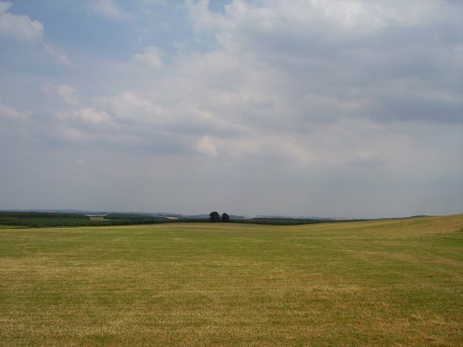
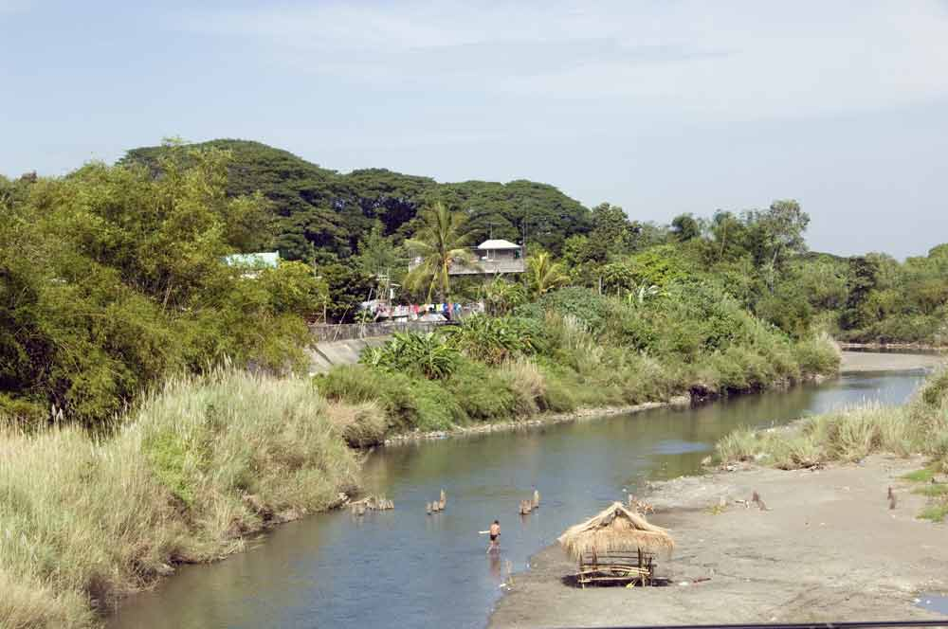
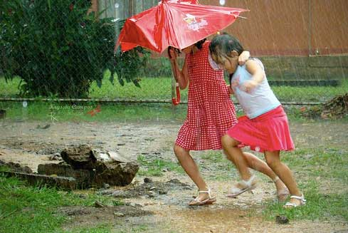
vocabulary
Large
Vast
Bank
Two sides of river
Monsoon
Rainy season

Slide 8
Group work
Group-1
What problems do the people face in much water?

Slide 9
Group -2
* What problems do the people face if there is little water?

Slide 10
Evaluation
Ask and answer-
What is water?
Why do we drink water?
What are the problems of much water?

Slide 11
Home work
Write at least three reasons how does water become polluted.

Slide 12
THANKS TO ALL

