Slide 1
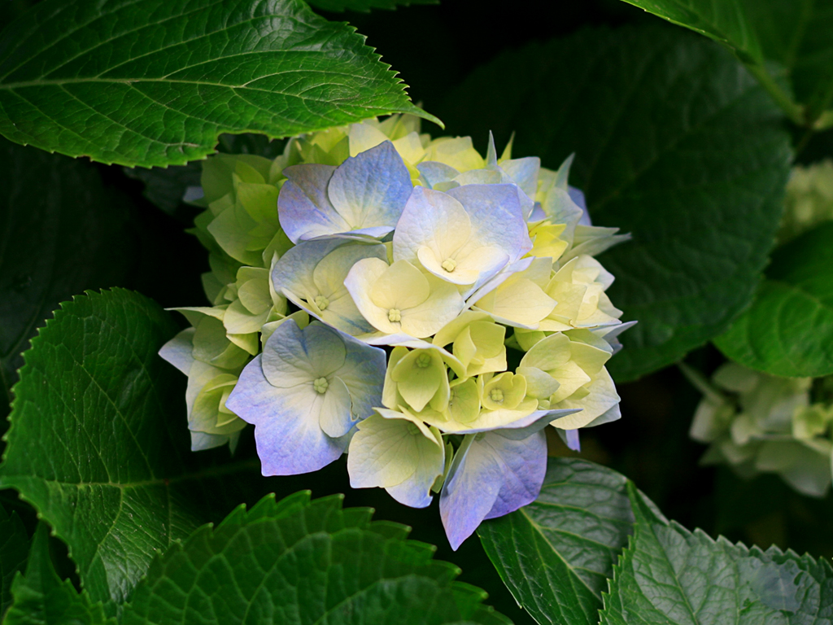
WELCOME

Slide 2
IDENTITY
Samiul Islam
Assistant Teacher
Halimunnessa Girls’ High School, Mymensingh.
ENGLISH FOR TODAY
CLASS : SIX
UNIT ---- LESSON – 16

Slide 3
Look at the picture, talk with your partner, who are they and what are they doing?
They are retired women and gossiping among themselves.

Slide 4
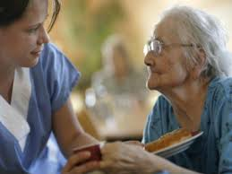
LESSON DECLARATION
So today we`ll discuss about
An old people’s home

Slide 5
Lesson outcomes
By the end of this lesson, students will be able to
read and understand texts through silent reading.
infer meaning from context
Listen for information.
ask and answer questions
Write answers to questions.

Slide 6
Individual work
Close your book and lesson to me carefully. Now write the following sentences (if they are true or false. If false, then give the right answers).
1. Suraiya Begum spends most her time taking care of her family.
2. She wants to set up a school for adults who cannot read or write.
3. There is already an old people’s home in the town.
4. Mariam enjoys spending time with her aunt.
5. The old people Mariam visits do not like children’s presence.
Notes:
Teacher can monitor the class and help the learners if they fail or do wrong.

Slide 7
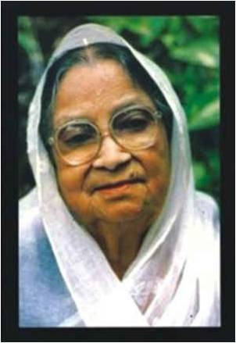
Vocabulary
Try to make sentence with the following words.
A woman whose husband has died and doesn`t married again.
Widow -
Suraiya Begum is a widow.
Notes:
First, the word will be shown, SS will be asked to pronounce the word. If it needed teacher will help. Then the picture will be shown and asked to guess the meaning. After that the meaning will be shown. Then they will be asked to make sentence. Teacher will show the students for the feedback. Slide 7, 8 and 9

Slide 8
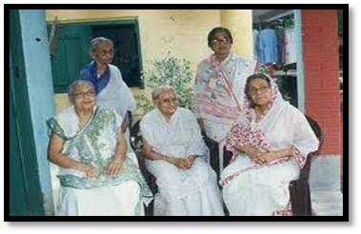
Vocabulary
Colleagues
Coworkers
They are Suriya begum’s colleagues .

Slide 9
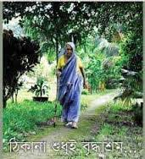
Vocabulary
Try to say the word meaning and make sentence.
Alone -
- isolated
The widow walking alone by the country side.

Slide 10
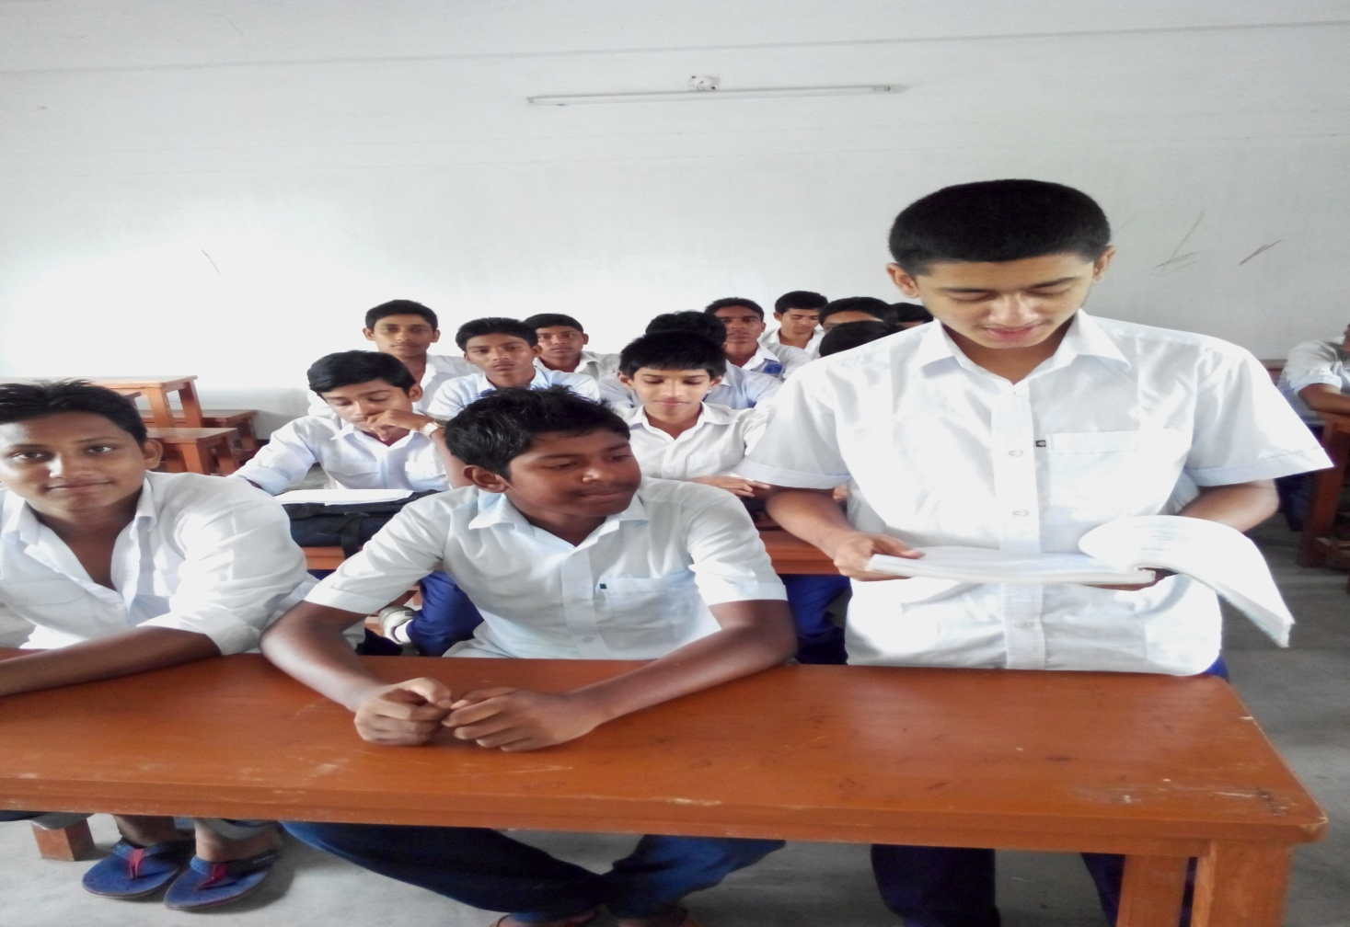
Loud reading

Slide 11
Section - A
Read the text carefully then match the words on the left with the words on the right that have similar meanings.
Bored | Woman whose husband has died and who hasn’t married again.
miserable | A person one works with in a profession.
colleague | Feeling tired because you don’t find interest in something.
widow | help
support | Very unhappy.

Slide 12
Section - B
Read the following letter then answer the following questions.
Who is the writer of this letter?
Who is she writing to? What is the relationship between the two?
Does the writer have any particular reason for writing this letter?

Slide 13
Section – B2
HOME WORK
Think and write about some good work such as teach, clean and help.

