Slide 1
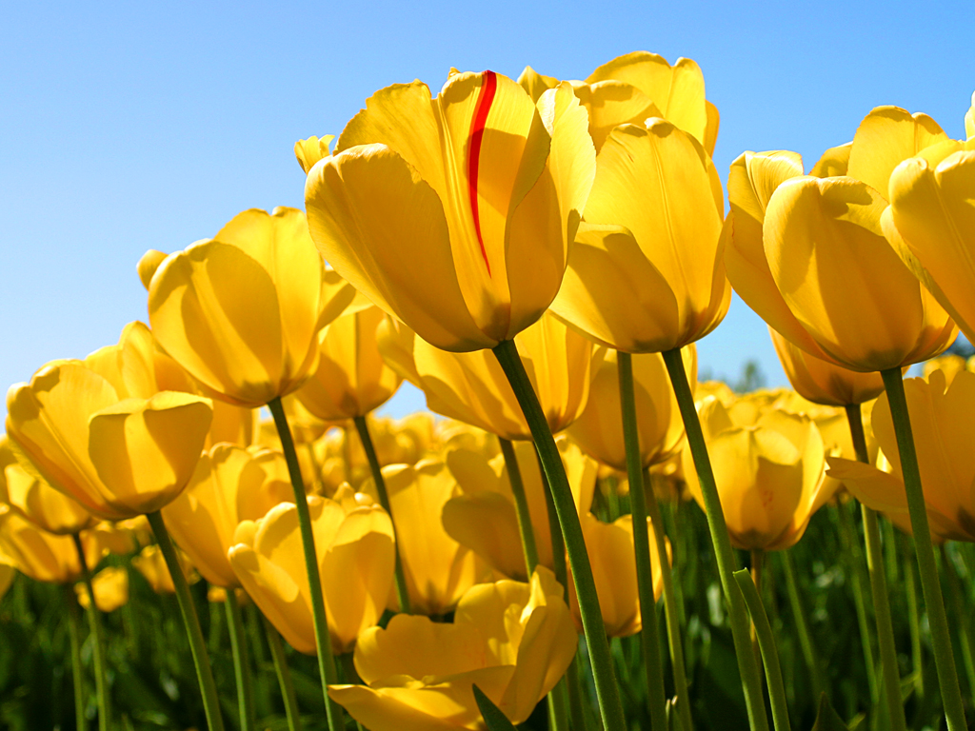
WELCOME

Slide 2
IDENTITY
Samiul Islam
Assist: Teacher
Halimunnessa Girls’ High School, Mymensingh.
Lesson
ENGLISH FOR TODAY
CLASS : SIX
UNIT ---- 10

Slide 3
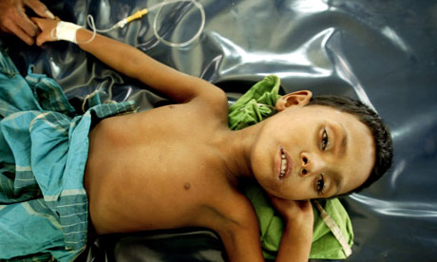
Look at the pictures
S: Yes, recently I have had a bad cold.
T: What did you do when you have had a cold ?
S: I went to a doctor for my remedies.
T: Have you had any health problems recently ?

Slide 4
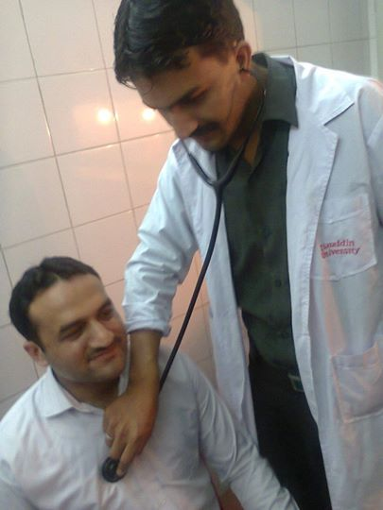
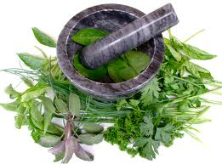
LESSON DECLARATION
So today we`ll discuss about
Remedies: modern and traditional.

Slide 5
Lesson outcomes
By the end of the lesson, students will be able to----
read and understand texts through silent reading.
infer meaning from context
Listen for information.
ask and answer questions
Write answers to questions.

Slide 6
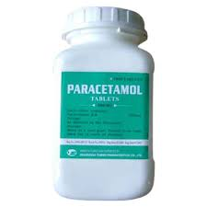
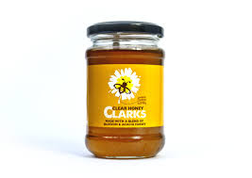
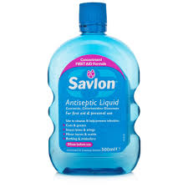
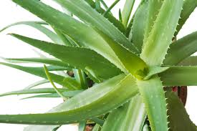
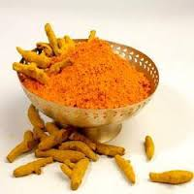
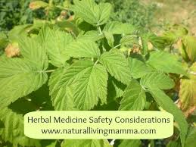
Look at the following pictures. Discuss with your partner what they are. Match them with their names given in the box.
Paracetamol,
Holy basil/Tulsi,
Antacid,
Honey,
Neem,
Savlon,
Turmeric,
Alovera.

Slide 7
Section - A
Read the text carefully then put the items in section A under the heading Natural cures or Chemicals. One example is shown
Natural cures | Chemicals
Honey | Savlon
Neem
Turmeric
Aloevera
Holy basil / tulsi
Paracetamol
Antacid
Burnol ointment

Slide 8
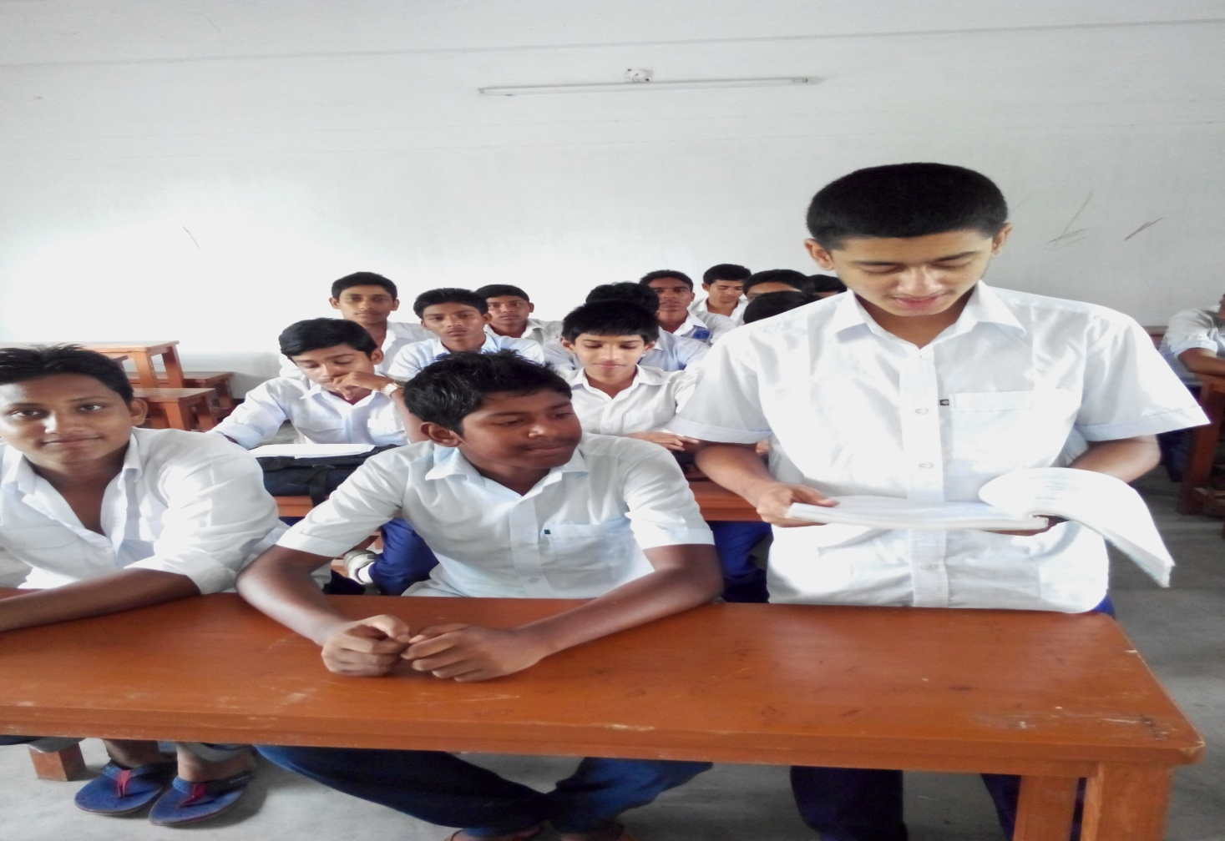
Loud reading

Slide 9
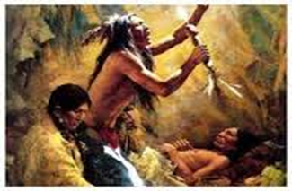
Vocabulary
Try to say the meaning of the following words and make sentence.
ancient
old
They are ancient people and used herbal medicines.

Slide 10
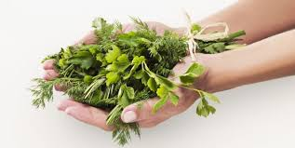
Vocabulary
Try to say the word meaning and make sentence.
Herb
Natural Medicine
Harbel remedies are not new system.

Slide 11
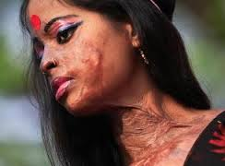
Vocabulary
Try to say the word meaning and make sentence.
Injury
Burn
For burn herbal medicines are aleovera or honey.

Slide 12
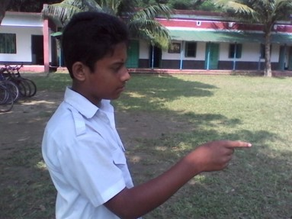
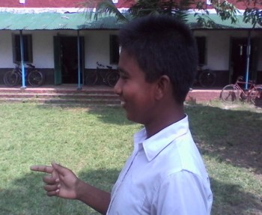
Pair works
Read the text again then ask and answer
the following questions :-
1. What are natural cures made of ?
Are herbal cures modern inventions ?
Which civilizations used herbal treatments ?

Slide 13
Group works
Work in groups. Complete the following expressions with words from the box.
bottle, box, can,
package, tube
tube
a ……………………. of ointment
a ……………………. of aspirin
a …………………… of bandage
a ……………………. of foot spray
5. a ……………………. of tissue
box,
package,
bottle/can
package,
Now write down some sentences using these phrases:

Slide 14
HOME WORK
Do you know any other remedies that people use in our country ? Write about one of two of such remedies.

