Slide 1
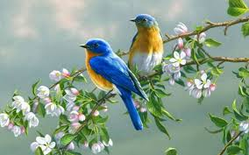
welcome

Slide 2
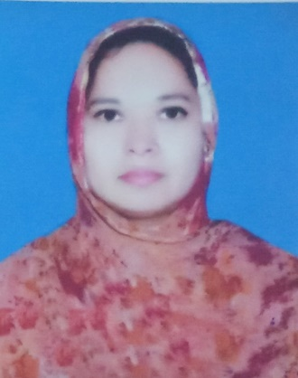
introduction
Class: seven
Sub: English 1st Paper
Time: 50 minutes
Musa. Rahima Akther
Asst. Teacher
Khulna Engineering University School

Slide 3
1. Whom can you see in the picture?
A woman
2. What is she?/ What is her profession?
A teacher

Slide 4
Today’s lesson is --- “A teacher (2)
Unit: 4
Lesson: 02
Page: 26
Time: 50 minutes

Slide 5
Learning outcomes
At end the lesson, students will be able to –
Talk about picture;
Read and understand texts;
Match words with their meanings;
complete the passage with words;
ask and answer questions;

Slide 6
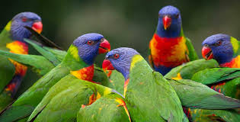
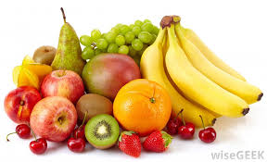
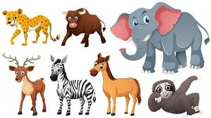
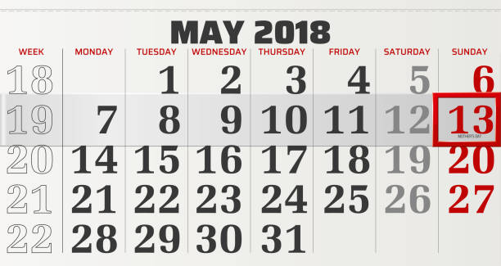
Key words
several
Several birds
Several fruits
Several animals
Several days

Slide 7
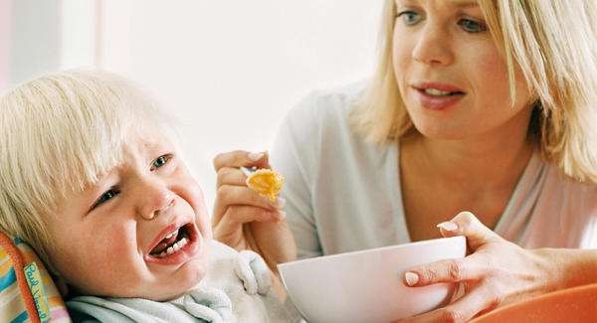
Key word
insist
Give presser to do something
A mother is insisting her baby to eat.

Slide 8
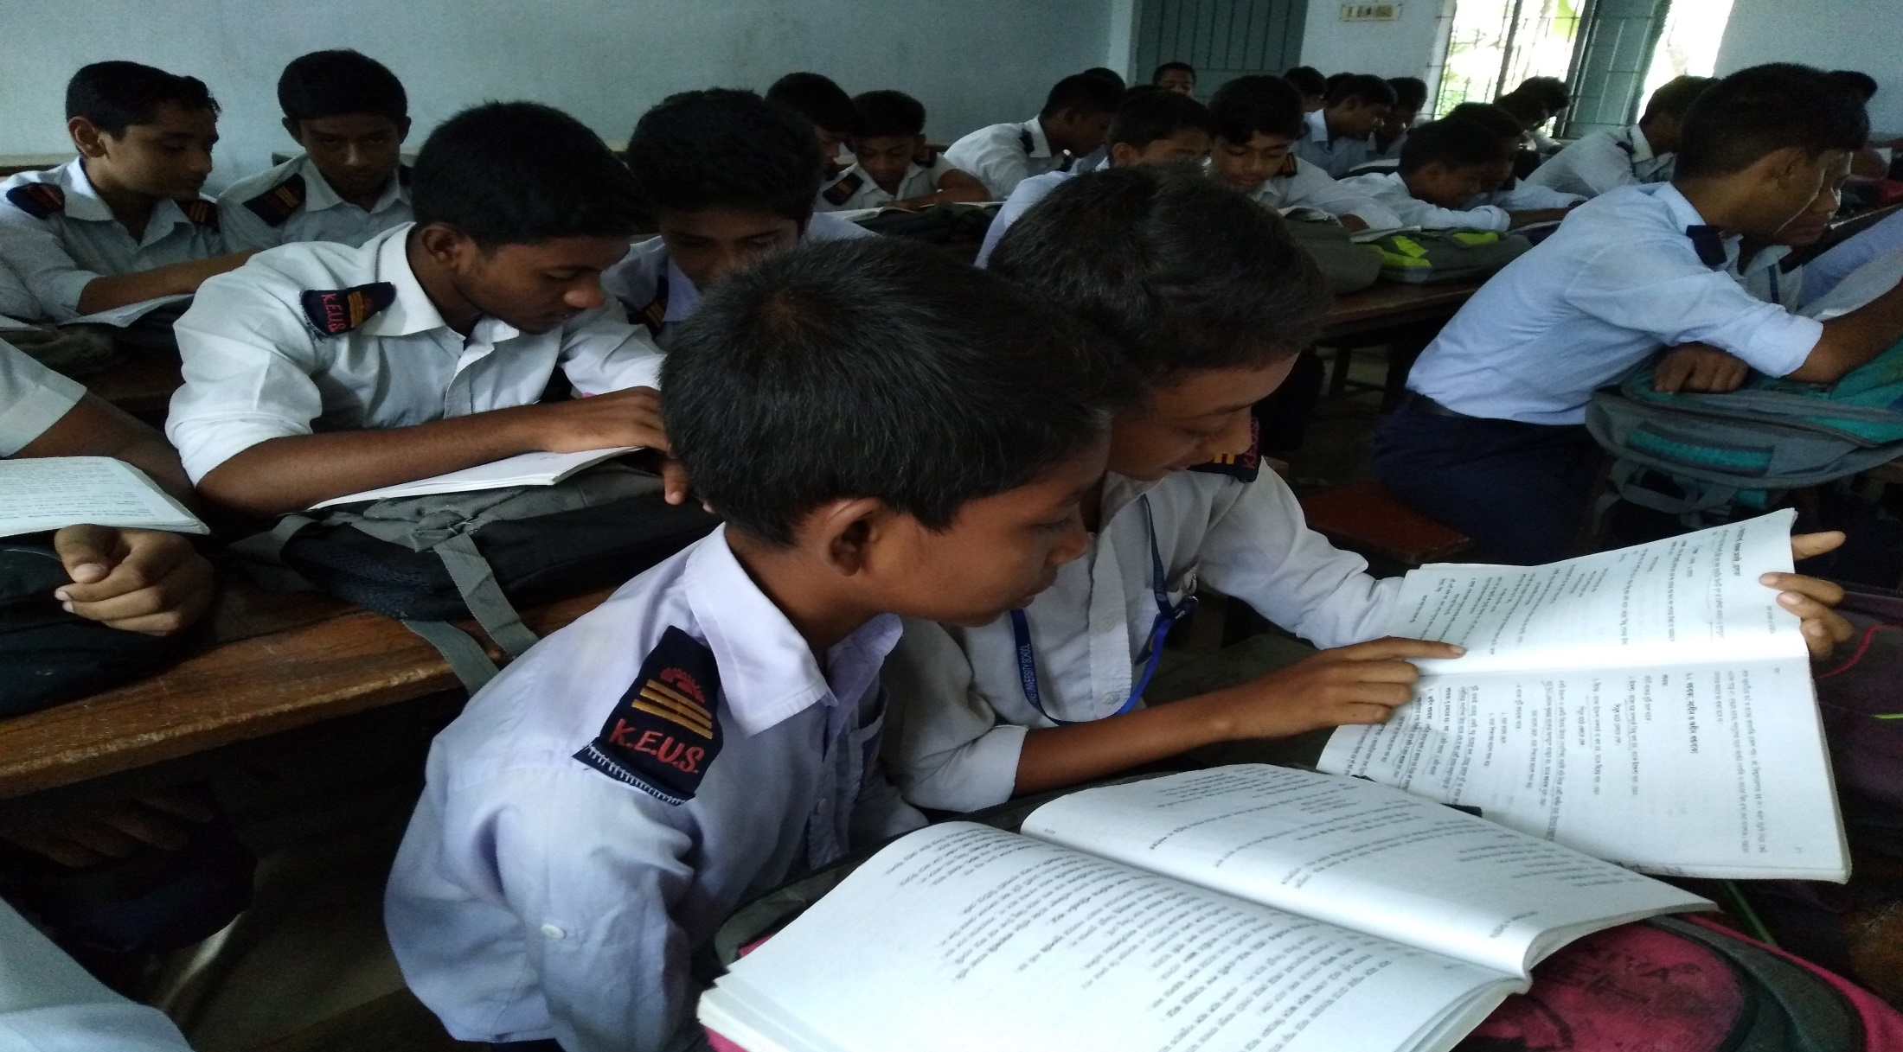
Read the text silently

Slide 9

Match the words with their meanings.
Words | Meanings
company | a long narrow passage in a building
vacant | relatives by marriage especially husband’s or wife’s family members
status | status to show something by doing
in-laws | connected with study, education
corridor | to encourage somebody to do something well
academic | high rank or social position
admire | business
demonstrate | empty (eg a seat not taken by anybody)
inspire | to show respect

Slide 10
Answer of matching
Words | Meanings
company | business
vacant | empty (eg a seat not taken by anybody)
status | high rank or social position
in-laws | relatives by marriage especially husband’s or wife’s family members
corridor | a long narrow passage in a building
academic | connected with study, education
admire | to show respect
demonstrate | to show something by doing
inspire | to encourage somebody to do something well

Slide 11
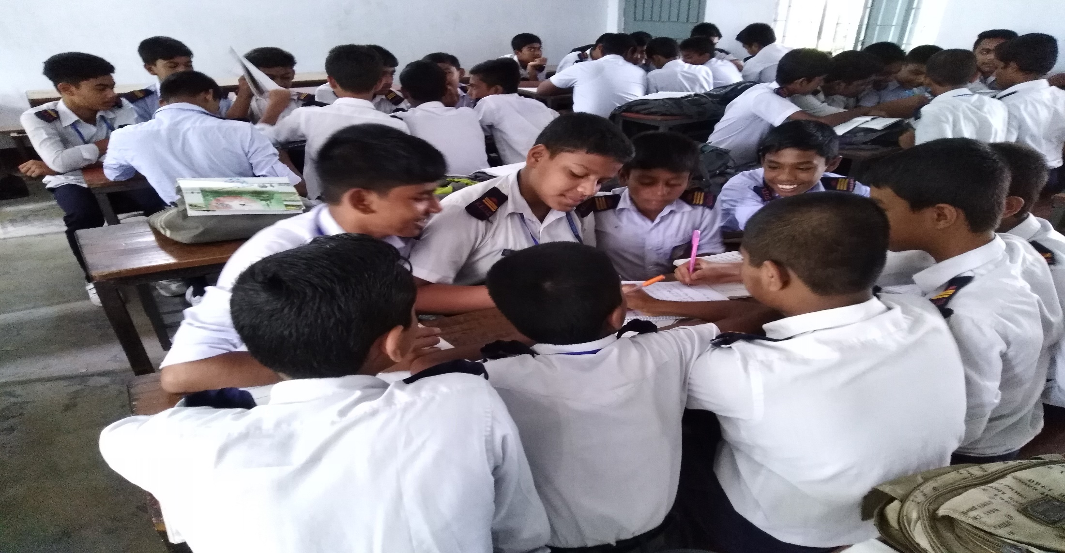
In groups discuss and write what students, teachers and community people do to Shahana. (12 minutes)

Slide 12
Make a list of things that Shahana does as a teacher.
Shahana helps with the household work.

Slide 13

Everyday she works hard to prepare her lessons.

Slide 14
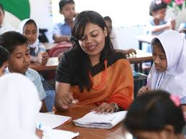
Everyday she goes to school, teaches her students
and helps both weak and bright students.

Slide 15
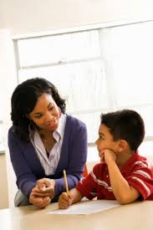
They often come to her in the teachers’ room, in the corridor and even on the road, and talk to her about any academic or personal problems.

Slide 16
Complete the passage with words from the box.(10 m)
The pilot she an in observation crashes whether young the girl
young
The
A father is talking to his daughter about her aim in life. ______ girl wants to be a pilot. ________ father asks her why. The young _______ replies that the job of a _________ is challenging that she likes. Besides ______ likes the speed and high responsibilities ______ a pilot’s life. The father asks ______ __she is not afraid of plane _________. The daughter says, “An accident is _______ accident”. The father appreciates his daughter’s _______________ and wishes her good luck.
The
girl
pilot
she
in
whether
crashes
an
observation

Slide 17
F. Read the completed passage in E. Ask and answer the following questions in pairs.
Q: What do you want to be?
A: I want to be a _____doctor__________ .
Q: Why do you want to be a ___doctor____________?
A: Because I like it / my parents want me to be _a doctor______________.

Slide 18
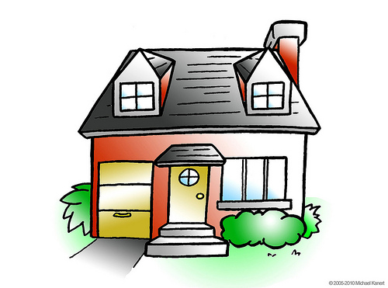
Home work
Write the summary of the lesson.

