Slide 1
Good Morning

Slide 2


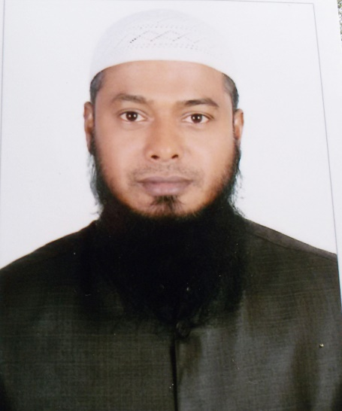
Identity
MD.TAIBUR RAHMAN
Assistant Teacher
01718640068
Class eight
English Second Paper
Part Grammar
Duration: 50 minutes

Slide 3
Look at the seen
The sun is rising up

Slide 4

Now see another sceen
The man is running………

Slide 5
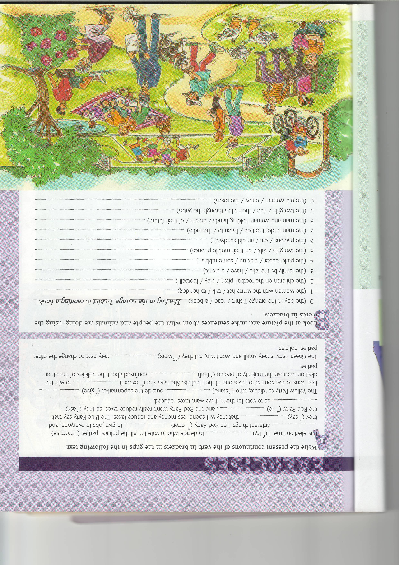

Slide 6

See again
The horse is flying……..

Slide 7
What does happen ?
In all the scenes work is going on
Rising, Running,Playing,Working,Singging ,Walking,Eating,Riding,Feeding,Reading etc.

Slide 8
Today’s Lesson
Present Continuous Tense

Slide 9
Learning Outcomes
By the end of the lesson the learners will have
Identified past continuous tense
Used ‘Subject +to be verb + base form of verb with ing +others’ in sentences
Used the above mentioned structure in questions and answers

Slide 10
Structure
Subject + am/is/are + verb + ing + complement.

Slide 11

Group work
Seeing the picture ,
make an appropriate sentence on present continuous tense.

Slide 12

Match your answer
A boy is reading a book .

Slide 13
Evaluation
What is continuous tense ?
What is present continuous tense ?
What is the structure of present continuous tense?

Slide 14
Pair work
Using these clues make 3 meaning full sentence:-
a) wait, me , Hasan, be , for
b) be, develop, Bangladesh, day by day

Slide 15
Home task
Will make sentence using the following words :-
Play, the , boys, field, in , be, the, football

Slide 16

THANKS TO ALL

