Slide 1
To my Presentation

Slide 2
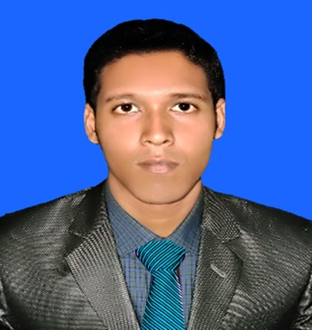
IDENTITY
Teacher
Lesson
MD:Moshfiqur rahman
Assistant Teacher
Agriculture
Ranachandi High School and College
Kishoreganj, Nilphamari.
English For Today
Class : Six

Slide 3
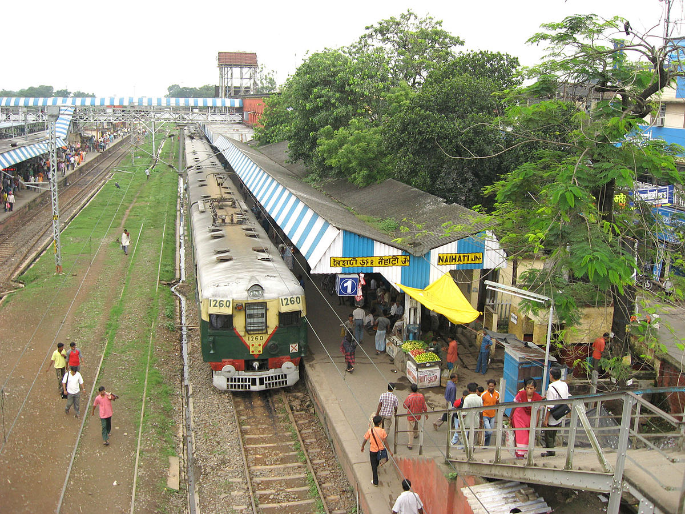
Look at the picture, What is this?
This is a Railway Station.

Slide 4
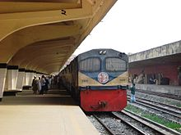
Today’s Lesson is--
At a Railway Station

Slide 5
Learning Outcomes
After completing this lesson students will be able to ..
1
Talk about people, places and familiar objects in short and simple sentences
2
Read and understand texts

Slide 6
Let`s enjoy the video clips
1. Click here
This is a Railway station in Bangladesh

Slide 7
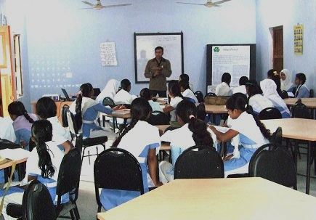
Follow the section A and listen the passage attentively then go to section A1 and solve the task.
Notes:
After completing the reading teacher will give the task slide no 9.

Slide 8
A2
(Match the words from Column A with Column B that has opposite meaning)
Column – A | Column - B
See off | Light
Long | Busy
Quiet | Receive
Heavy | Drop
Pick up | short
Notes:
Teacher will throw the slide for the ss. At first ss will try to solve then teacher can give the feedback by arrow. If it is possible teacher can go to the section A1 for more exercise using blackboard.

Slide 9
Look at the picture, What things you see and what are happing?
This is a train station and the Train stand there.
Notes:
At first teacher will show the picture and try to get answer form students then he can give feedback.

Slide 10
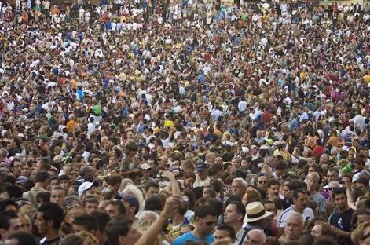
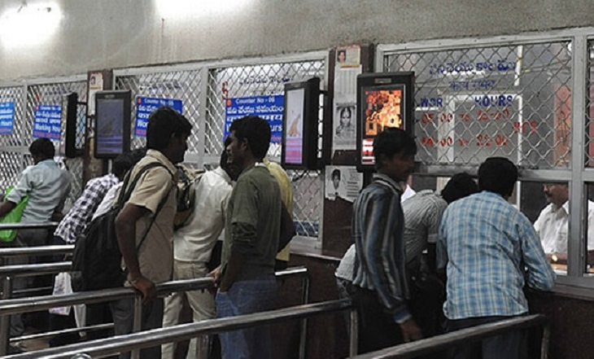
Try to make sentence with the following words:
Crowded
It was very crowded in the field.
Ticket Counter
There is a long line of people at the ticket counter.
Notes:
First, the word will be shown, SS will be asked to pronounce the word. If it needed teacher will help. Then the picture will be shown and asked to guess the meaning. After that the meaning will be shown. Then they will be asked to make sentence. Teacher will show the students for the feedback.

Slide 11
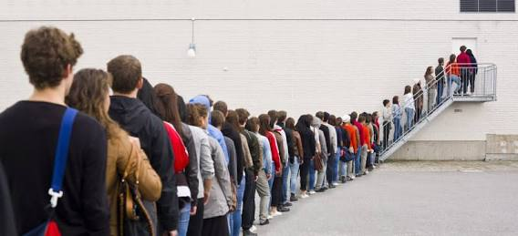
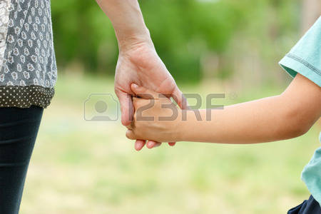
Queue
Everyone stands in the queue.
Tightly
Mother is holding her child tightly.
Notes:
First, the word will be shown, SS will be asked to pronounce the word. If it needed teacher will help. Then the picture will be shown and asked to guess the meaning. After that the meaning will be shown. Then they will be asked to make sentence. Teacher will show the students for the feedback.

Slide 12
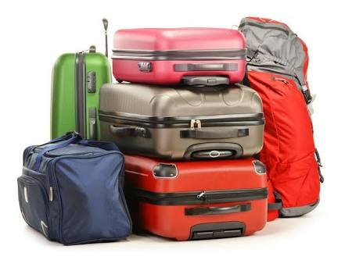
Loudly
The man screams loudly.
Suitcases
A suitcase is a box or bag with a handle and a hard frame.

Slide 13
Magazine
We should read Magazine regularly.
Whistled
Every Policeman has a Whistled.

Slide 14
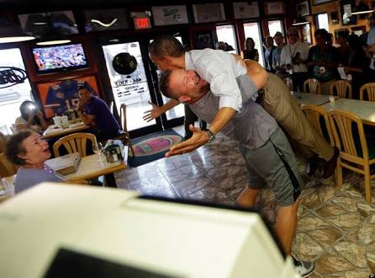
Picked Up
He picked up the man.

Slide 15
Pair works
Read the text again and make a conversation between you and your classmates about ‘Railway Station’.
Notes:
Teacher can ask pair by pair in front of class for evaluation.

Slide 16
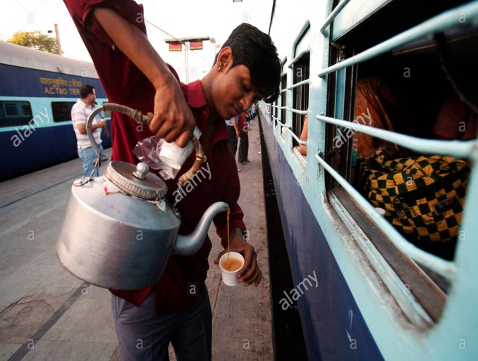
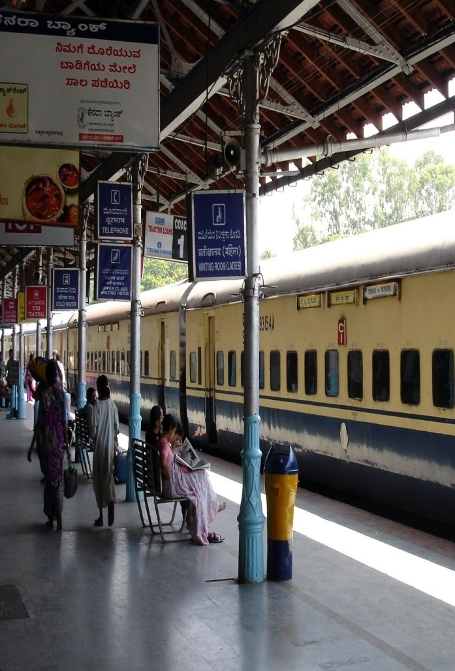
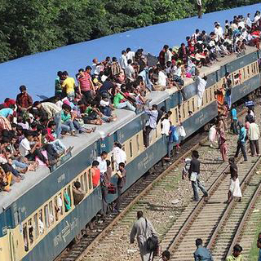
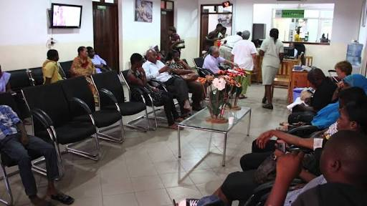
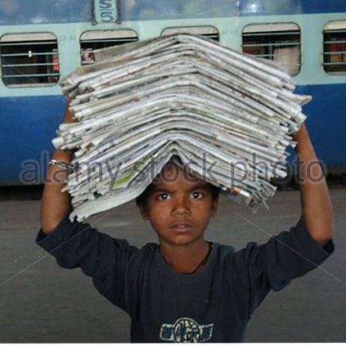
Individual/Pair work
Look at the above pictures and write a few sentences about The Railway Station.
Notes:
Teacher can shortly discusses about the pictures. Teachers also can take orally.

Slide 17
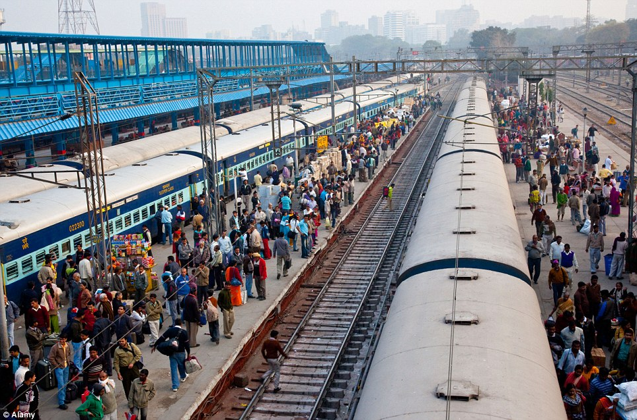
Write a short notes about “The Railway Station” using your own words.
Notes:
Teacher can give some instructions about the home work.

Slide 18
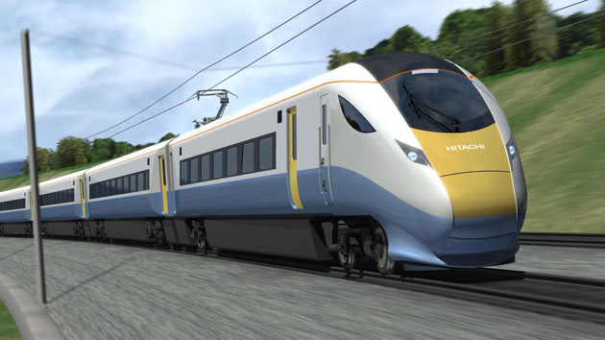
Notes:
Teacher can use any other language.

