Slide 1


WELCOME

Slide 2


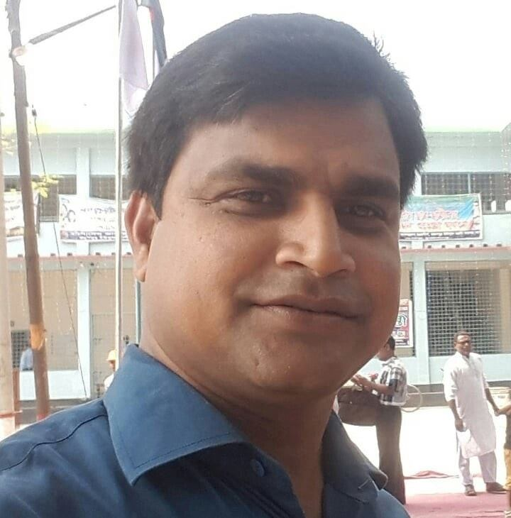
Introduction of teacher:
Md Soriful Islam
Assistant Teacher
Chowrapara Fazil Madrasha,
Niamatpur, Naogaon

Slide 3

Introduction of lesson:
Class: Ten
Subject:English Ist Paper
Unit: Three
Lesson:Five
Time:50minus
Date:27/10/2019

Slide 4
Let’s enjoy the video clip

Slide 5


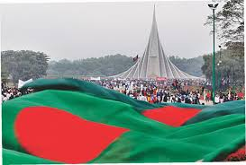
Today our topic’s name:
Independence Day

Slide 6
Learning outcomes
After we have studied this unit,we will be able to---
Talk about events and festivals.
Ask and answer questions and given options in a logical sequence.
Infer meanings from context.

Slide 7
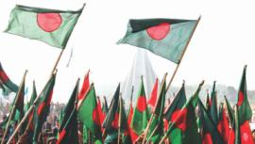
Vocabulary:
Procession
Raise voice on a street with an issue

Slide 8
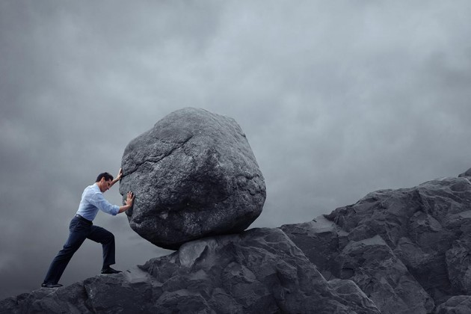
struggle
Try hard to win

Slide 9
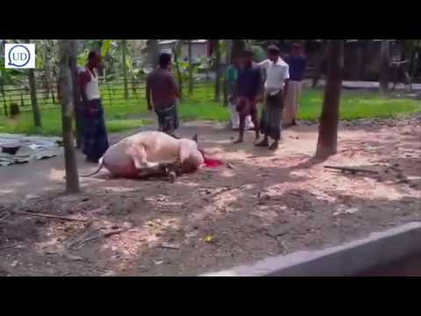
Sacrifice
Giving up favourite things.

Slide 10
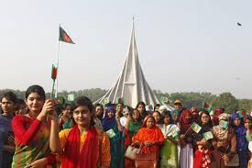
Look at the picture:

Slide 11
Individually work:
Ask and answer the Qquestions
1.Which day is independence Day?
2.Why do we observe the Day?
3.Which organisations arrange cultural functions?

Slide 12
Solution:
1.Independence Day is 26 March.
2.We observe the Day begins at national Memorial give the fiower.
3.Diplomats,political parties,social and cultural organigations,educational institutions also organize their individual programmes.

Slide 13
Look at the picture:

Slide 14
Pair work:
1.What can you see in the picture?
2.Where is it?
3.Why was it built?

Slide 15
Solution:
1.The picture is the National Mausoleum?
2.The National Mausoleum is at Saver?
3.It is built Because respect to Freedom Fighters.

Slide 16
Look at the picture:

Slide 17

Group work:
I.How do you observed the day at first?
2.What happened the day?

Slide 18
Solution:
1.We observed the day at first with the students and teachers give the flower at the National Mausoleum to Freedom Fighters.
2.The day begins with 31 gunshots.Early in the morning the president and the Prim Minister on behalf of the nation places floral wreaths at the National Mausoleum at Saver.In Bangabandhu stadium, school children,scouts and girl guides take part in various displays to entertain thousands of spectators.

Slide 19

Evaluation:
1.Our biggest festival is-------------
a.Victory day Day b.Independence Day c.Shaheed Dibosh
2.The celebreation of Independence Day begins with----------
a.Gunshots b.Processions c.placing wreaths at the national Memorial.
3.On Independence Day a National Parade is held-------------
a.At the National Parade Ground. B.At the Mirpur Stadium
c.In Bangabandhu Stadium.

Slide 20

Home work
1.Write a paragraph on Independence Day about 1o sentences.

Slide 21

THANKS To ALL

