Slide 1
WELCOME

Slide 2
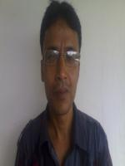
Teacher’s Identity
Debabroto Chakrobortty
Asst. Teacher
Fulhari High School
Shailkupa, Jhenaidah.
Bangladesh.

Slide 3
Class
Nine &Ten
Subject: English 1st Paper

Slide 4
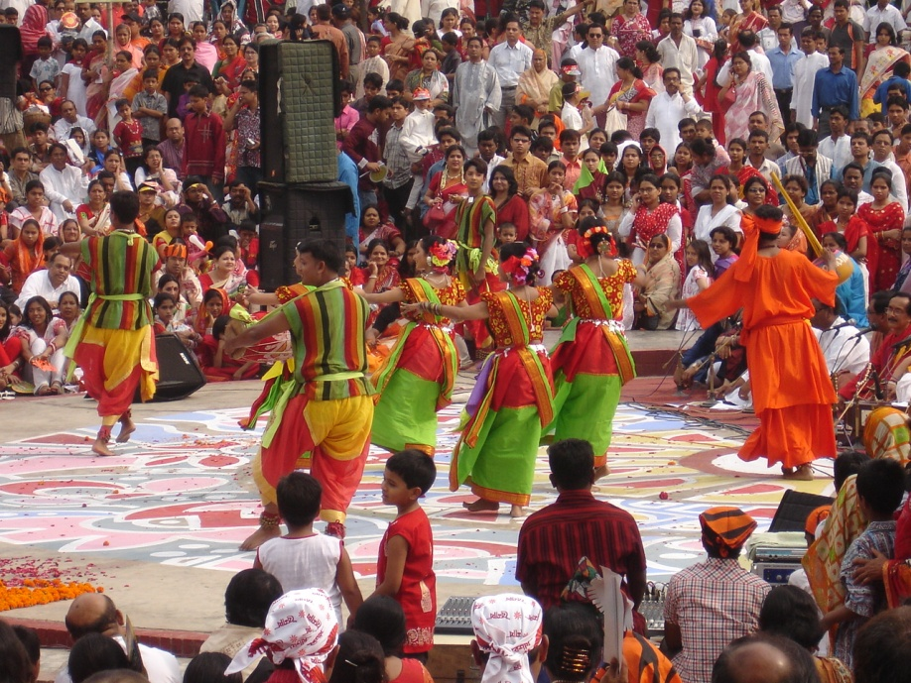
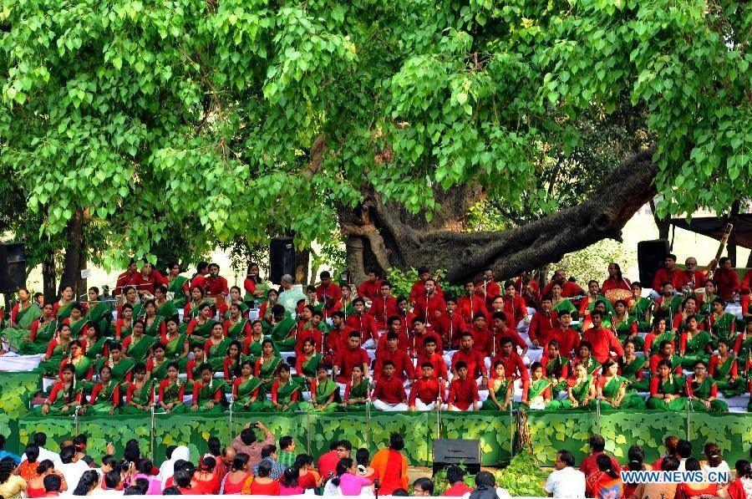
Look at the picture
When do we celebrate this festival ?
PAHELA BOISHAKH

Slide 5
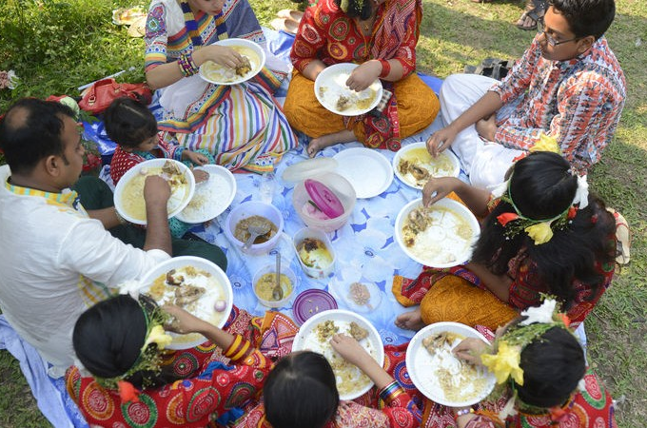
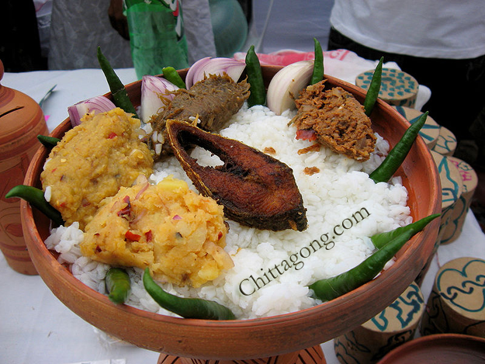
When do we enjoy this kinds of food ?
PAHELA BOISHAKH

Slide 6
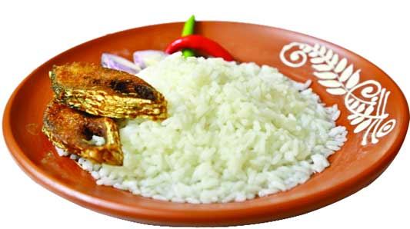
Lesson Declaration
PAHELA BOISHAKH
Unit-3
Lesson : 6

Slide 7
LEARNING OUTCOMES
After completing this lesson students will be able to-
1. read the text.
2. tell about pahela boishakh.
3. ask and answer questions and give opinions in a logical sequence.
4. write and compare among different festivals.

Slide 8
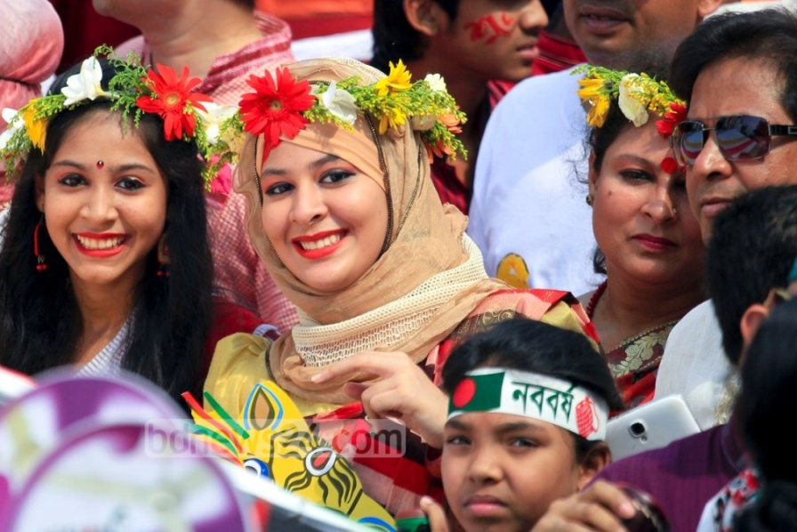
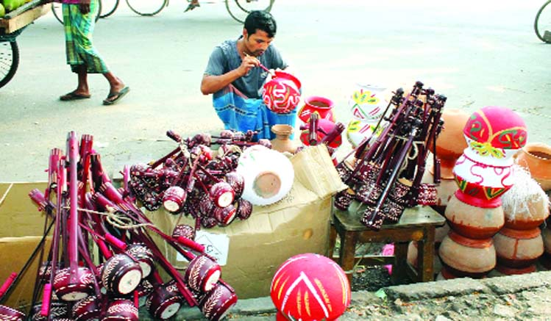
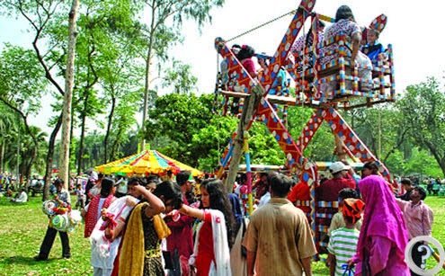
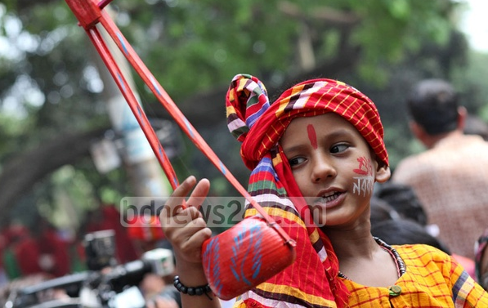
PAHELA BOISHAKH

Slide 9
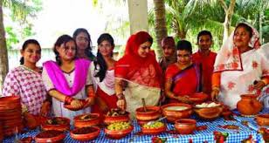
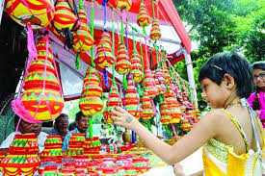
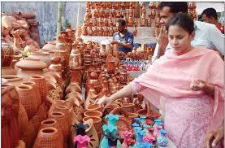
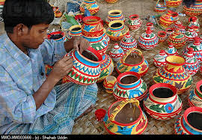
PAHELA BOISHAKH

Slide 10
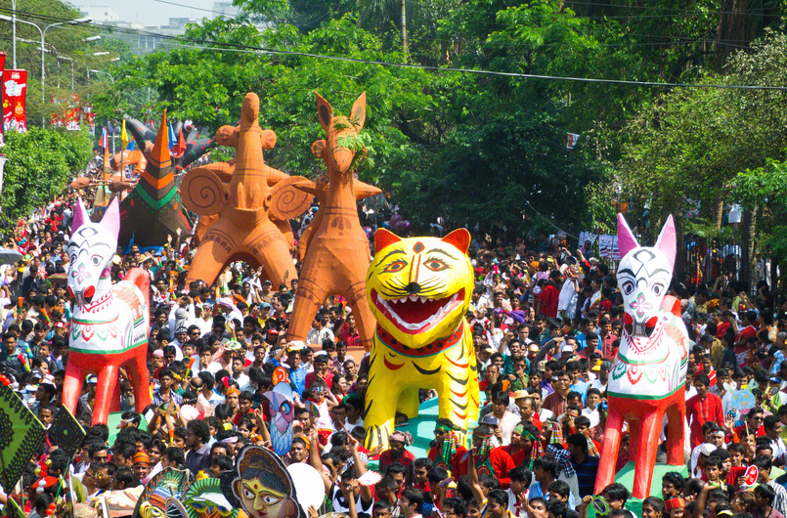
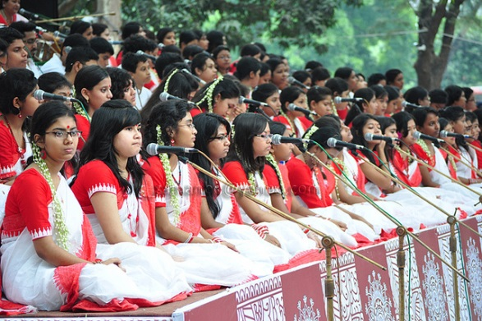
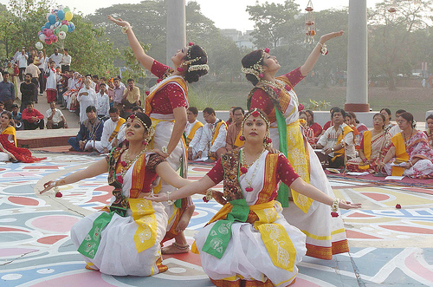
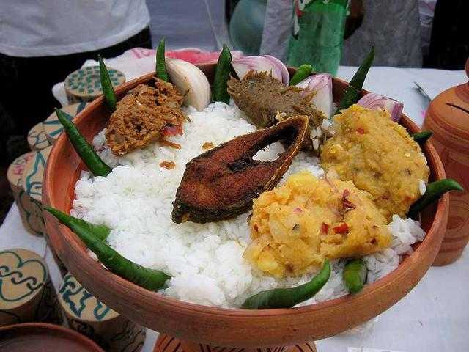
PAHELA BOISHAKH

Slide 11
Vocabulary
Traditional
Conventional
Adj
Celebration
Ceremony
Noun
Procession
Journey/Manifestation
Noun
Observe
Accomplish
Verb

Slide 12
Students silent reading

Slide 13
‘Pahela Boishakh’ is the first day of Bangla new year. The day is a public holiday. This day has a special significance for us as it forms a part of Bangalee culture and tradition. People from all walks of life, irrespective of their ethnic identity or religious beliefs, celebrate the day with traditional festivities. On this day, the whole of Bangladesh is in a festive mood. The day inspires people to start life with renewed hopes and inspirations.

Slide 14
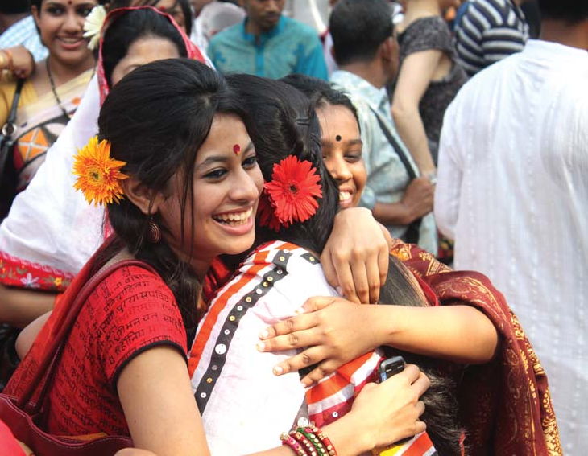
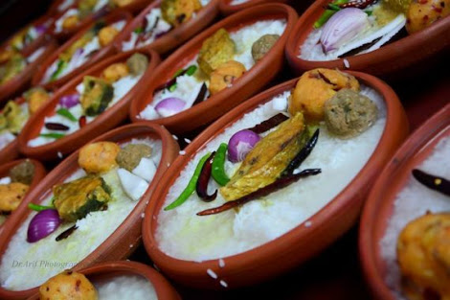
Every year the day is celebrated traditionally. People wake up early in the morning, have a bath and wear their traditional clothes. Women wear white saris with red borders and adorn themselves with colourful churis and flowers, while men dress themselves with pajamas and punjabis. It is a day when people love eating traditional food.

Slide 15
This day the most colourful event is held in Dhaka. Early in the morning, people in hundreds and thousands pour in from all directions to attend the cultural function at Ramna Batamul organised by Chhyanata. The culture programes begings just with sunrise and the renowned artists of the country take part in the programme that starts with the famous Tagore-song Esho-he-Boishakh, Esho Esho...... . Artists also sing traditional folk songs, and display classical dance with the rhythm of musical instruments.

Slide 16
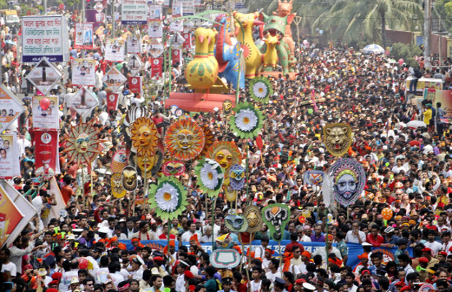
People also come to join the colourful processions, the biggest carnival of the country, organised by the Fine Arts students of Dhaka University. The procession usually displays the traditional practices of Bangalee culture. The masks and wreaths worn by the people are so fascinating! Often they symbolise contemporary worries or happiness in the national life. It attracts increasing number of foreign tourists every year.

Slide 17
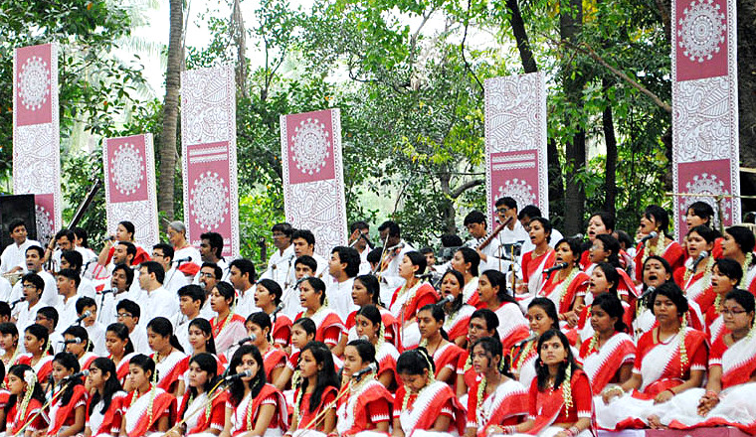
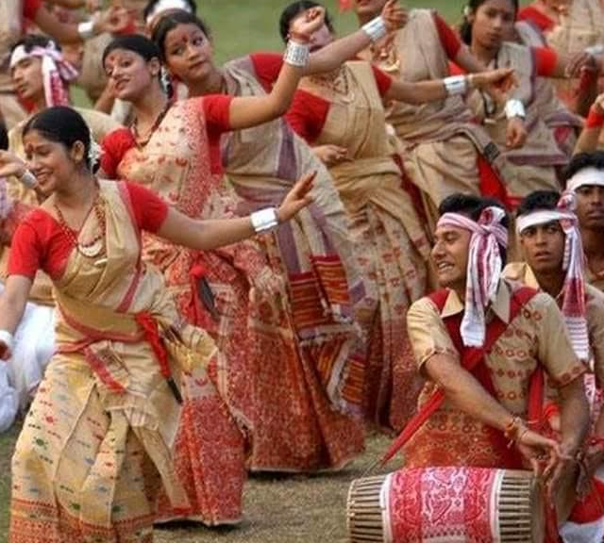
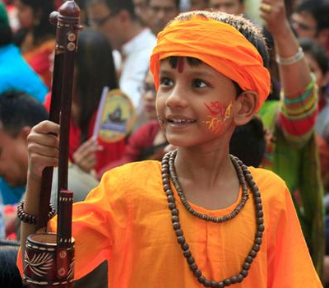
The day is also observed all over the country. Different social and cultural organisations and educational institutions celebrate the day with their own cultural programmes.

Slide 18
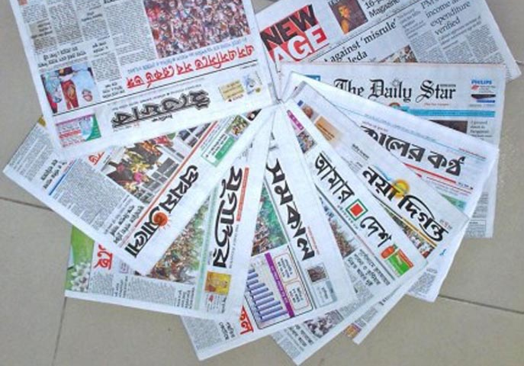
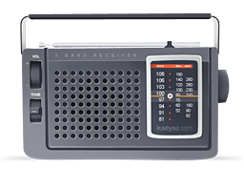
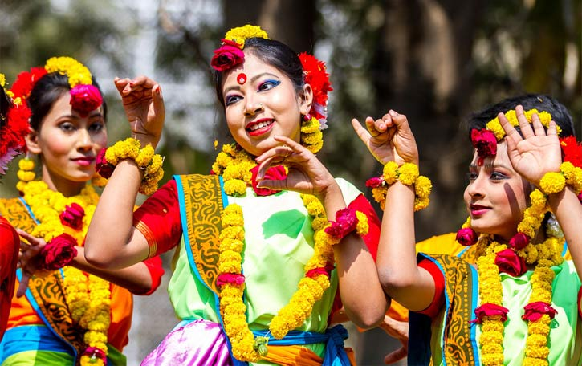
On this day, newspapers bring out special supplements. There are also special programmes on the radio and television channels. The celebration of Pahela Boishakh marks a day of cultural unity for the whole nation irrespective of caste and creed.

Slide 19
Group Works
Complete the passage with suitable words.
The word Pahela means the first and Boishakh is (a) ......................... month of Bangla calendar. The day is observed not (b) .............................. in Bangladesh but (c) .............................. in some other parts of the world. In England, the Bangalees also (d) .................................the day with a street (e) ..................................... in London.
first
only
also
celebrate
procession

Slide 20
Pair Works
Answer the following questions.
1. What do you mean by pahela Boishakh?
2. How do the women adorn themselves?
3. How is the day observed in Dhaka?
4. How does Pahela Boishakh inspire people?
5. What do the mass media do ? Why?

Slide 21
Evaluation : Individual work
Choose the best answer from the alternatives.
a. People celebrate Pahela Boishakh ----- their ethnic identity.
i) regarding ii) according to iii) considering iv) regardless of
b. People throughout the country celebrate the day by
A) attending traditional cultural programmes
B) eating traditional food.
C) dressing themselves with modern clothes.
Which of the above answers is/are correct ?
i) A & B ii) B & C iii) A & C iv) B
c) In the passage, the word `dress’ is a/an --- .
i) noun ii) adverb iii) verb iv) noun & verb
d) The programme at Ramna Batamul is organised by -----.
i) Bulbul Lalitakala Academy ii) Shilpakala Academy
iii) Bangla Academy iv) Chhayanat

Slide 22
Home Work
Write with in ten sentences about how did you celebrate Pahela Boishakh.

Slide 23
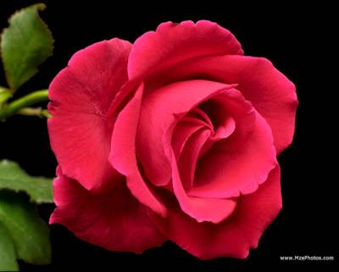
Thank you so much to all.

