Slide 1
Welcome to my class

Slide 2
Presented by-
Md.Azharul Islam Khan.
Assistant teacher.
Dhala Govt. Primary School.
Tarail ,Kishoreganj

Slide 3
Lesson title:Write to me soon.
Unit:8,Lessons:1-2
Lesson part:A

Slide 4
Learning Outcomes:At the end of the lesson students will be able to-
1.Read the passage with correct pronunciation .
2.Identify the symtomes of fever and flu.
3.Follow doctor’s instructions.

Slide 5
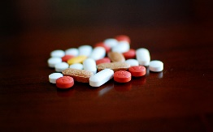
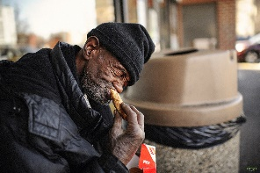
New words
Throat……
Fever……
Flu……
Medicine….
Advice…
Hungry…
Strong….

Slide 6
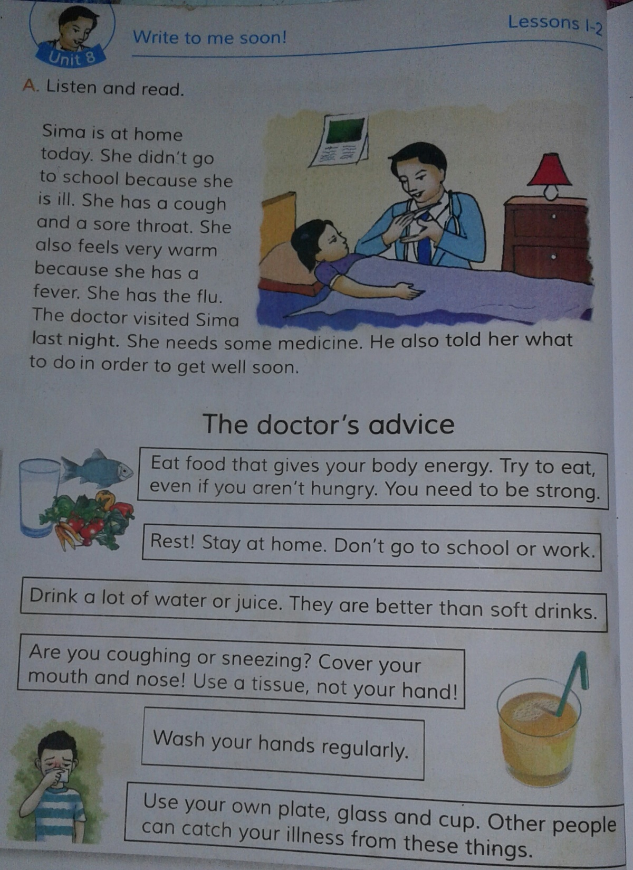
Now read after me.

Slide 7
BINGO GAME
Throat,Medicine,Fever,Flu,Advice,Hungry,Warm,Rest,Sneeze,Cover

Slide 8
Matching(Oral)
Throat | Counsel
Medicine | Cold
Fever | Inaction
Advice | Neck
Rest | Drug

Slide 9
True/False(Oral)
1.Sima didn’t go to school because she wanted to stay at home.
2.Sima feels fine,but she has a sore throat.
3.Sima is warm because she has a fever.
4.Sima should eat ,even if she doesn’t feel hungry .
5.Sima and her brother should use the same cup and glass .

Slide 10
Thanksall.

