Slide 1

Well come All are student

Slide 2

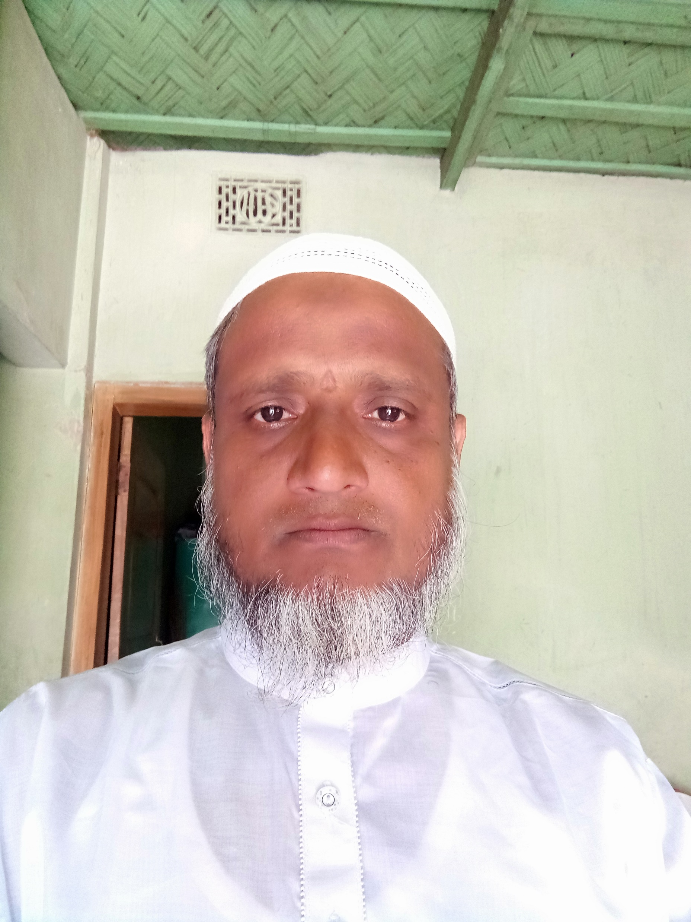
Teachers Introduce
saidul305844@gmail.com
Asistant Teacher
Enayetpur Alim madrash
Gazir hat, senbag, Noakhali

Slide 3
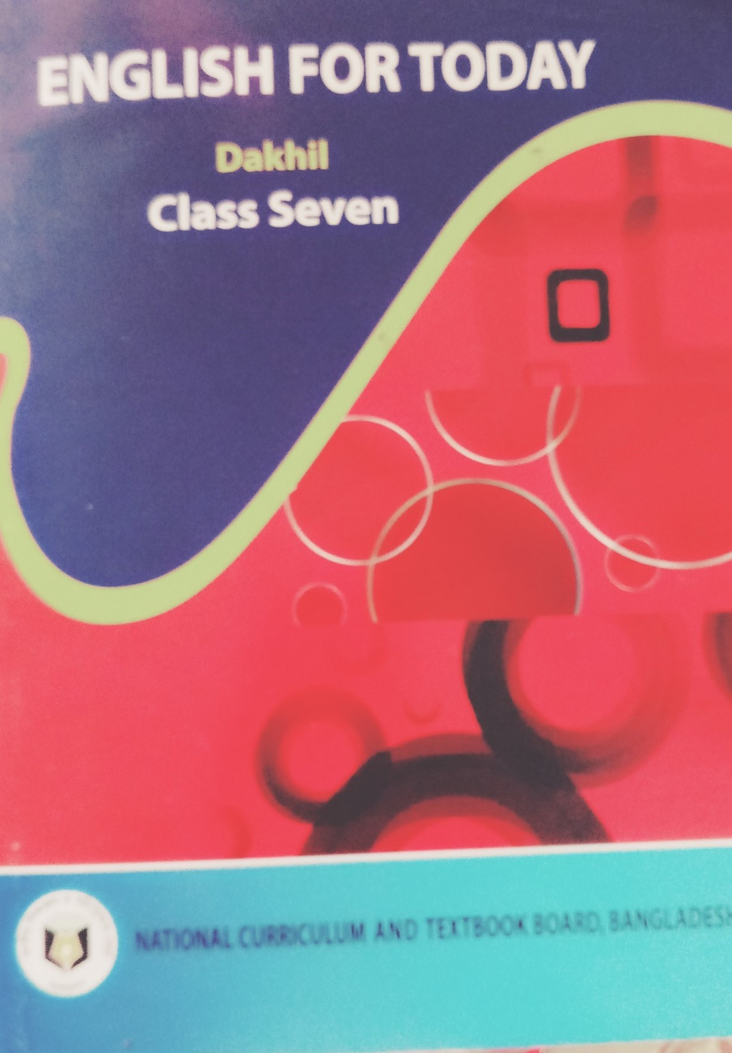
Lesson introduce
Class- seven
English for Today
Unit-Nine
Lesson- 4

Slide 4
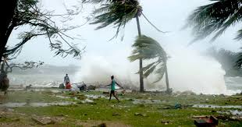
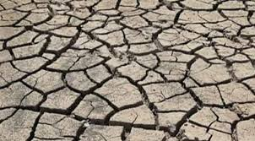
What do you understand by looking at these picture?

Slide 5
The title of the lesson
What happens next?

Slide 6
Learning outcome
At the end of this lesson the students—
Dangerous conditions can tell about the future of the world.
Will be able to mention the possibility of mans inability to live on earth day by day
Disease epidemic will occur and may explain the possibility of wildlife can be description.

Slide 7
Read the passage silently.
What happens as a result of global warming? The ice on the earth`s surface is melting fast due to extreme heat. Oceans and seas are warming too. All the ice that melts will fill up the oceans and seas and they will overflow on land. Thus a huge area of land will go under water. Some of the best land for growing food is also the most low-lying. That means it will be flooded first. Even some big cities like London, Kolkata and Bangkok will get flooded. That means thousands of people-----

Slide 8
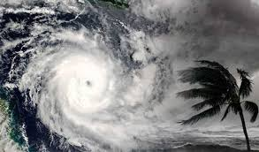
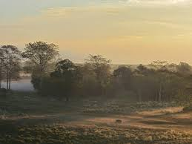
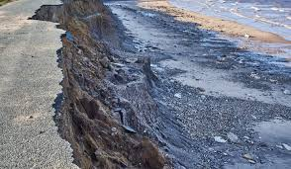
words | Amage | Meanings in Bangla | Meanings in English | Synonyms | Antonyms
Cyclone |  | ঘূর্ণিঝড় | Wheelbarrow | ---- | ---
Outcome |  | পরিণতি | The result for effect. | result,effect. | ---
Warm |  | উষ্ণতা | To become hot. | Hot | cool
Erosion |  | ক্ষয় সাধন | Action of eroding something | Affect, loss | Interest

Slide 9
Single work
(a)Oceans and seas are warming for-
i. Men ii. extra use of fuels iii. Cutting trees iv. Global warming
(b) For global warming ice is—
i.Getting hard ii. Getting soft iii. Melting iv. Freezing
(c)What is global warming--?
i. rise of flood ii. Rise of sea iii. Melting of ice iv. Rise of heat in the environment
(d)Thousands of people will encounter extreme
i. Famine ii. Poverty iii. Illness iv. Drought
Click to here for answer

Slide 10
Evaluation
Give short answer to the flowing questions.
1.Why is the ice on the Earth`s surface melting fast.
2.What will the melted ice do?
3. What will happen to the people for gradual warming?
4. What is the reason of heavy rainfull?

Slide 11
House
work
Question :1. Summarize the above passage in your own words.

Slide 12
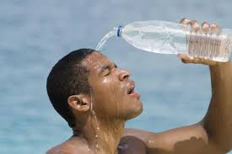
Thanks all are students

