Slide 1
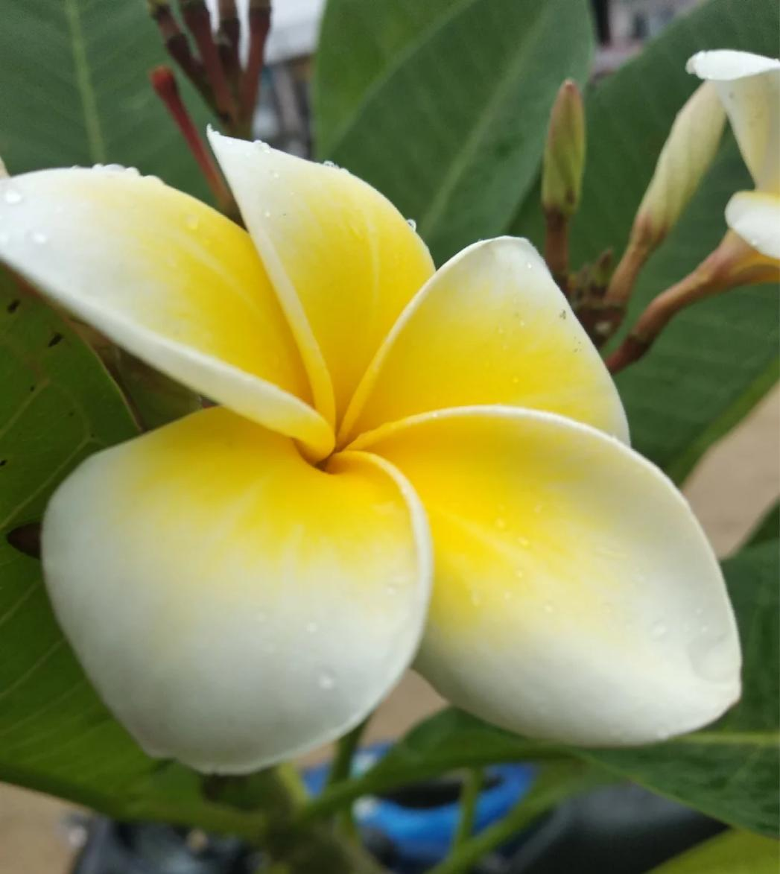
Welcome everybody

Slide 2
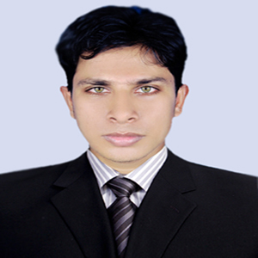
Teacher’s Information
Md. Rabiul Mowla
Assistant teacher
Mogdhara Adorshopara govt. primary school

Slide 3
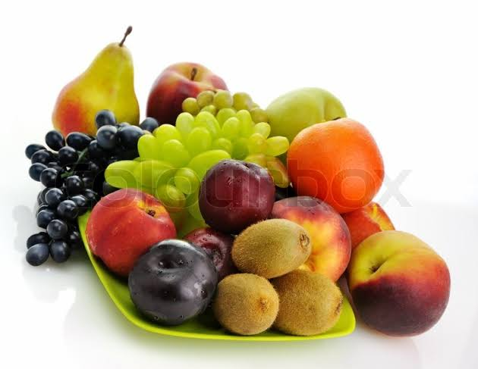
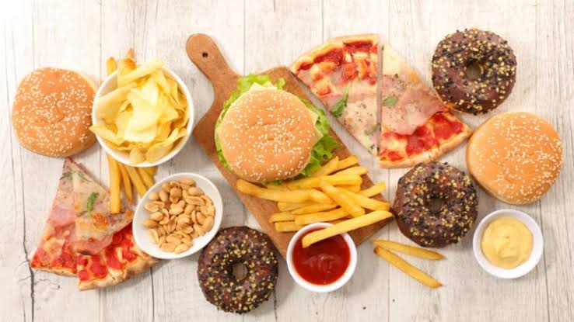
What do you see in the picture?
Do you eat fruits?
What food do you like most?

Slide 4
Today’s Lesson
Eat healthy
Unit-6
Lesson 1

Slide 5
Learning Outcomes

Slide 6
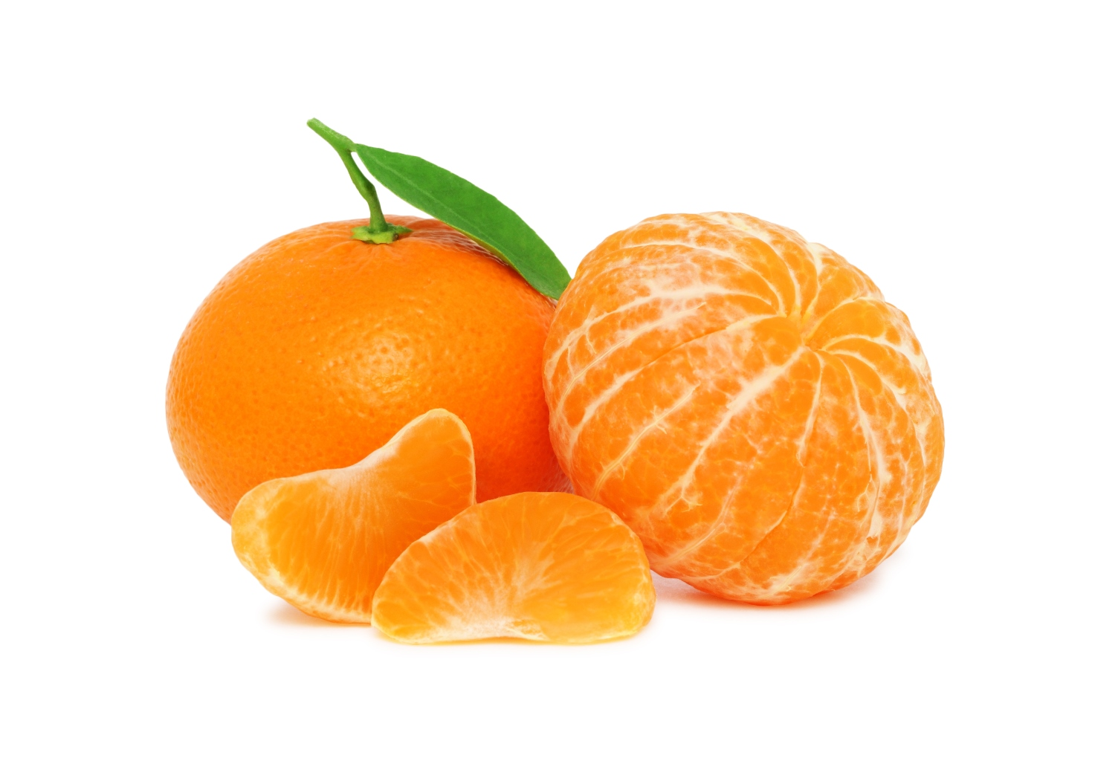
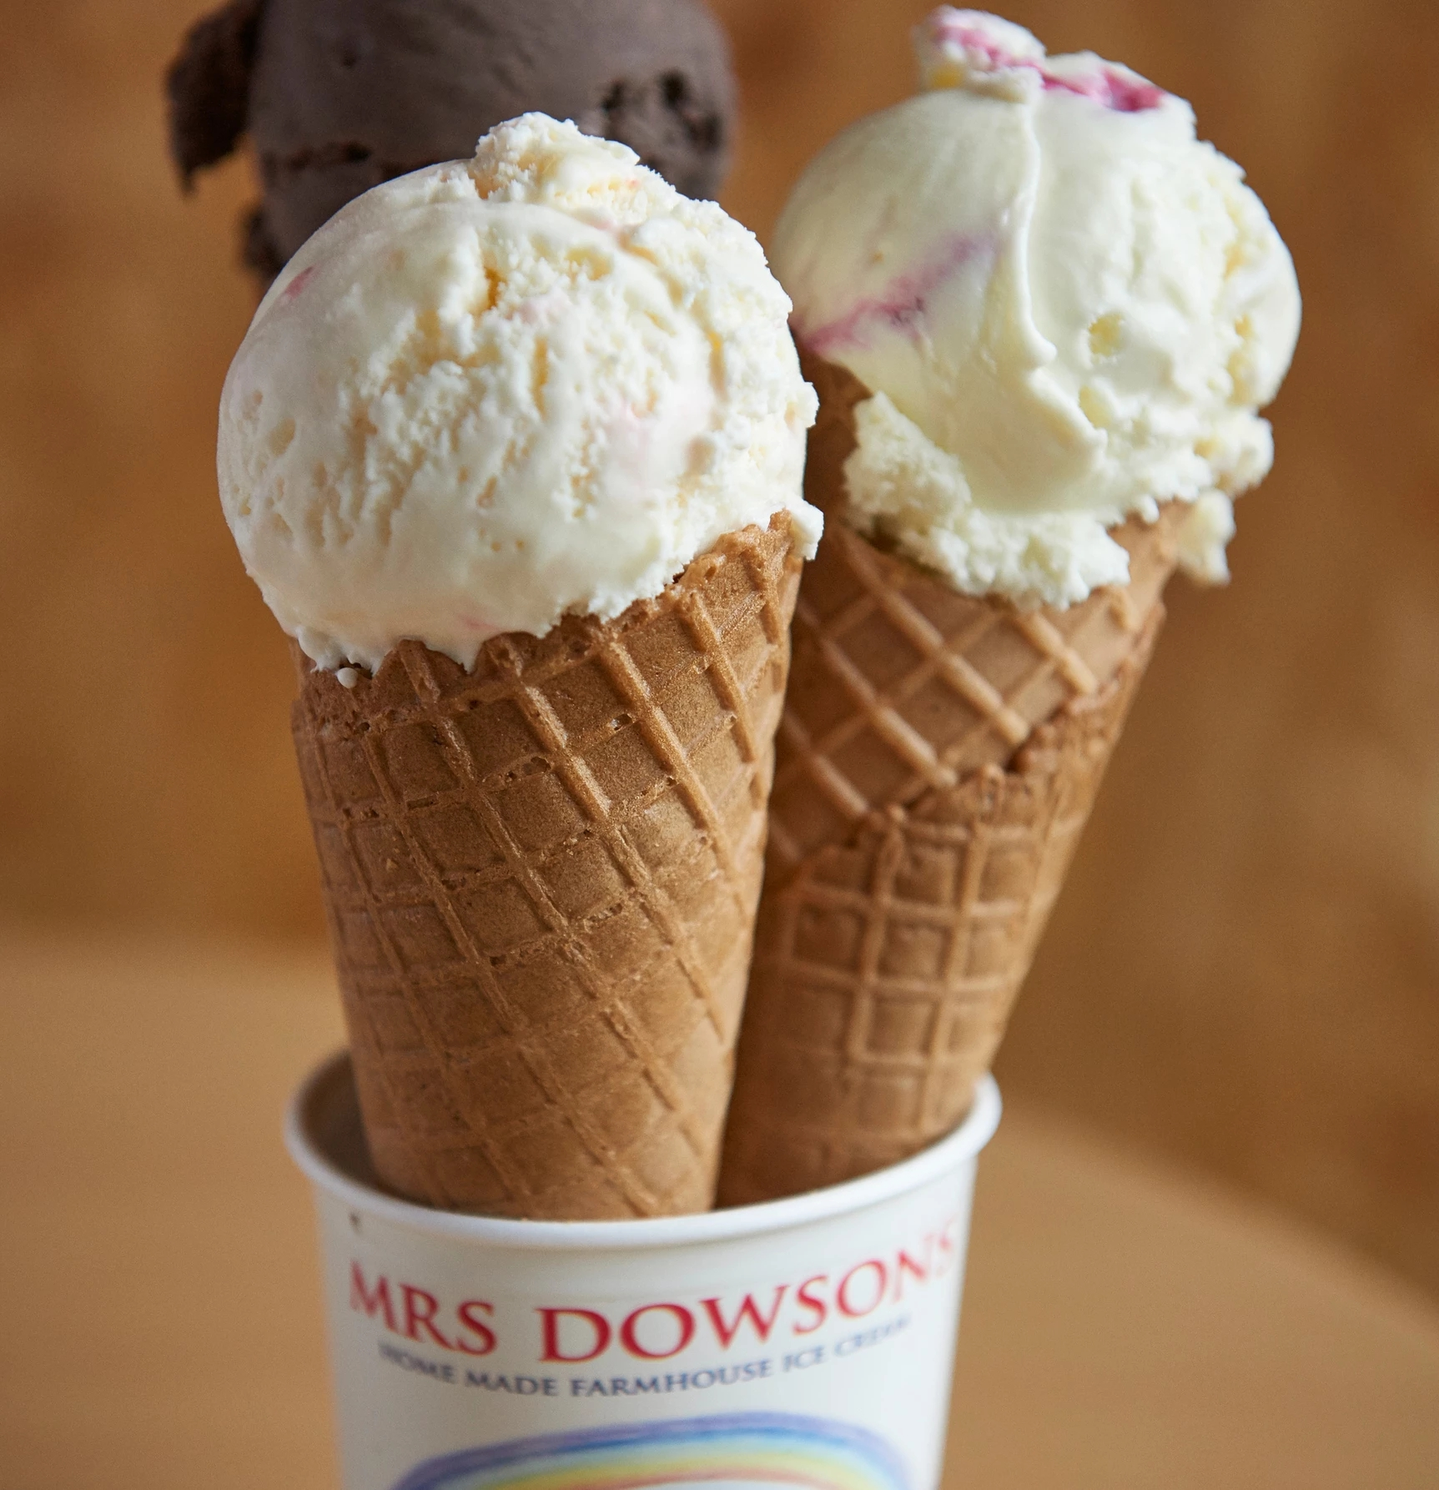
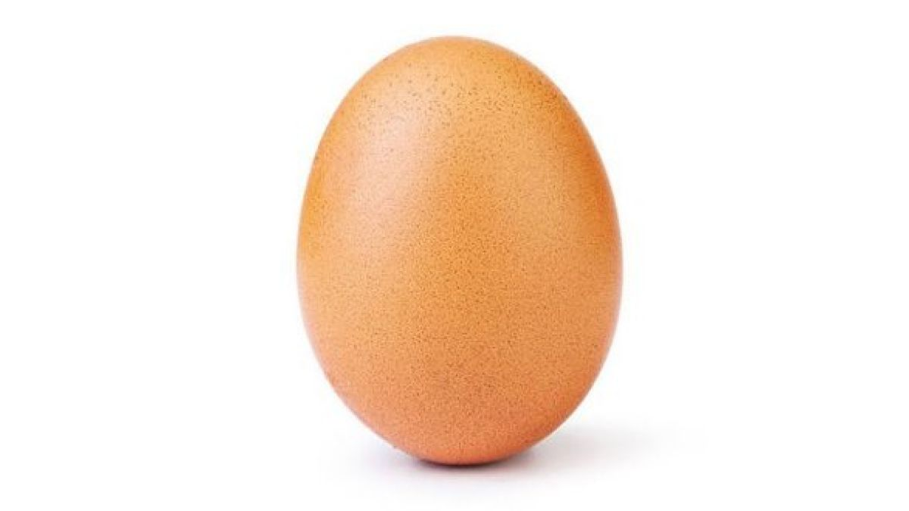
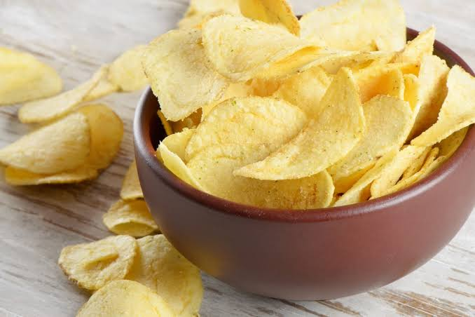
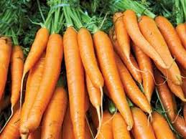
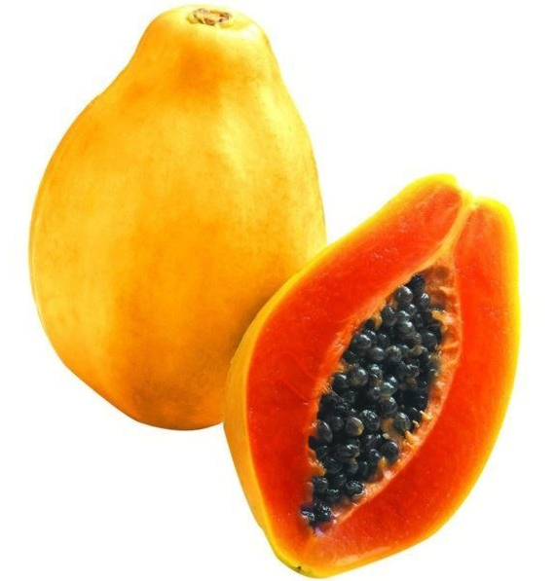
__g
eg
ange
Or____
ce
am
I__ - Cre__
aya
Pap___
arr
Chi__
C___ots
ps

Slide 7
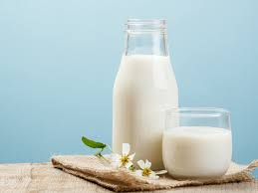
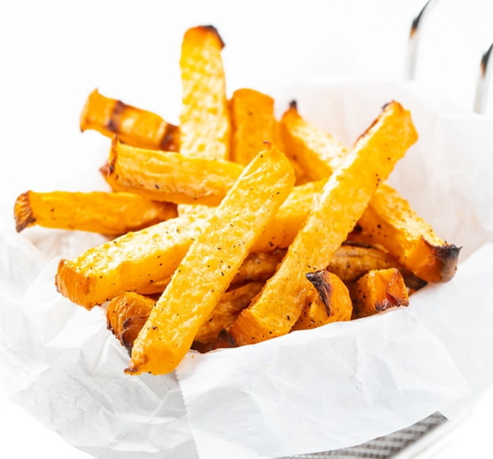
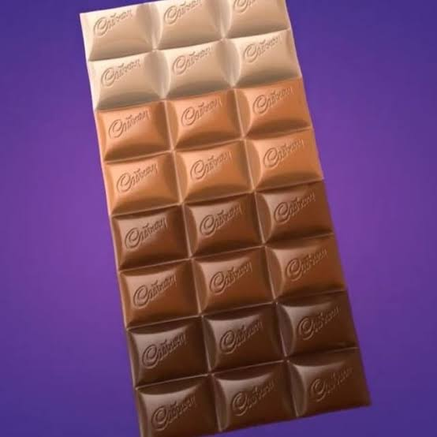
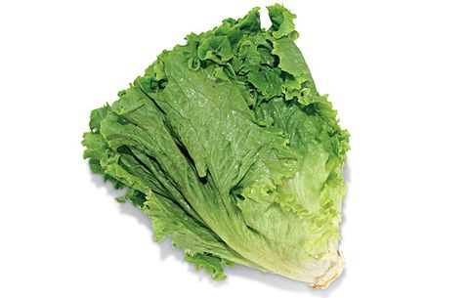
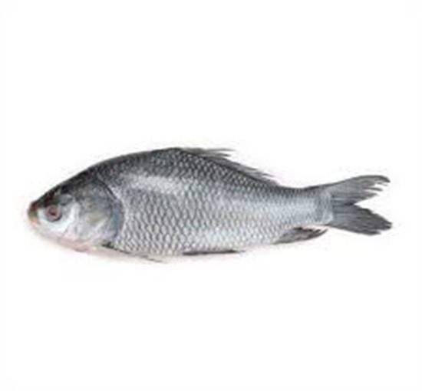
Milk
Fries
Lettuce
Fish
Chocolate

Slide 8
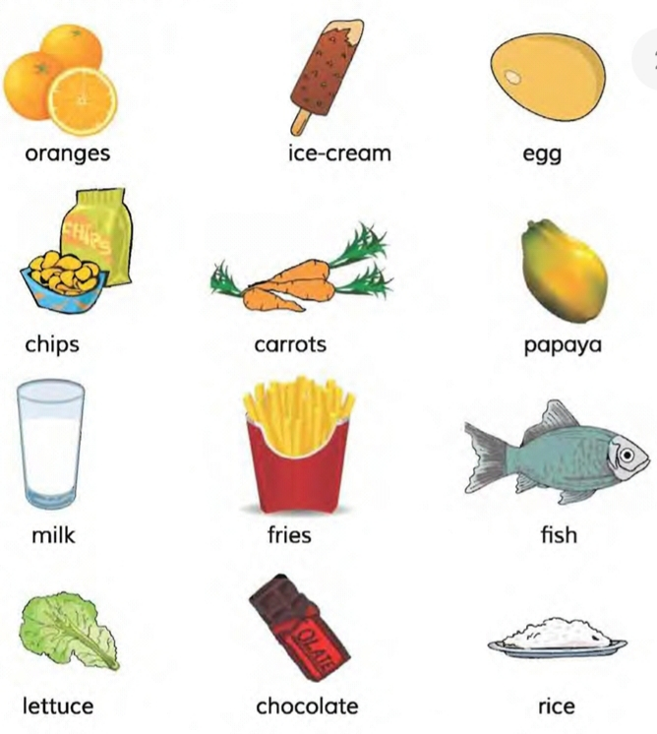
Let’s introduce with some foods
1. Underline which foods you like?
2.Circle which foods you think are healthy

Slide 9
Let’s see which are good food and which are unhealthy food.

Slide 10
Good Food

Slide 11
GOOD FOOD

Slide 12
Unhealthy Food

Slide 13
Let’s some conversations

Slide 14
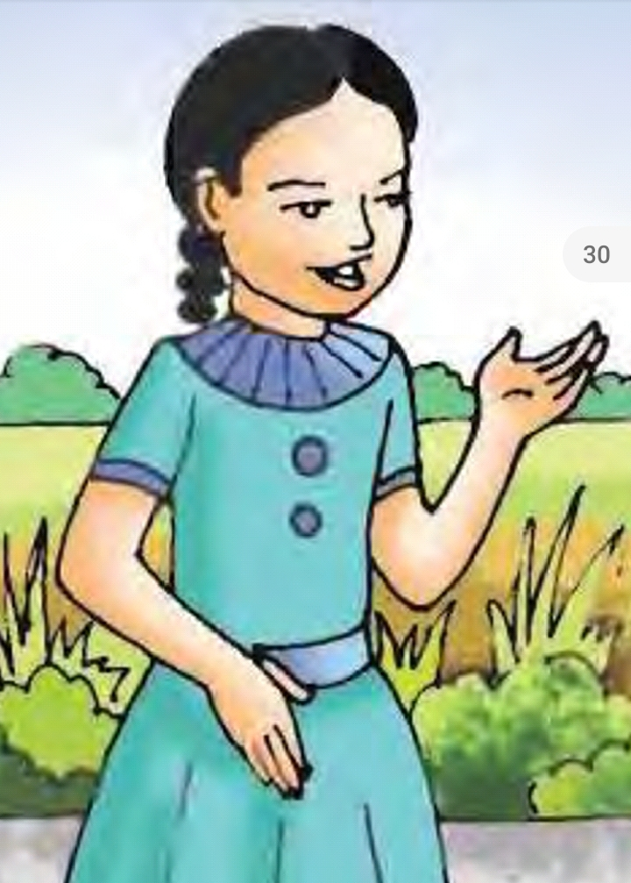
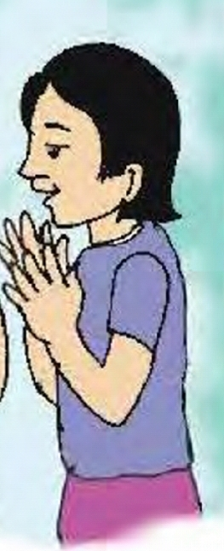
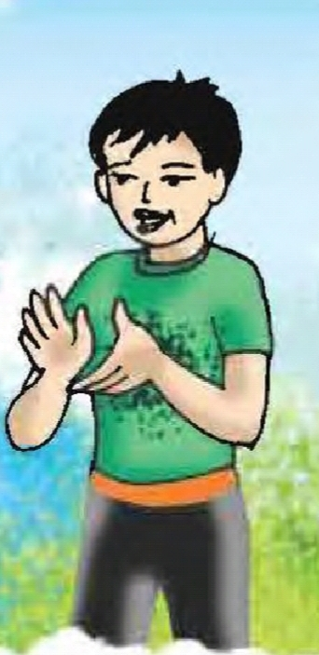
I like oranges
I like them too.
I don’t like them.

Slide 15
I think oranges are healthy
I think too so.
I don’t think so.
I think they are unhealthy

Slide 16
I like them too.
I like eggs.
I don’t like them.

Slide 17
I think eggs are healthy
I think too so.
I don’t think so. I think they are unhealthy

Slide 18
Group work
Now make a conversation among you

Slide 19
Evaluation
Write down some foods which are healthy.
Write down some foods which are unhealthy.

Slide 20
Thank you

