Slide 1
WELCOME TO ENGLISH CLASS

Slide 2
INTRODUCTION OF THE TEACHER
ASHIS Kumar GHOSH
M,S,S.M ED
English Teacher
Farazikandi kamil Madrasha.
Matlab (North), Chandpur.
Mobile:01917-083886

Slide 3
Introduction to the lesson
Class: ix
Subject: English
Unit: Eight, Lesson:1
Topic: Buildings & Monuments ( prose)
Time: 50 Min.
Date: 16/ 06/ 16

Slide 4
Aims and Objectives
By reading the lesson SS will be able-
to say described about Monument.
meaning of new words.
Answer to the questions.

Slide 5
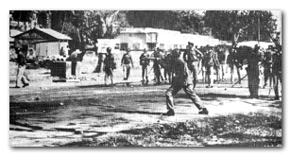
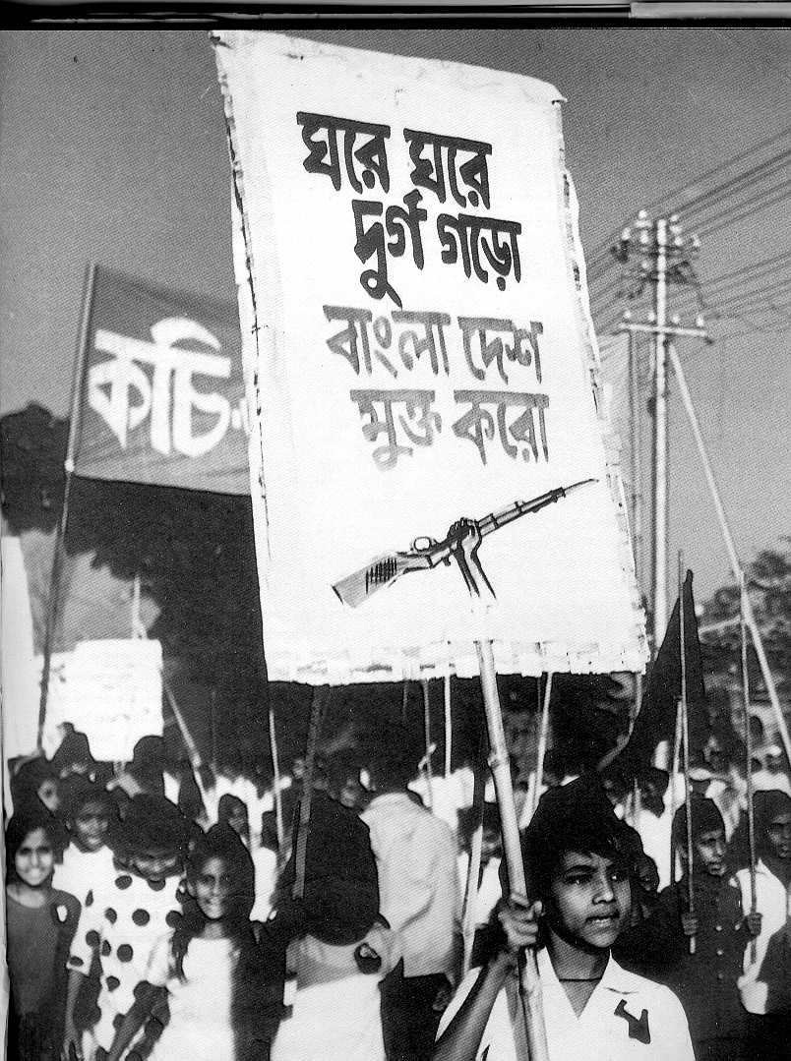
struggle
Struggle of freedom

Slide 6
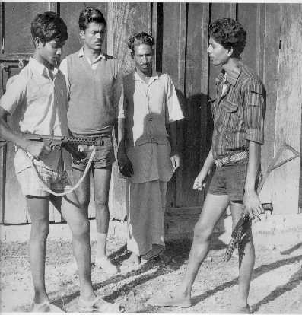
Freedom fighter
Victory

Slide 8
Title of the lesson
National Memorial

Slide 9
Ideal lesson
The Teacher will teach to the students colon, semi colon, dash, comma etc. with correctly.

Slide 11
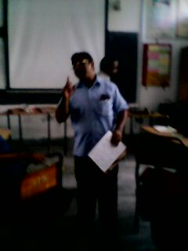
Loudly lesson
The teacher will to teach the students 3 / 4 with pronunciation.

Slide 12
Individual Work: 5 Min.
1. What is the National Memorial?
2. Where is situated?

Slide 13
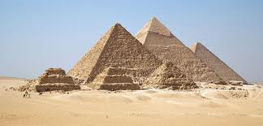
Pair work: 7Min
Vocabs
Weapons
Arms
Graves
Tomb
Martyrs
Sacrificer

Slide 14
Museum

Slide 15
Group works: 10 Min
1. Why is the museum near the Monument?
2. What is the meaning of “It is built with concrete, but made of blood”?

Slide 16
Evaluation
1. How many towers of the National Memorial?
2. How high is the tower of the National Memorial?

Slide 17
Home work
Write a paragraph about the background of The National Memorial not more than 10 sentences.

Slide 18
Thanks

