Slide 1
Welcome

Slide 2
INTRODUCTION

Slide 3
Lesson Introduction
Subject: English For Today
Class: Six
Lesson:9
Time:50 mins.

Slide 4
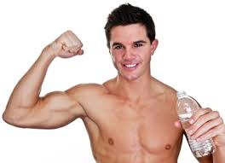
LOOK AT THE PICTURE
WHAT DO YOU SEE IN THE PICTURE ?
A healthy man

Slide 5
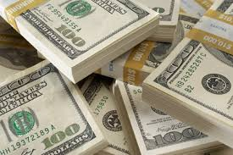
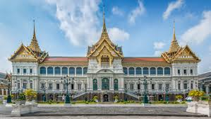
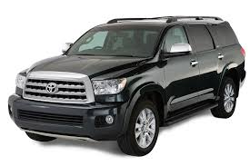
Look at the picture
CASH
palace
car
WHAT DO YOU SEE IN THE PICTURE ?
THESE ARE WEALTH

Slide 6
LESSON DECLARATION
HEALTH IS WEALTH
Lesson -9

Slide 7
Learning Outcomes
After completing the lesson students will be able to
write a new vocabularies
ask and answer questions
write a summary
Ask and answer MCQ questions

Slide 8
MODEL READING

Slide 9
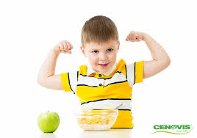
VOCABULARY
Healthy: Physically fit
Nasif is a healthy boy

Slide 10
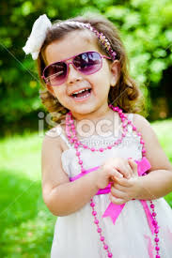
Cheerful:Jolly,Happy
Tarin is very cheerful today

Slide 11
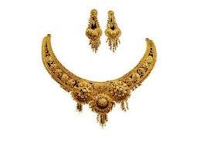
Wealth:Asset, Property
Cash
Gold
Car
Everybody wants more wealth

Slide 12
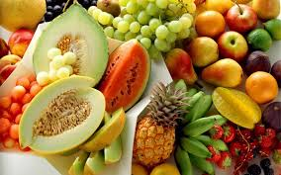
Fresh:Clean, New
Everybody should eat fresh vegetables

Slide 13
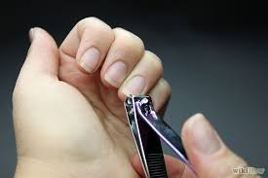
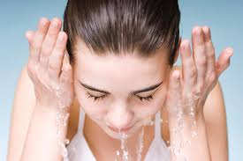
Hygiene: Practices of keeping good health
We should follow the rules of hygiene

Slide 14
Individual Work
Q-1: What do you mean by hygiene ?
Q-2: What are essential for good health ?
Q-3: What do we mean by balance diet ?

Slide 15
Answers
1.The rules and practices of keeping good health are called hygiene.
2. Proper food and nutrition, physical exercise, rest and sleep, cleanliness and proper medicare are essential for good health.
3. Balance diet means that our food should contain correct proportion carbohydrate,fat, protein, vitamins, minerals and water in it.

Slide 16
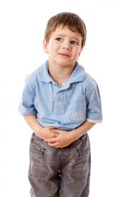
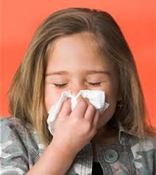
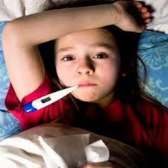
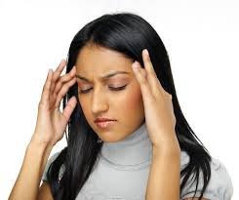
LOOK AT THE PICTURE AND WRITE DOWN THE NAME OF DISEASE
Stomachache
Fever
Headache
Cold

Slide 17
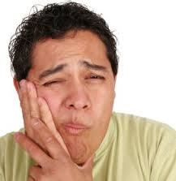
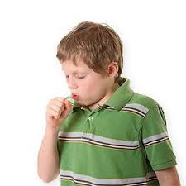
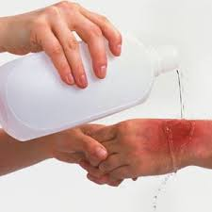
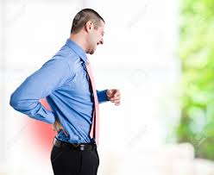
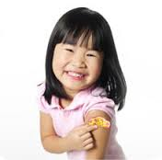
Toothache
Cough
Burn
Backache
Skin injury

Slide 18
Pair work
Q -1: Have you had any of these or any other health problems recently ? Which ones ? or what ?
Q - 2: What do you do when you have a headache or a cold or a toothache ?

Slide 19
Answers
1. Yes, recently I have had a bad cold.
2.When I have a headache, I usually take paracetamol and some rest.
I see a doctor and take medicines prescribed when I have a cold.
And when I have a toothache, I see a dentist and follow his advice.

Slide 20
Problems and Remedy
An insect bite
A stomachache
A burn
A skin injury
Antiseptic
Antacid
Burnol ointment
Antiseptic

Slide 21
Group work
Write a summary of the text Health is wealth

Slide 22
Answers
Summary: This lesson is about the rules of good health. Hygiene is the first condition of good health. Proper food and nutrition, physical exercise, rest and sleep, cleanliness and proper medicare are essential for good health. Good health is important for an active,cheerful and happy life.

Slide 23
Evaluation
1.Choose the best answer from the alternatives
“If you are healthy, you can be happy and can help others in society as well”.
In the above sentence the ‘others’ refers to…..
(i) body organs (ii) health and wealth (iii) people living in the society
(iv) rules of health
Personal hygiene means-----
A.keeping oneself neat and clean B. keeping household clean
C. having physical exercise
Which of the above answers is/are correct ?
(i) A & B (ii) B & C (iii) A,B & C (iv) A

Slide 24
Home work
Write a paragraph on the rules of Good Health

Slide 25
THANKS
THE END

