Slide 1

Welcome dear students

Slide 2
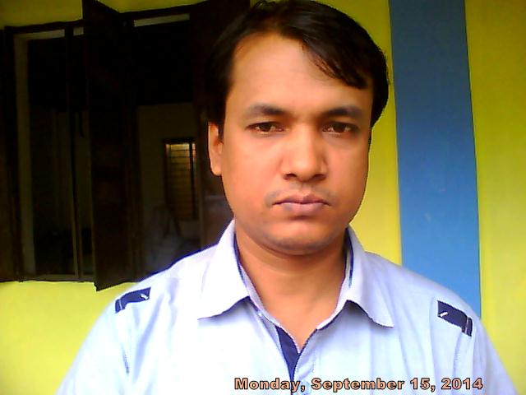
Presented by
Md. Jamal Hossen
Assistant Teacher
Poyal Goacha Technical Girls’ High School

Slide 3



Slide 4





Slide 5



Slide 6


Slide 7
Learning Outcomes
Be able to familiar with an e-mail.
Procedure of giving message through e-mail.
Writing an e-mail
Be able to Communicate with other through e-mail

Slide 8
Can You Say What is E-mail?
Electronic mail Popularly known as e-mail is the communication of textual messages via electronic means.
E-mail is a means of sending messages between computers.
To send and receive e-mail you need access to the internet.

Slide 9
Writing an e-mail you have to follow the following procedures:
Your e-mail address
Whom do you write to i.e. his / her e-mail address
Subject
Sending Time : Day, Date & time of the sending
Salutation
Body / Message.
The Subscription

Slide 10
Format:
From: Senders Name and his / her e-mail address
To: Receivers Name and his /her email address.
Sent: Day, Date and Time of the sending messages
Subject: To mention the subject of the messages in short.
The Salutation
The Subscription
Dear Sharmin
The Body / Messages
Rina

Slide 11
Example of Writing an e-mail
Suppose your are Anika and your friend is Samira who lives in Dhaka. You are going for a picnic. Now, send a message through E-mail to your friend inviting him to go for the picnic with you.

Slide 12
From: Mahi<Nafisa@gmail.com
To: Montasir < monisha@gmail.com
Sent: Monday, 15 August, 2014; 8:30 a.m.
Subject: Invitation to go for a picnic.

Slide 13
My dear friend
Receive my cordial love at the very outlet of the e-mail. Hope you are hale and hearty.
You will be glad to know that we are going to hold a picnic on the 28th of this instant at Jahangirnagar University Campus, at Savar, that has gained the importance as an entertainment spot. With a view to breathing in fresh air and watching migrating birds, a good number of visitors come here from different places.

Slide 14
We also would like to spend a day in the lap of nature. It is quite near to Dhaka as well. Rownok, Jawab, Sami, Shaheen, Lamia and some of our close friends will join us to the picnic.
I hope that you will certainly join us, enhance our pleasure and have a nice day.
Your loving friend
Anika

Slide 15


Slide 16
Group Work
Discuss with your partner how to write an e-mail.

Slide 17

Evaluation
1. What is an e-mail ?
2. How many parts of an e-mail ?
3. How can you send a message through e-mail ?
4. How can you write subject of the message ?
5. What will be the body of the message ?

Slide 18
Home Task
Suppose you are Faiaz. You have a pen friend named Sadik who lives in Iran. He wants know about Bangladeshi Food / Culture. Now send a message to him through e-mail about the food, food habit and culture of Bangladesh.

Slide 19

Good Bye

