Slide 1
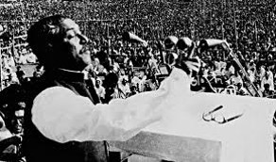
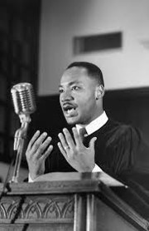

Slide 3
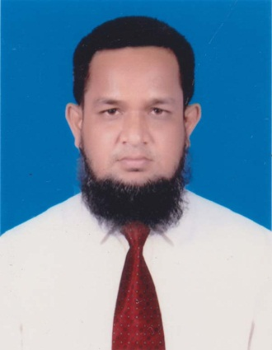
Identity
MD.ABDUR ROUF
Lecturer(English)
Khalna Islamia Fazil(Degree) Madrasah
Patnitala,Naogaon.
Mobile-01767650169
Class-11-12
Subject: English 1st
Unit: One
Lesson: One
Time: 50 Minute

Slide 4
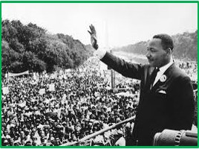
Who is the person?
Martin Luther king

Slide 5
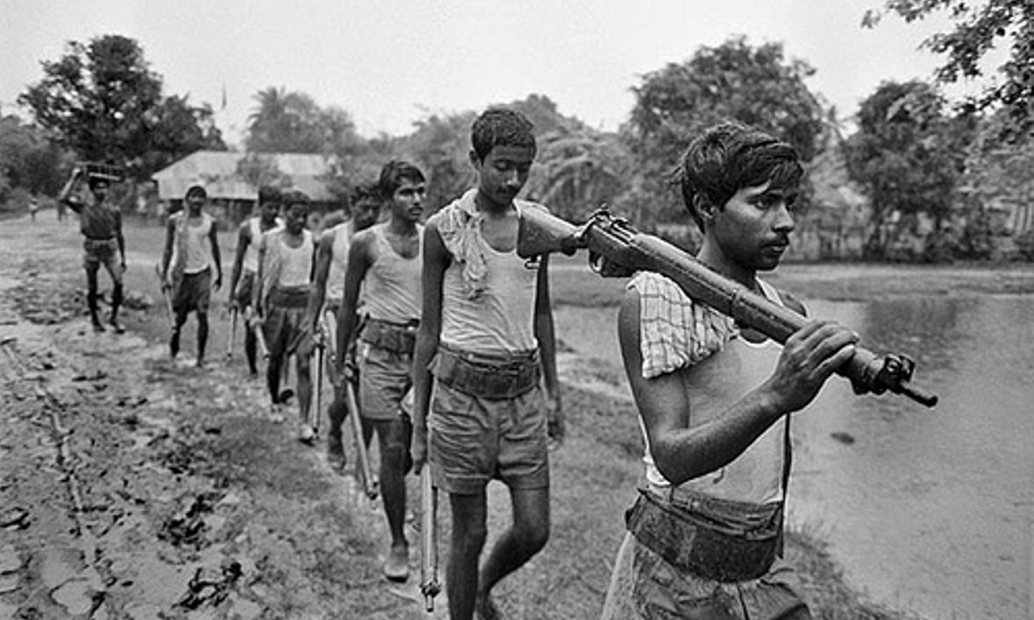
What do you see in the picture?
They are going to Warfield.

Slide 6
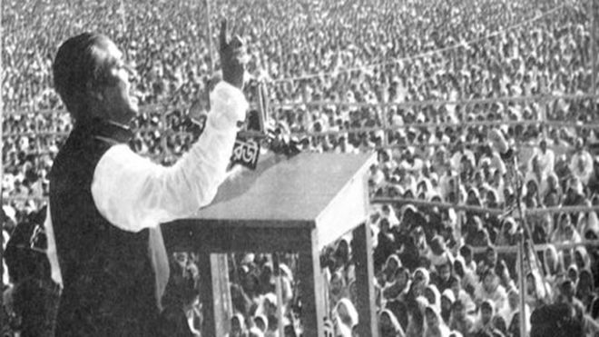
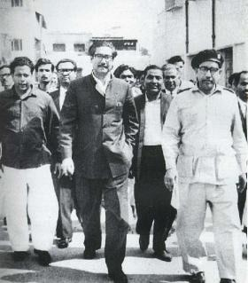
What do you see in the pictures?
The father of the Nation Bangabandu Sheikh Mujibur Rahman

Slide 7
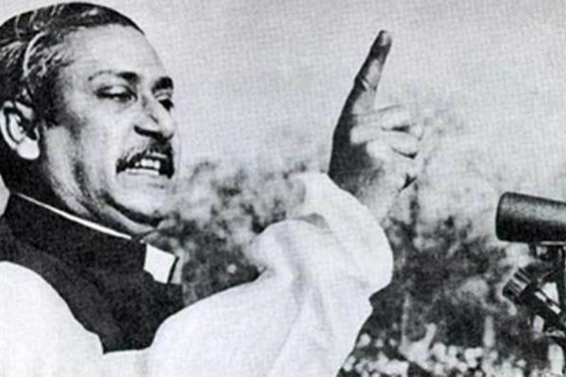
Today’s Lesson
Unforgettable History
Unit –One, Lesson -One
Class-XI-XII & Alim

Slide 8
Learning Outcomes
After the lesson Students will be able to -
Know about Banggabondhu Sheikh Mujibur Rahman;
Comprehend and understand the text;
Ask and answer the question;
Complete flow chart

Slide 9
Fact file of Bangabandhu Sheikh Mujibur rahman
1920: He was born.
1929:He was admitted into Gopalgonj Public school
1934:He under went eye surgery.
1932: Mujib married Fazilatunnesa.
1940:He was enrolled at the Islamia college.
1949: He was elected joint Secretary of Awami Muslim league.
1966: Mujib proclaimed 6 Point.
1953:He was made the party’s general secretary.
1966: He became President of AL.
1970: Awami league won the general election because of his leading.
1971: he brought political emancipation for Bengali Nation.

Slide 10
That you see in the picture. Everything is happened by the leadership of Sheikh Mujibur Rahman.

Slide 11
Single Task
Time-5 minute

Slide 12
https://www.youtube.com/watch?v=XFG0i1cv2zY

Slide 13
Now, open your book at page 1 and read the passage silently.

Slide 14
Pair Work
Time: 8 Minute

Slide 15
Important events ----------
1958
Ayub Khan Decleared Martial Law
1966
Sheikh Mujibur Rahman launched six point movement.
23Feb,1969
Sheikh Mujibur Rahman was given the title ‘Bangabandu’
7December,1970
Pakistani General election was held.
25March
1971
Pakistani Military Junta attacked East Bengal

Slide 16
Bangabandhu Sheikh Mujibur Rahman’s direction of 7th March speech
Directives for common people | Directives for office employees | Directives for Pakistani army
Confront the enemy with whatever you have. | Bangladeshi courts, magistracies, government offices and educational institution will be shut down indefinitely. | Stay in your barracks.
No one will pay taxes. | Take orders only from Bangabandhu. | Don’t try again to aim your bullets at our chests.
Shut down all shops and make sure that traffic on all roads and ports are brought to a stand still. | On 28th employees will go and collect their salaries. | Withdraw martial law.

Slide 17
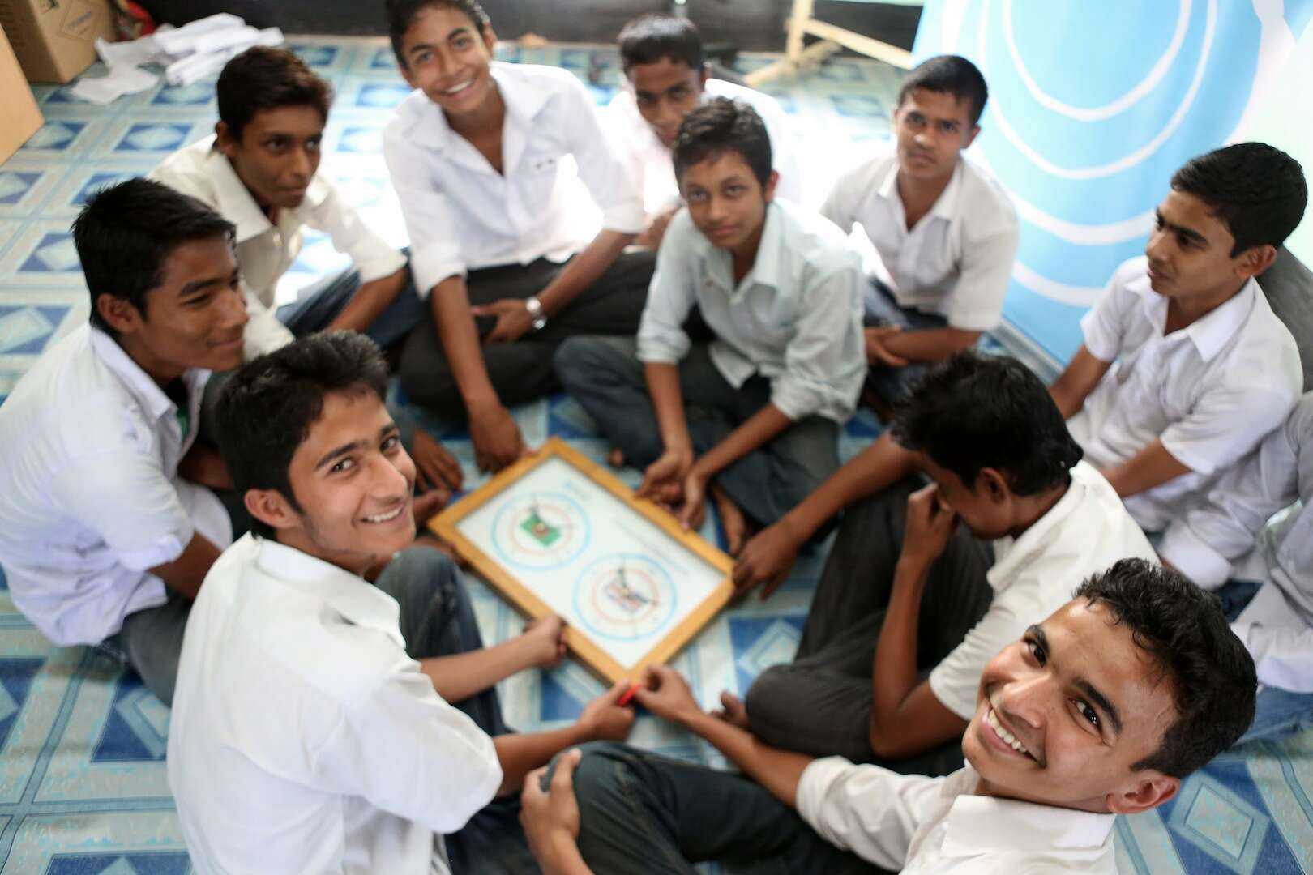
Group Work
Time: 8 Minute
Now complete the flow chart with proper information
1966
23February 1969
7December 1970
25 March 1971
1958

Slide 18
Home Work
Write a paragraph on the major events leading to March 7.

Slide 19
See you again

