Slide 1
স্বাগতম

Slide 2
Introduction
Md. Forhad Alam
Assistant Teacher(Computer)
Kurarbazar DBI High School
Beanibazar, Sylhet.
Email:forhadalam79@gmail.com
Unit-9, Lesson-2
Time: 45 Minite

Slide 3
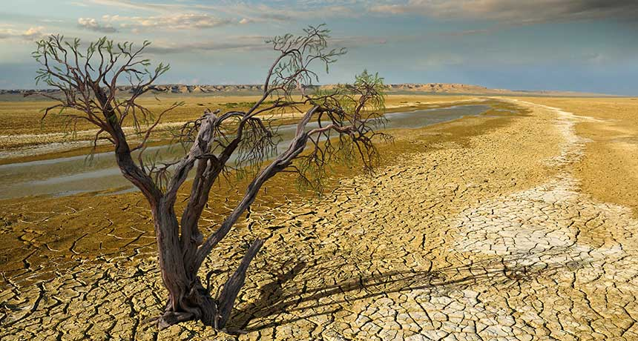

Slide 4
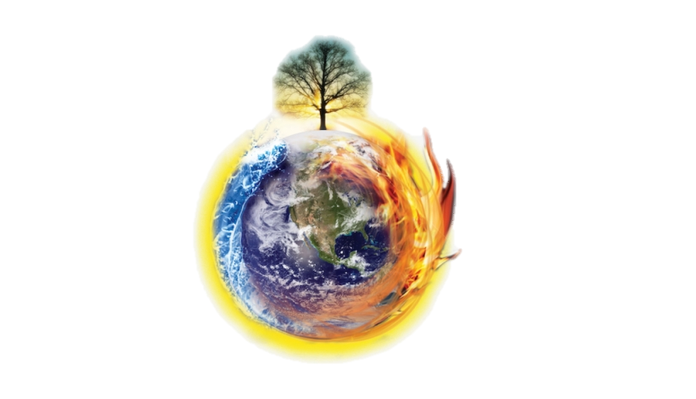
What can you see in the pictures?
The world is getting warmer.

Slide 5
Todays lesson is
The heating up of Earth!
The heating up of Earth!

Slide 6
After this lesson students will be able to…
Read and understand text;
Talk about climate and environment;
Ask and answer question.

Slide 7
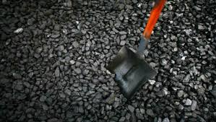
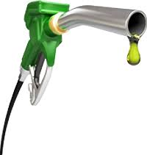
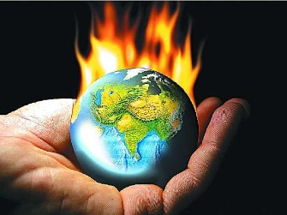
Vocabulary
Heat up
Responsible
fuels
coal
a combustible black or dark brown rock consisting chiefly of carbonized plant matter, found mainly in underground seams and used as fuel.
to become warm or hot
material such as coal, gas, or oil that is burned to produce heat or power
having an obligation to do something

Slide 8
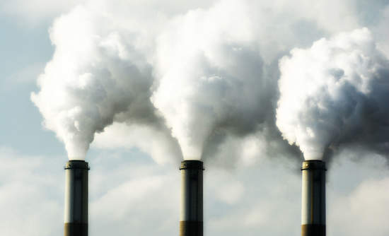
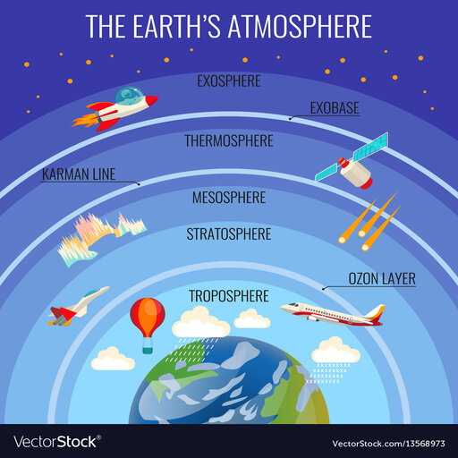
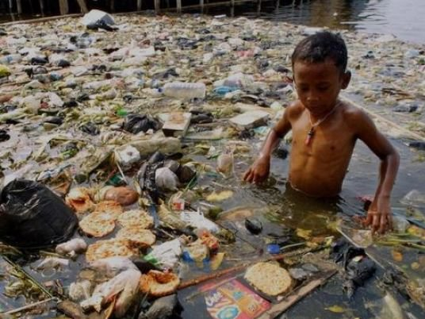
pollution
Carbon dioxide
the presence in or introduction into the environment of a substance which has harmful or poisonous effects.
a colourless, odourless gas produced by burning carbon
atmosphere
the envelope of gases surrounding the earth or another planet

Slide 9
Silent reading

Slide 10
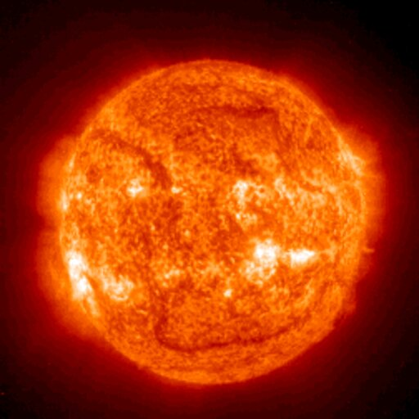
What is this picture?
The Sun is getting hotter.
It is also very old.
It is about 4500 million years old.

Slide 11
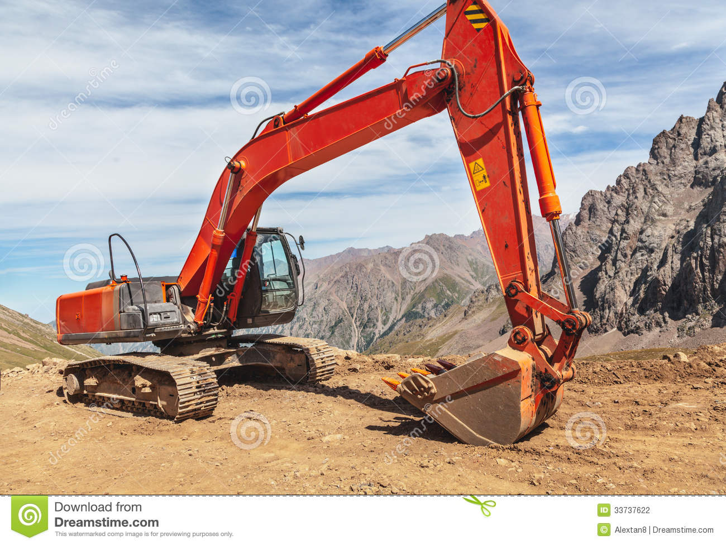
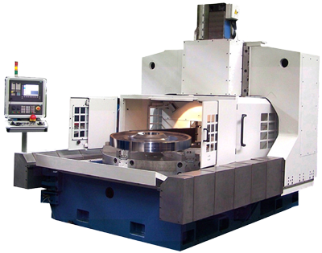
Human’s and their machines are responsible for the rapid heating up of the Earth.

Slide 12
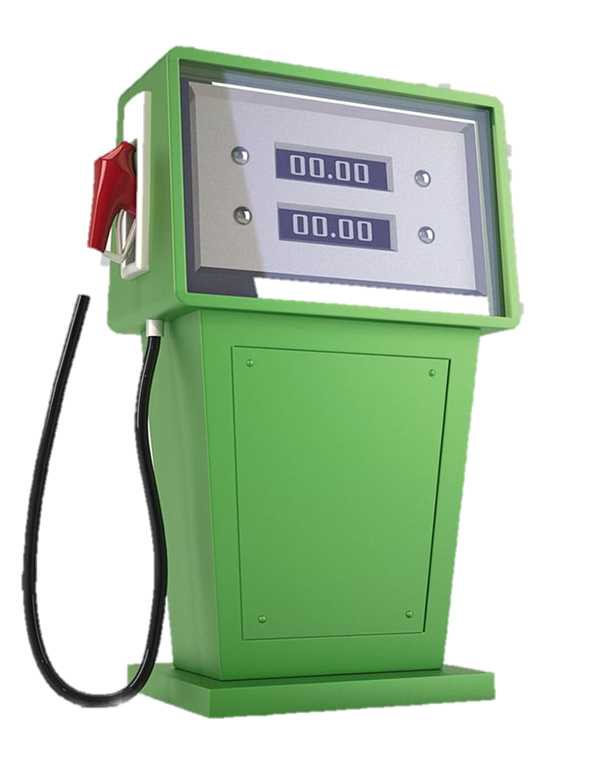
Almost all machines use fuels such as oil, gas or coal. All of them are polluting environment.

Slide 13
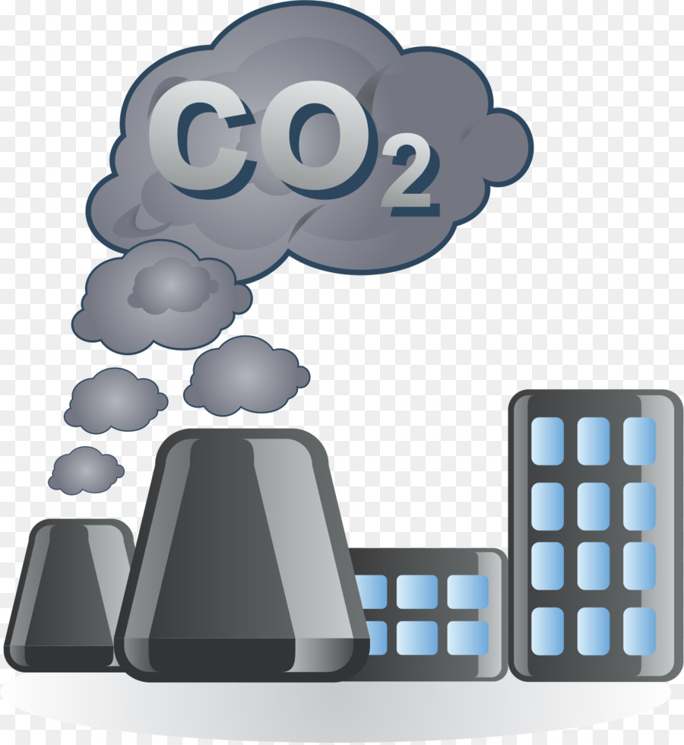
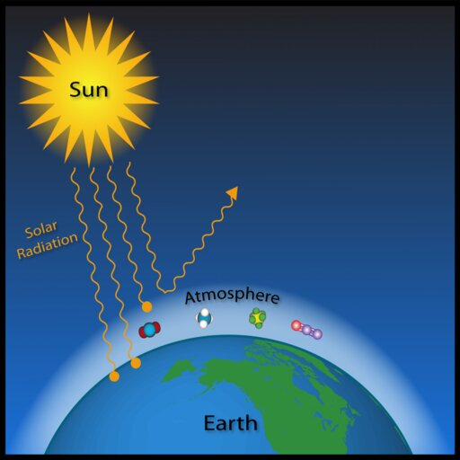
This pollution contains a gas called carbon dioxide.
It is the gas which pollutes the atmosphere.

Slide 14
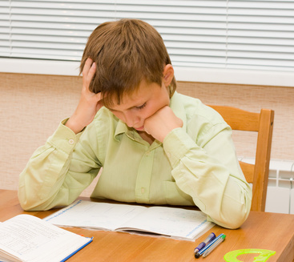
Time-10 minutes
Individual work
True or False. If False, give the correct information.

Slide 15
Match your answer
1) True.
2) False.
The correct ans- Human and their machines are responsible for the earth’s getting hotter.
3) True.
4) True.
5) False.
The correct ans- Now the sun is hotter than ten years ago.

Slide 16
Pair work
Complete the sentences with suitable words.

Slide 17
Match your answer.
fuel
1. Humans use …………………………………. To run machine.
make
2. Machine burn fuels and ………………………pollution.
substances
3. Pollution contains ……………………………such as carbon dioxide.
polluted
4. Carbon dioxide makes the atmosphere…………….
changed
5. The climate is getting…………………rapidly now.

Slide 18
Evaluation
Who is responsible for heating the earth faster?
Most of the pollution contains any gas?
What do you think should be done to avoid pollution?

Slide 19
Home Work
List the 10 things that are heating up the earth see to you?

Slide 20
Thank you all.

