Slide 2
Teacher`s Identity
Md. Abdul Wazed
Assistant teacher
Gopalpur Govt. Primary School
Ghoraghat, Dinajpur

Slide 3
Lesson
Subject : English
Class :Five
Lesson unit : Sport

Slide 4
Learning outcomes:
By the end of this lesson the students will be
able to :
1.1.2 say sentences with proper intonation.
1.5.1 read words, phrases and sentences in the text with proper pronunciation,
9.1.1 take dictation of short and simple paragraphs.
11.1.1 write simple letters to friends and relatives.

Slide 5
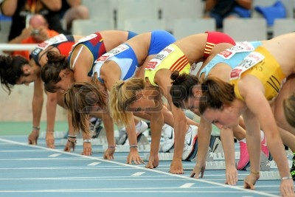
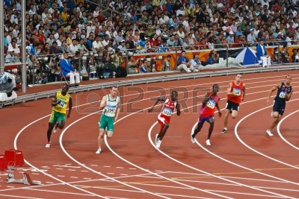
Emotion

Slide 6
DECLARATION
Sport

Slide 7
New words
biggest
competition
nation
Host city
participate
almost

Slide 8
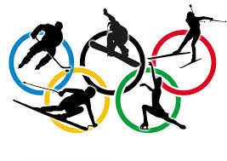
The Olympic Games
The Olympic games are the biggest sport competition in the world.

Slide 9
The Olympic Games
years
2001 | 2002 | 2003 | 2004
2005 | 2006 | 2007 | 2008
2009 | 2010 | 2011 | 2012
2013 | 2014 | 2015 | 2016
2017 | 2018 | 2019 | 2020
The Olympics are held every four years in a different host city.

Slide 10
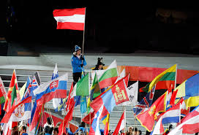
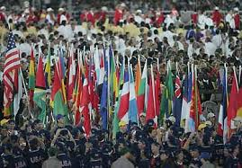
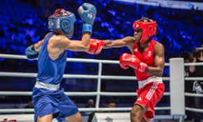
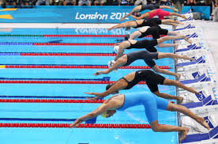
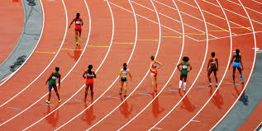
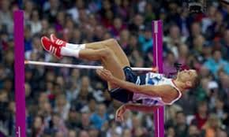
More than 200 nations send a total of about
13,000 athletes to compete in more than 30
different sports.

Slide 11
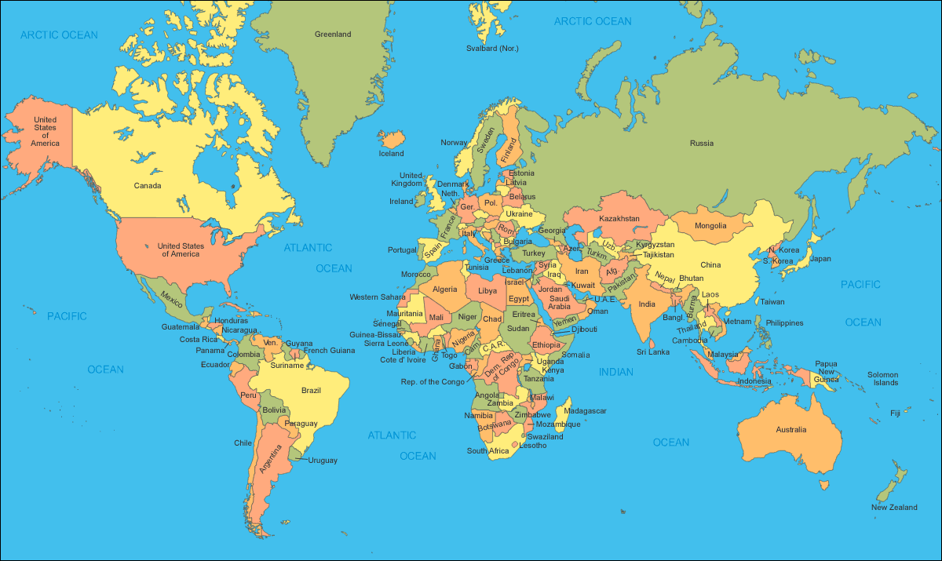
The fast Olympic games are held in Greece almost 3,000 years ago.
Greece
Bangladesh

Slide 12
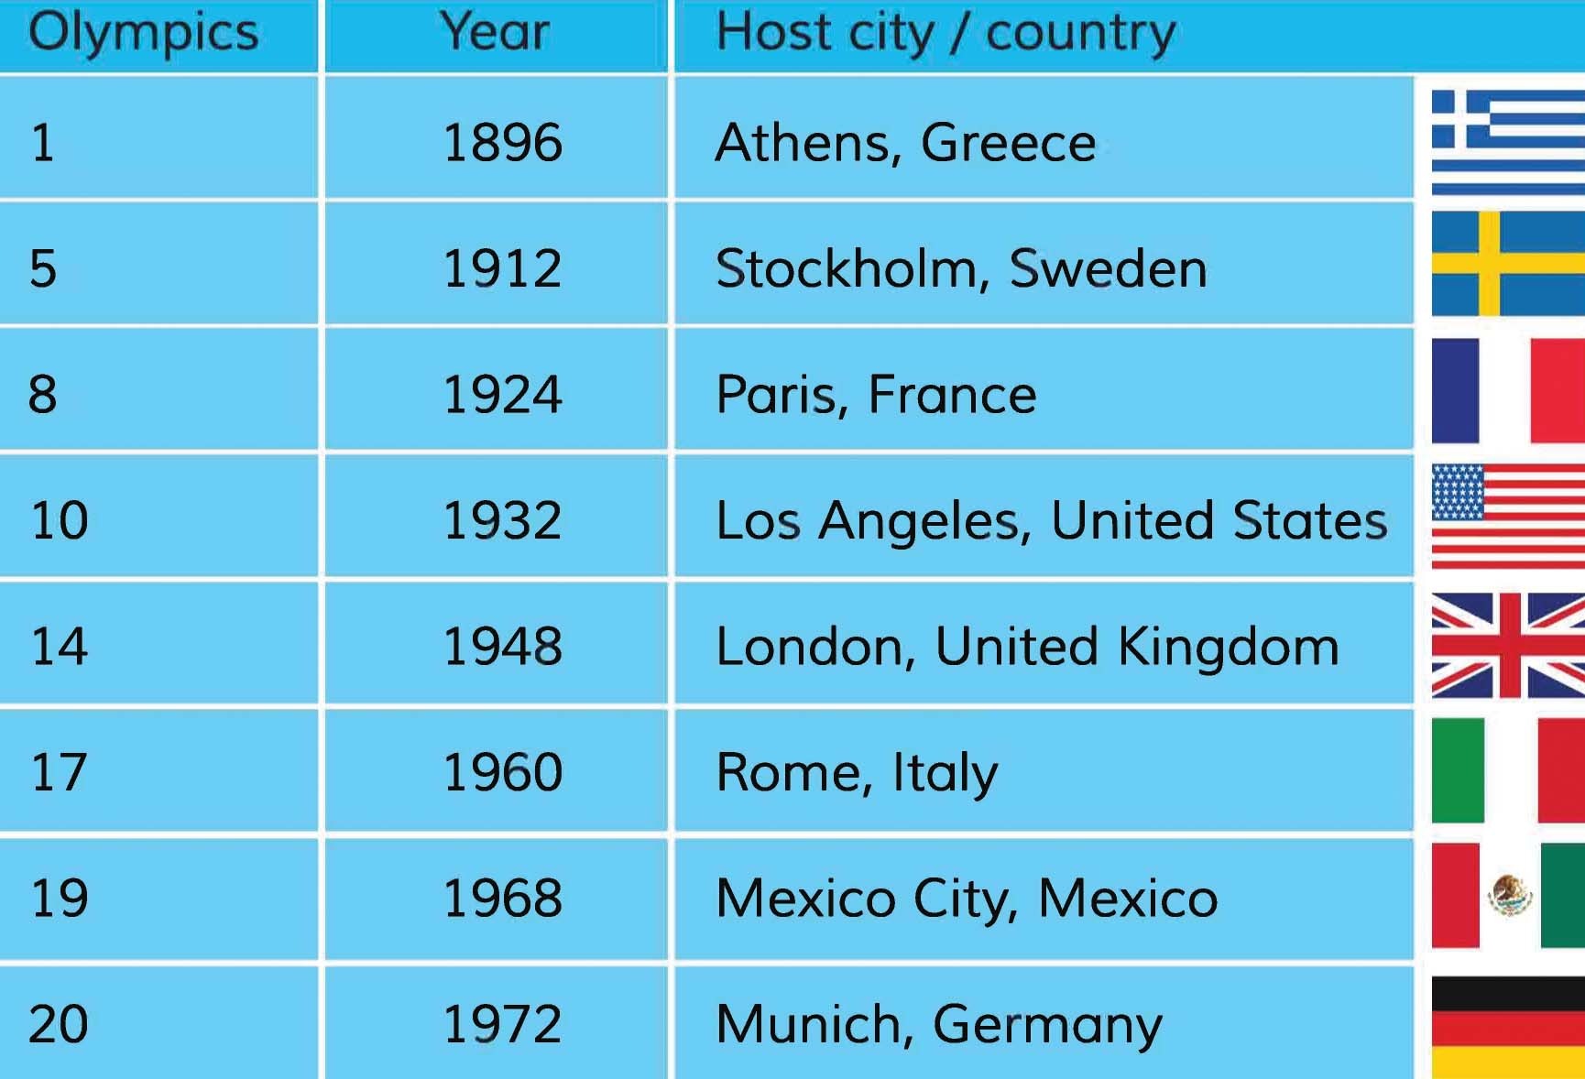
The modern Olympic games started in 1896, and there have been 31 Olympic competition since them.

Slide 13
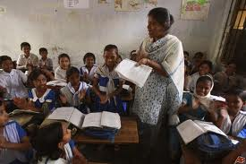
Teacher`s reading

Slide 14
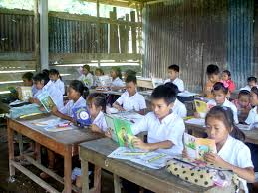
Silent reading

Slide 15
Group work
Write the answers with the help of the text:
1.What is the Olympic Games?
2. How many nations take part in this competition?
3. Where was the games first held?
4. Where does the game come from?

Slide 16
Evaluation
Put the right word in each blank:
1.The First Olympic Games started in--------
2. -------- nations participate in this games.
3. There are -------- event in the game.
4. The Olympic game are hole in every ----- year after.

Slide 17
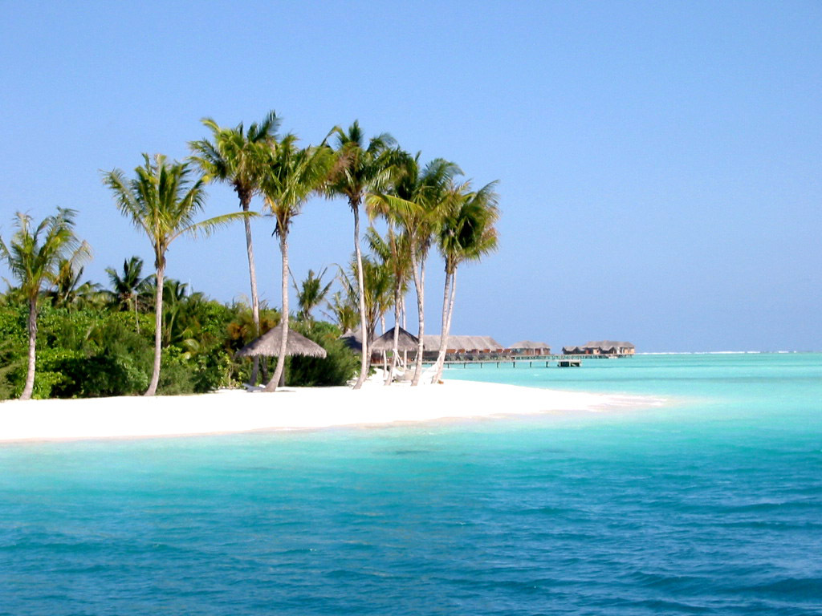
SEE YOU AGAIN
THANKS

