Slide 1

Welcome

Slide 2

Presenting for you
Lesson Contacts:
Class: one
Subject: English For Today
Unit: 27
Rhyme
Lesson: 1-3
Page: 45
Md Emran Hossen
Assistant Teacher
Kattali Nurul Haque Chowdhury Government Primary School
Pahartali, Chattogram.
01819-893135
emran81hossen@gmail.com

Slide 3
Learning Outcomes:
Students will be able to……
Listening:
1.1.1, 4.1.1
Speaking:
1.1.1, 1.1.2, 4.1.1, 4.1.2

Slide 4

How are you students? How is your health?
OK. Now enjoy a video..

Slide 5
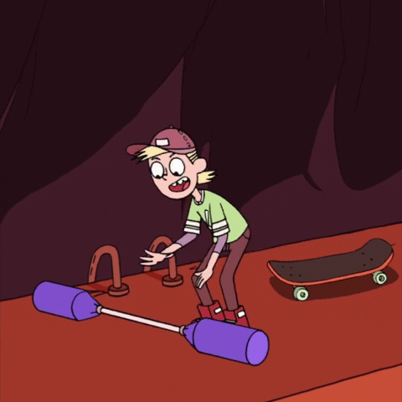

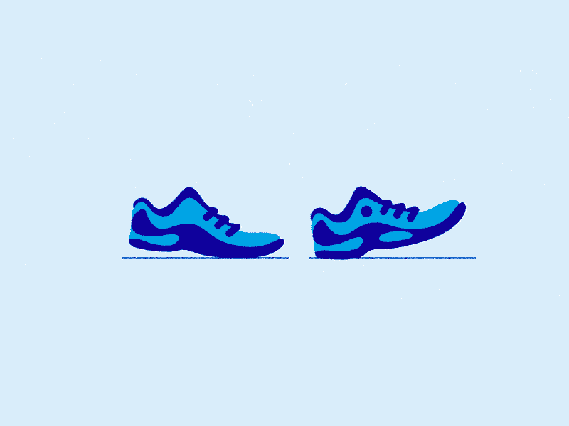
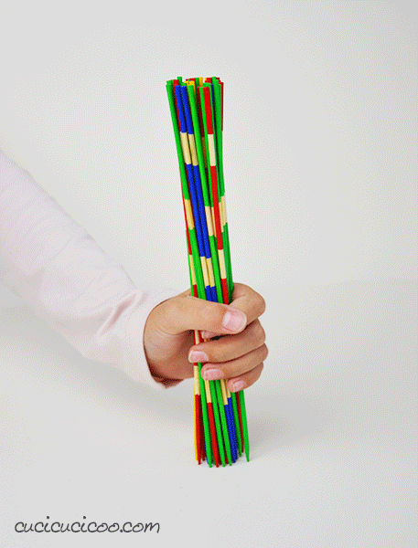
What is this?
Look at the picture.

Slide 6

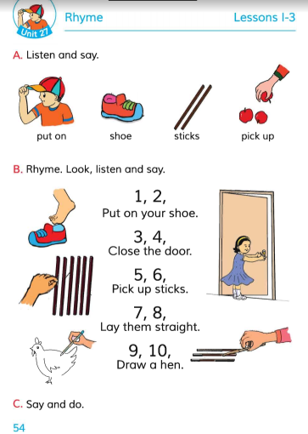





Today we will read ‘Rhyme’ at page 54.

Slide 7
Put on
Sticks
Pick up
Shoe

Slide 8
?
Put on
?
Sticks
?
?
Pick up
Shoe

Slide 9
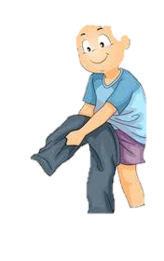
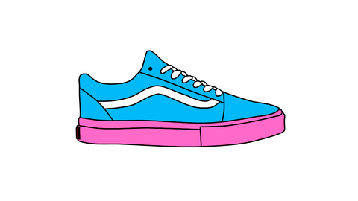

Match the words with the pictures
Sticks
Pick up
Put on
Shoe

Slide 10
Today we will enjoy a rhyme.
Do you enjoy to reciting rhyme?

Slide 11
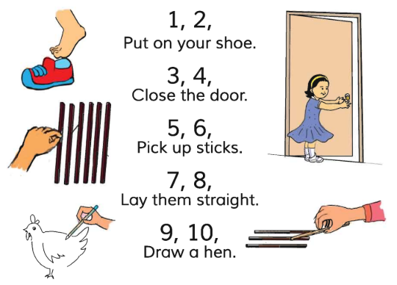
Look, listen and say after me

Slide 12
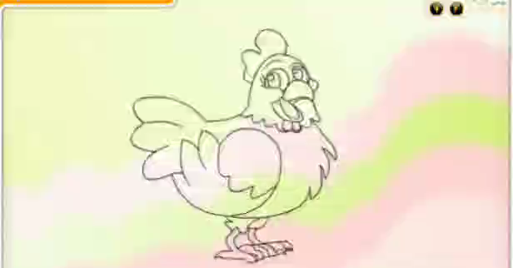
Look and listen

Slide 13
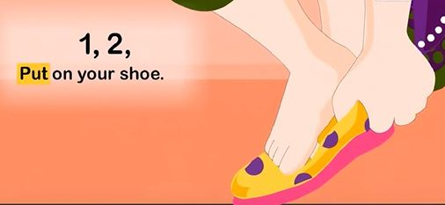
Look, listen and say after me

Slide 14
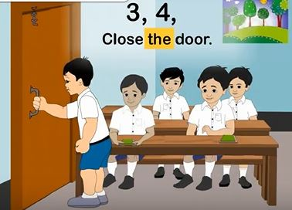
Look, listen and say after me

Slide 15
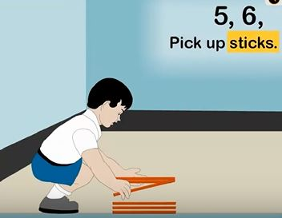
Look, listen and say after me

Slide 16
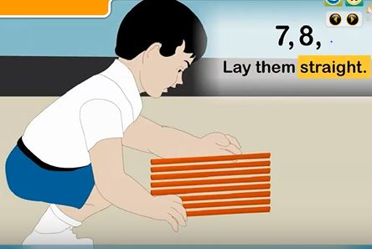
Look, listen and say after me

Slide 17
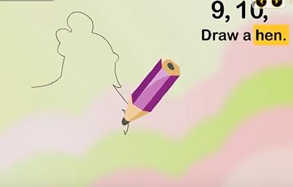
Look, listen and say after me
0

Slide 18
1 , 2
Now I will show you one line then you have to say the next line.
?
3 , 4
?
5 , 6
?
7 , 8
?
9 , 10
?

Slide 19
Look, say and find out the mistake
1 , 2
Put on your
door
3 , 4
Close the
shoe
door
5 , 6
Pick up
straight
straight
7 , 8
hen
Lay them
hen
9 , 10
Draw a
sticks

Slide 20
Now say and do
1 , 2
Put on your shoe.
3 , 4
Close the door.
5 , 6
Pick up sticks.
7 , 8
Lay them straight.
9 , 10
Draw a hen.

Slide 21

Thank you.

