Slide 2
Introducing
Mst. Najmi Khatun
Assistant Teacher
03 no. Dewpura GPS
Gomastapur Chapainawabgonaj
Class : Three
Subject: English
Lesson Unit: 29
Lesson: 1 – 3
Lesson Title: Where is it?
Today’s Lesson: (B and C)
Total Time: 40 minutes
Notes:
Page no 58

Slide 3
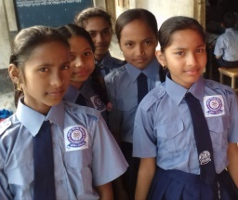
Good morning, students.
Good morning, teacher.
How are you today?
Fine. and you?
Fine, thank you.

Slide 4
Learning outcomes:
Students will be able to
Speaking: 6.2.1 talk about people and objects.
Writing: 8.1.1- write sentences from the textbook or model

Slide 5
What do you see in the picture?

Slide 6
Today's lesson
Where is it?

Slide 7
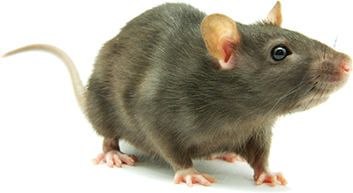
What do you see in the picture?
The rat is ..….......... the cats.
between

Slide 8
What do you see in the picture?
The bag is ………..…… the door.
In front of

Slide 9
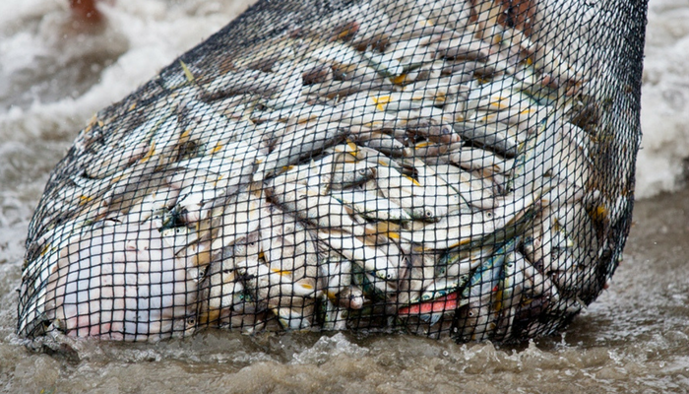
What do you see in the picture?
The fish is …… the net.
in

Slide 10
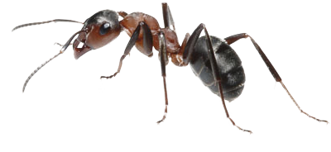
What do you see in the picture?
The ant is …… the igloo.
on

Slide 11
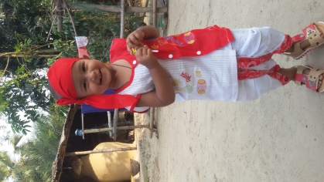
What do you see in the picture?
The girl is ……..… the tree.
behind

Slide 12
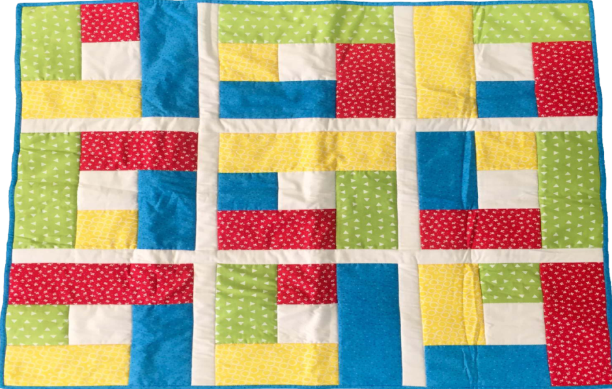
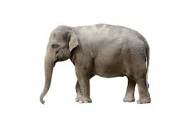
What do you see in the picture?
The elephant is …..…….. the quilt.
under

Slide 13
preposition
in
under
between
behind
In front of
on
Let’s see a chart

Slide 14
Everybody look, listen and say after me.
between
in
on
behind
under
In front of

Slide 15
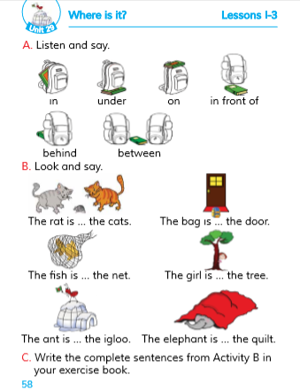
Open your book at page 58.

Slide 16
Write the complete sentences with (in, on, under, behind, in front of, between)
Group work
The rat is …… the cats.
The bag is …… the door.
The fish is …… the net.
The girl is …… the tree.
The ant is …… the igloo.
The elephant is …… the quilt.

Slide 17
Evaluation
See the pictures and say where is it.
between
in
on
behind
under
In front of

