Slide 1
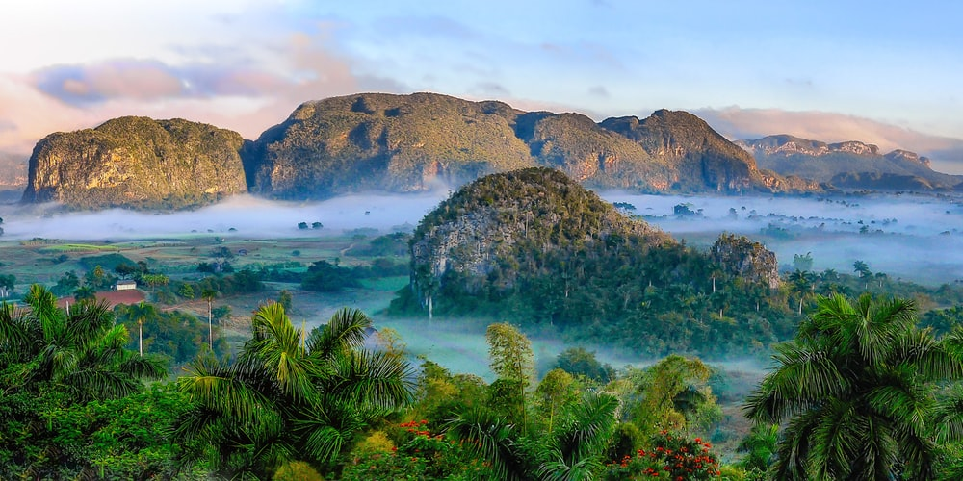
Welcome to our English class

Slide 2
Identity
Manik Chandra Majumder
Senior Teacher (English)
Gazirhat High School
Senbag, Noakhali
Mobile No: 01717155169
Email:manikmajumder01@gmail.com
Class : Nine-Ten
Subject : English 1st paper
Time : 50 Minutes
Date : 00/00/2020

Slide 3
Dear students, observe the following sentences.
In spite his poverty, he is happy.
He is poor but (he) happy.
Though/Although he is poor, he is happy.
What kind of changes do you observe in the sentences ?
Transformation of Simple to Compound & Complex

Slide 4
Our Today’s topic is-----
Simple
Complex

Slide 5
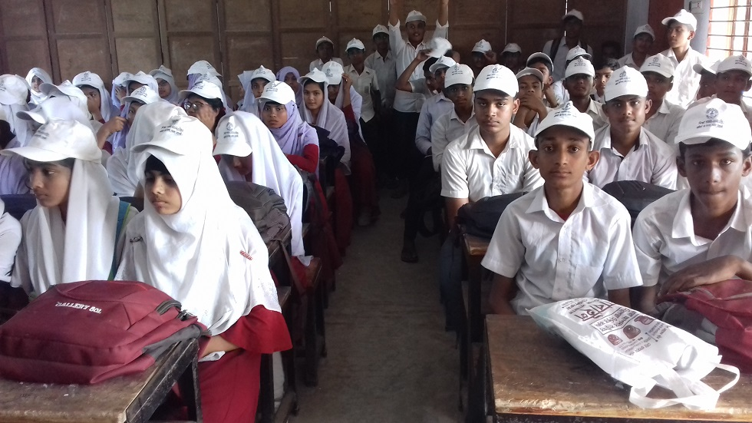
Learning Outcomes
At the end of the lesson the students will be able to
identify simple, compound & complex sentences,
make structures of each form of sentences,
change the simple form into complex.

Slide 6
The simple sentence to Complex.
Simple sentence start with In spite of ----------to Complex
Structure: Though/Although +1st clause possessive turn into sub +being turn into Be verb/having turn into Have/ Verb+ing takes Verb according to 2nd clause + Ext. words +(,)+ 2nd clause.
Simple: In spite of my going to his house, he did not meet me.
Comx: Though/Although I went to his house, he did not meet me.
Simple: In spite of going there, I could not meet him.
Comx :Though/Although I went there , I could not meet him.

Slide 7
Simple sentence start with Because of -----------to Complex.
Structure: : Since/As1st clause possessive turn into sub +being turn into Be verb/having turn into Have/ verb + ing takes Verb according to 2nd clause + Ext. Word +(,)+ 2nd clause.
Simple: Because of (his) being ill , he could not attend meeting.
Complex : Since/As he was ill , he could not attend meeting.
Simple: Because of his illness, he could not attend meeting.
Complex :Since/as he was ill , he could not attend meeting.
Simple: Because of (his) studying hard, he made a good result.
Complex : Since/As he studied hard , he made a good result.

Slide 8
Simple Sentence with too + Adjective +to +V-------to Complex
Structure: Sub+ V +So +Ext. words + that +Sub(1st) +cannot/could not +v---.
Simple : He is too weak to walk
Complex : He is so weak that he cannot walk.
Simple: The boy was too short to touch the roof.
Complex: The boy was so short that he could not touch the roof.

Slide 9
Simple Sent. start with pre. participle (v+ing /being/ having) ---to Complex.
Structure: When(time)/Since/As (cause) +2nd clause sub +being turn into be verb/having turn into have/ main verb with ing takes verb according to 2nd clause + Ext. words+(,) + 2nd clause.
Simple : Waking up , I received the phone call.
Complex : When I woke up , I received the phone call. (time)
Simple : Being disappointed, he resigned from the post.
Complex: Since/As he was disappointed, he resigned from the post. (reason)
Simple : Having forgotten him, I went to work.
Complex: Since/As I had forgotten him , I went to work. (reason)

Slide 10
Simple sentence start with By+ gerund (v+ ing ) ----to Complex
Structure: If + 2nd clause Sub + Verb + Ext. words (,)+ 2nd clause.
Simple: By drinking milk, you will get vitamin.
Complex: If you drink milk , you will get vitamin.
Simple: By working hard, we will be successful.
Complex : If we work hard , we will be successful.

Slide 11
Simple sentence start with Without+ gerund (v+ ing ) ----to Complex
Structure: If + Sub + Verb with Neg. form +Ext. words +(,) +2nd
clause.
Simple : Without working hard, you will not pass.
Complex :If you do not work hard , you will not pass.
Simple : Without drinking milk, you will not get vitamin.
Complex: If you do not drink milk you will not get vitamin.

Slide 12
Simple sentence with Infinitive (to /in order to +v)----to Complex.
Structure: Sub +verb + Ext. words + So that + Sub+ can /could + Verb + ------.
Simple : He reads attentively to pass.
Complex : He reads attentively so that he can pass .
Simple : He worked hard to succeed.
Complex : He worked hard so that he could succeed.

Slide 13
Simple sentence with present participle-----Complex.
Structure: Sub +V + object (NP) + Relative pronoun (Who/ Which) Be verb (according to object& tense + present participle
Simple: I saw a boy running in the field.
Complex: I saw a boy who was running in the field.
Simple : I saw a flying bird in the sky.
Complex : I saw a bird which he was flying in the sky.

Slide 14
Simple sentence with pronominal object ( me, us, you him, her, them-----Complex
Structure: Sub +V + pronominal object + Relative Adv. (When) +
Subjective form of object + Be verb (according to object& tense +
present participle.
Simple: I saw him coming.
Complex: I saw him when he was coming.
Simple : I saw her dancing .
Complex : I saw her when she was dancing.

Slide 15
Simple sentence with Adjective --------to Complex
Structure: Sub +V + Adj. + Noun +and +Sub+ suitable Relative pronoun + Be verb + Adjective.
Simple : Tareq is a meritorious student.
Complex :Tareq is a student who is meritorious .
Simple :Runa is an intelligent girl .
Complex : Runa is a girl who she is intelligent .
Simple : Health is wealth.
Complex: It is health which is wealth

Slide 16
Sim Sent. start with At the time + possessive +V+ ing--- complex .
Structure: Sub +verb + Ext. words + when+ sub ( possessive) + suitable verb+ -----.
Simple: At the time of his going to school, I saw the boy.
Complex: I saw the boy when he was going to school.
Simple: At the time of my taking breakfast, he came to my house.
Complex: He came to my house when I was taking my breakfast.

Slide 17
Simple sentence with point of time/age---- Complex.
Structure: Sub +verb +Ext. words + when + Appropriate Sub + suitable be verb + time.
Simple: They came here in 1971.
Complex: They came here when it was 1971.
Simple: Jerry came to the orphanage at the age of four.
Complex: Jerry came to the orphanage when he was four.
Simple: We achieved our independence in 1971.
Complex: 1971 is the time when we achieved our independence.

Slide 18
Simple sentence mentioning place---- Complex.
Structure: Place name + Be verb +the place + where + sub + verb .
Simple: He lives at Cumilla
Complex: Cumilla is the place where he lives.
Simple: Train starts and stops at station.
Complex: Station is the place where trains starts and stops.
Simple: Students learn in classroom.
Complex: Classroom is the place where students learn.

Slide 19
Evaluation
Transform the following simple sentences to complex.
She is working hard to get a prize.
The beggar was too ill to beg.
They work hard to earn money.
Health is wealth.
Sitting on chair, the girl was reading on a book.
Finding me, she acted madly.
The tea being hot, I could not drink it.
I could not attend class on account of my illness.

Slide 20
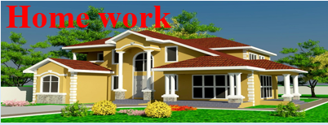
Make the simple sentences into complex.
He works hard to shine in life.
The boy is too small to carry the lo
At the time of their playing, it began to rain.
The writer took a small cabin.
By running fast, you can get the train.
Without giving up smoking, your health will be deteriorated.
The sun having set, they stopped playing.

Slide 21
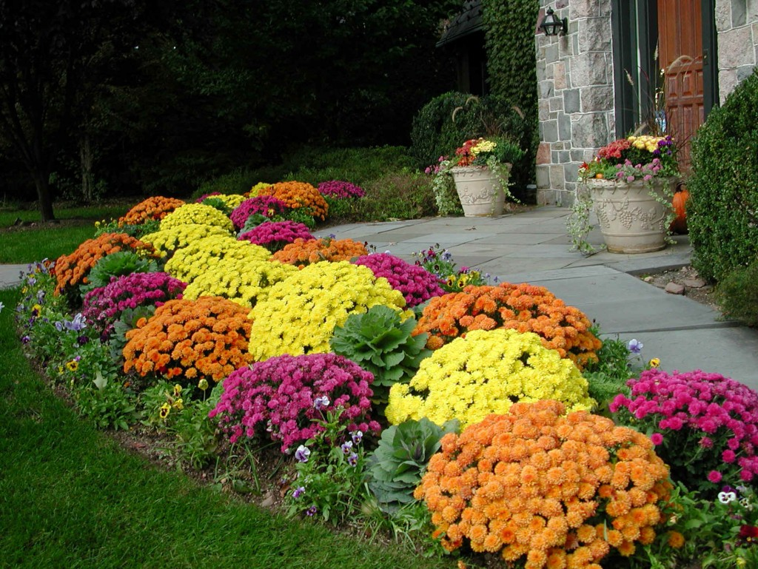
Thank you all
Good bye

