Slide 2
WELCOME

Slide 3
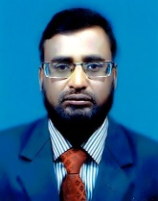
Introduction
Md.Ahsan Habib
Assistant teacher
33 no decreer char gps
Sadarpur,faridpur
ahsanhabib5183@gmail.com
Class:Three
Subject:English
Unit:12
Lesson:3-5
Time:45 mins

Slide 4
Learning outcome
Students will be able to-
1.2.1.recognize and read cursive small letters.
1.2.1.write cursive small letters.

Slide 5
Let`s see the video

Slide 6
What do we see the vedio?
Cursive small letters
(q-t)

Slide 7
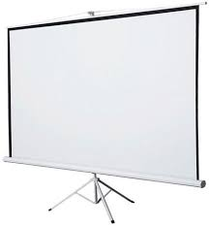
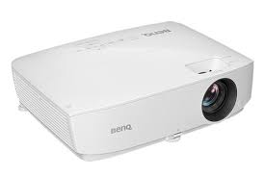
Lesson Declaration
Cursive small
(q-t)

Slide 8
Let`s see how to write cursive
Small letters

Slide 9
মোঃ আহসান হাবীব,সদরপুর,ফরিদপুর-০১৭১৮৯৮৫৮২৮,ahsanhabib5183@gmail.com
Click on the pencil to see it write.

Slide 10
মোঃ আহসান হাবীব,সদরপুর,ফরিদপুর-০১৭১৮৯৮৫৮২৮,ahsanhabib5183@gmail.com
Click on the pencil to see it write.

Slide 11
মোঃ আহসান হাবীব,সদরপুর,ফরিদপুর-০১৭১৮৯৮৫৮২৮,ahsanhabib5183@gmail.com
Click on the pencil to see it write.

Slide 12
মোঃ আহসান হাবীব,সদরপুর,ফরিদপুর-০১৭১৮৯৮৫৮২৮,ahsanhabib5183@gmail.com
Click on the pencil to see it write.

Slide 13
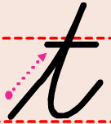
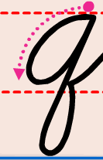
Look and say.Trace in the air

Slide 14
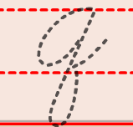
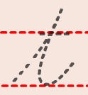
Trace and write.

Slide 15
Open at page 25

Slide 16
Look and say.Trace

Slide 17
Individual work
Write the missing letter.

Slide 18
Evaluation
Write cursive small letter q-t

Slide 19
Home work
Write cursive small letter q-t

Slide 20
GOODBYE

