Slide 1
KKT Digital World,L.P High School,Chhatak,Sunamgonj.

Slide 2
.Welcome to the KKT Digital world Presentation

Slide 3
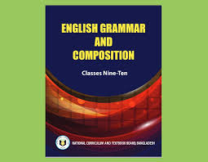
Introduction
Komal Kanta Ray Talukder
Assistant Teacher
L.P High School
Chhatak,Sunamgonj.
Presentation-made by
Class:Nine/Ten
Subject:English 2nd Paper
Transformation of Sentences
Part-3

Slide 4
Let us watch and
guess a video
The sea is so dangerous.
How dangerous the sea is!

Slide 5
Our today’s topic is--
Transformation of sentence
Part-3 (Assertive to Exclamatory)

Slide 6
Learning outcomes
After completing this lesson,we will be able to-
identify assertive sentence.
identify exclamatory sentence and its classifications.
change from assertive to exclamatory sentence.

Slide 7
Let us see a video

Slide 8
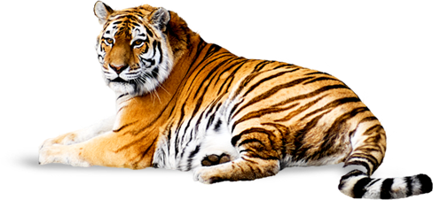
The tiger is a ferocious animal.
Assertive sentence
What a ferocious animal the tiger is!.
Exclamatory sentence

Slide 9
Structure of Assertive Sentence
Structure of Assertive Sentence
Structure of Assertive Sentence
(a) Subject + verb +a/an + adjective +noun
(‘very/so/too/great’ may have or not after verb)
(b)Subject +verb +adjective
(‘very/so/too/great’ may have or not after verb)
It is a very interesting story. / It is an interesting story.
It is very interesting./ It is interesting.

Slide 10
Structure of Exclamatory Sentence
(a) What + a/an + adjective +subject + verb +!
( adverb ‘very/so/too/great’ will be omitted)
(b) Subject +verb +adjective
( adverb ‘very/so/too/great’ will be omitted)
Note: Assertive with a/an begins with ‘What’
Assertive without a/an begins with ‘How’
What an interesting story it is!
How interesting it is!

Slide 11
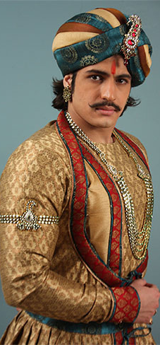
Class Activities
Change the sentences into Exclamatory
Akbar was a very powerful king of India.
He was very handsome.
There was an aristocratic throne for him.
It looked very gorgeous.
He was indeed a successful king.

Slide 12
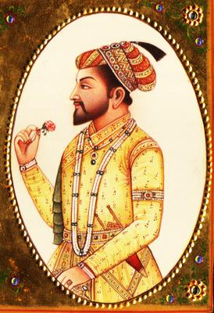
Had I the wings of a bird!
I wish I had the wings of a bird.
I wish I were a king.
If I were a king!
I wish< If/Had +subject +Extension +!

Slide 13
Activities at home
The Padma is a very big river.
It is so deep.
The river contains a vast water.
The water of the river is very useful for the people.
It is beneficial for cultivation.
The fishermen enjoy fishing in the river very cheerfully.
The fish of this river is really tasty.
I wish I had a boat.
I wish I were a fisher man.
I like the river very dearly.

Slide 14
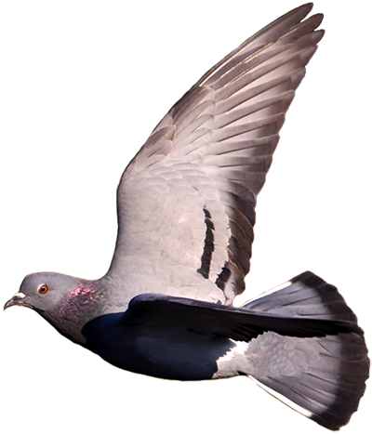
Inviting to part-4
May God keep you safe and sound.

