Slide 1
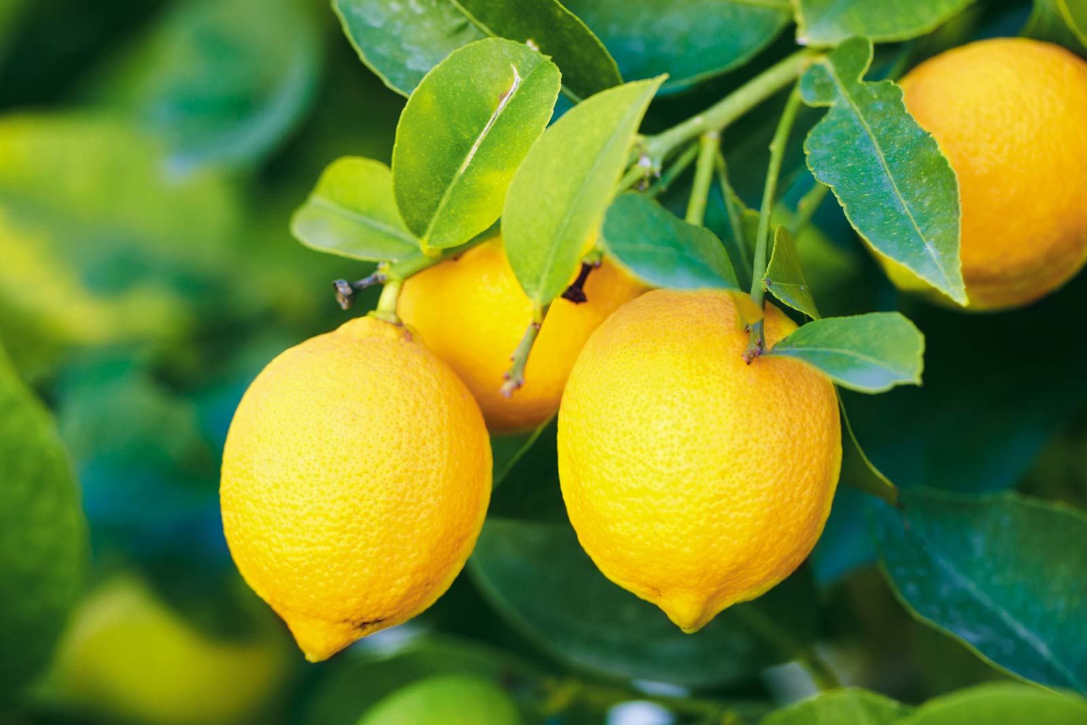
Welcome to My New Class

Slide 3
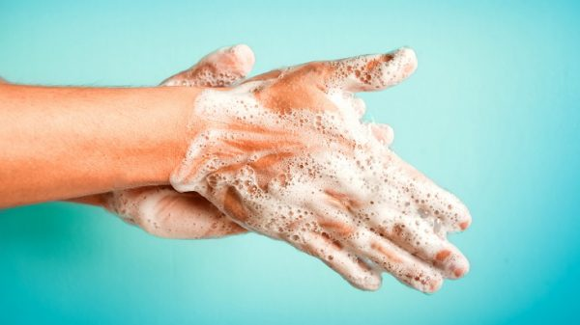
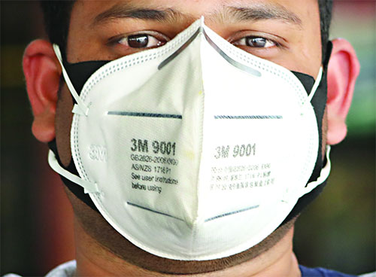
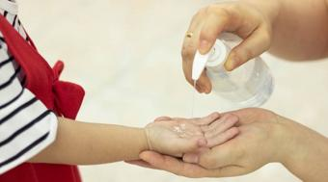
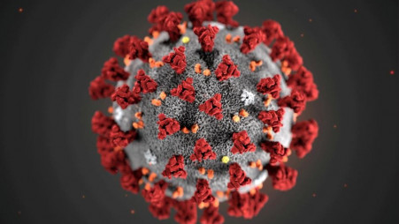
Seeing the pictures, guess the topic

Slide 4
Today’s topic is
Dialogue
A dialogue between two friend about Corona Virus
For Class: Nine/Ten
Subject: English First

Slide 5
Myself: Hi Nazrul, how are you?
Nazrul: Hi, I’m well and you?
Myself: I’m also well. You looked worried what happen?
Nazrul: I’m thinking about Corona virus. It is very dangerous and it has no remedies. What do you know about it?

Slide 6
Myself: Well, it is the burning question of the world. It has lock down the whole world. Also there is death toll in most of the countries. We are afraid of it. What about you?
Nazrul: It is also spreading in our country because the people of our country aren’t conscious of it. They do not follow the codes of conduct and the rules of govt. and WHO.
Myself: As a result there may cause great disaster in our country.
Nazrul: How can we save ourselves?

Slide 7
Myself: We have to follow the rules of good health prescribed by the WHO. We have to eat balanced diet, wash our hands with soap or hand-wash, wear mask when we go out, after returning from out-side, wash ourselves to protect from virus because “prevention is better than cure”.
Nazrul : You are right. We have to follow all these rules to save ourselves from corona virus. Thank you very much for your kind informations . It is high time I left the place. Bye.
Myself: You are most wecolme. Bye. See you.

Slide 8
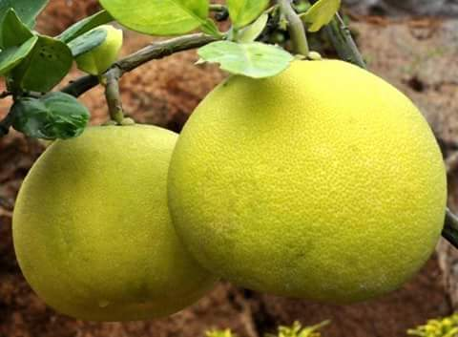
Pair Work :
Practise the dialogue between two partner.

Slide 9
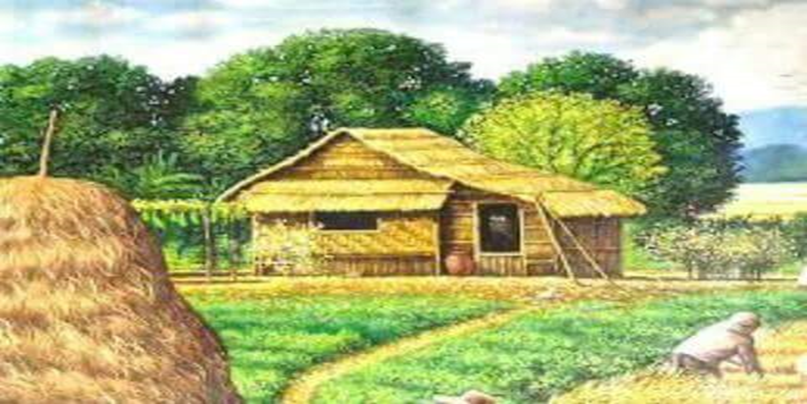
HW : Write a dialogue between two friend about dengue fever.

Slide 10
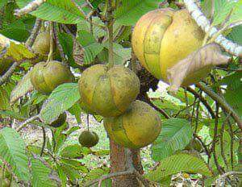
Goodbye Students

