Slide 1

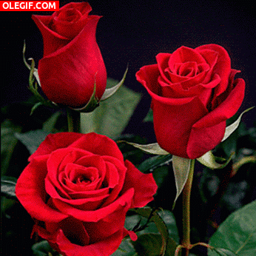
Welcome to English class .

Slide 2
Identity
Teacher
Class
Md.Ilias Ahmed
B.A(Hons)English ,M.A (English) ,B.Ed
Assistant Teacher ( English )
Polisha High School ,Madarganj
ID No – 03
E-mail – ilias.ahcb@gmail.com
Class : Nine
Subject : English 1st Paper
Unit - 03
Time : 50 minute
Date : 13-03-2019

Slide 3

Watch this Video attentively
Upload a Related video Here . Esho he boishakh Edo Edo song should be uploaded here . You can find it in YouTube.

Slide 4

What’s the video about ?
Where do you think the video was taken ?
What are the people doing ?

Slide 5
Pahela Boishakh

Slide 6
After we have studied this unit ,we will be able to
talk about events and festivals.
ask and answer questions.
infer meanings from the context .

Slide 7
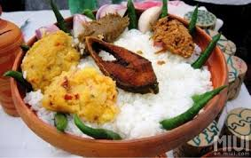
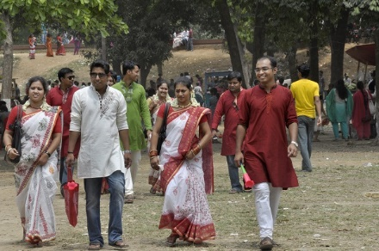
Women wear sarees with colorful churies and flowers and men dress themselves in pajamas and punjabis .People love to eat traditional food .

Slide 8
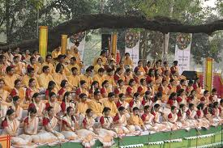
Hundreds and thousands people attend the cultural function at Ramna Batamul organized by Chhayanaut .The programme starts with famous Tagore-song Esho-he-Boishakh,Esho Esho......

Slide 9
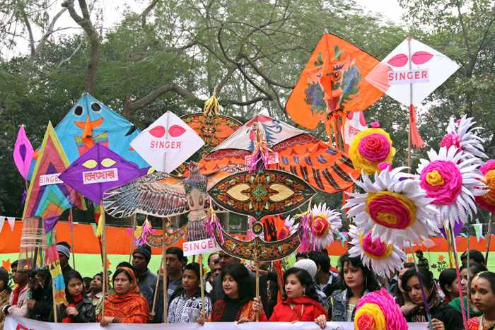
Colorful processions , the biggest carnival of the country , organized by the Fine Arts students of Dhaka University .

Slide 10
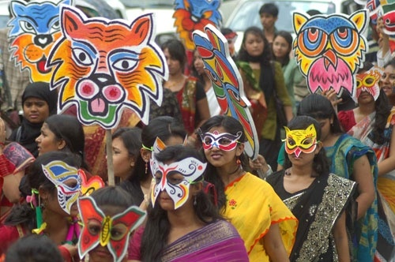
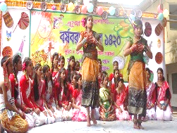
1
2
The masks and wreaths worn by the people .It symbolizes contemporary worries or happiness in the national life.
Different social and cultural organizations and educational institutions celebrate the day with their own cultural programs

Slide 11
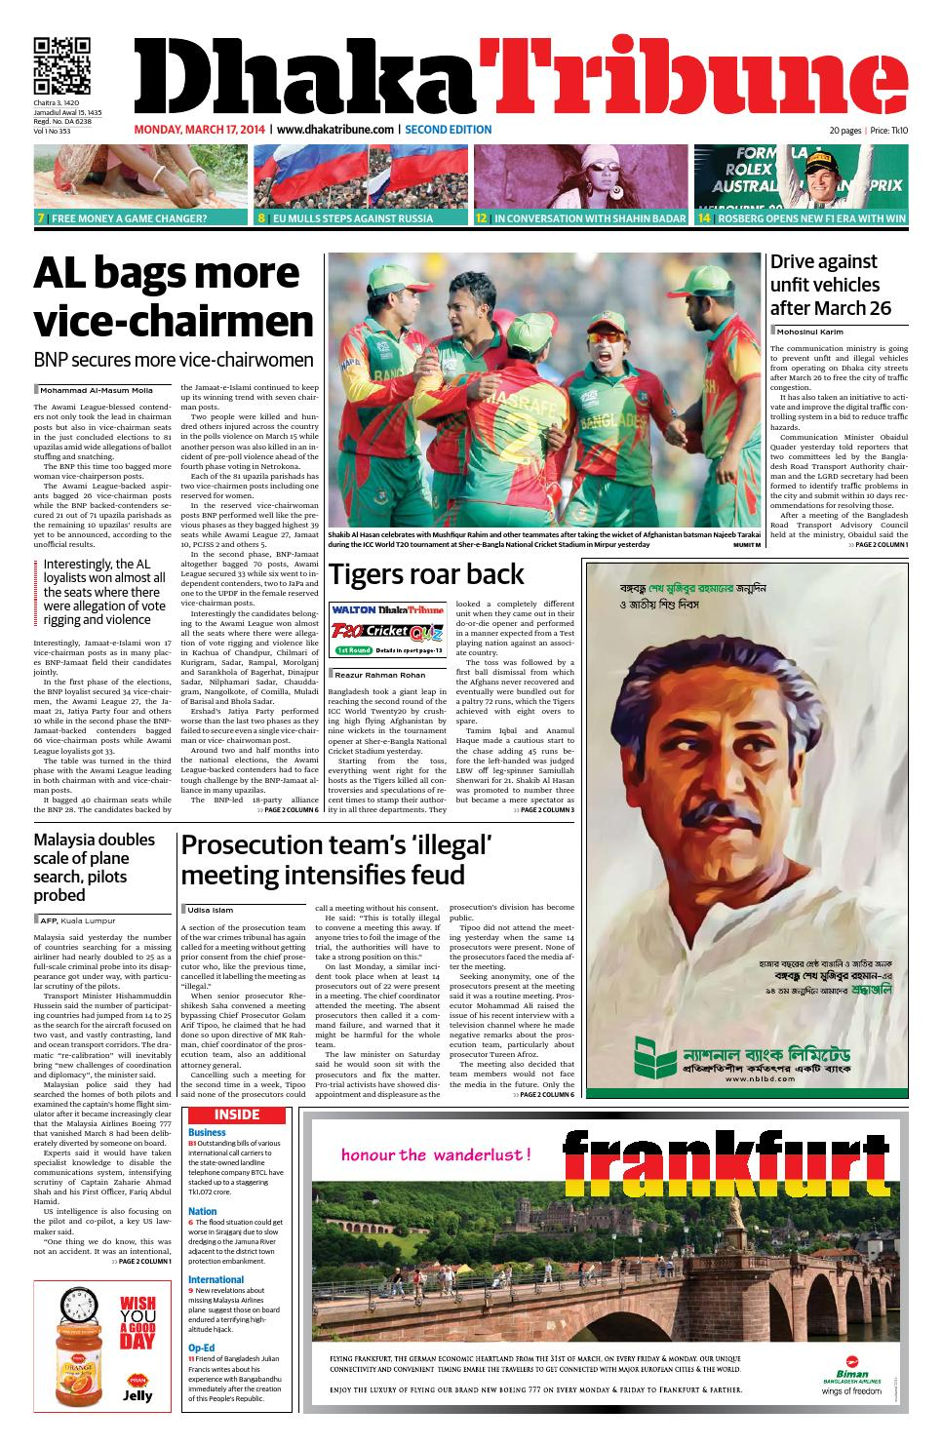
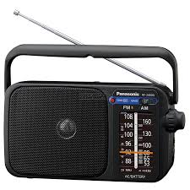
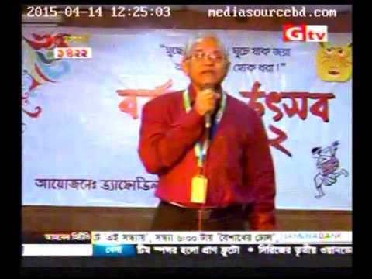
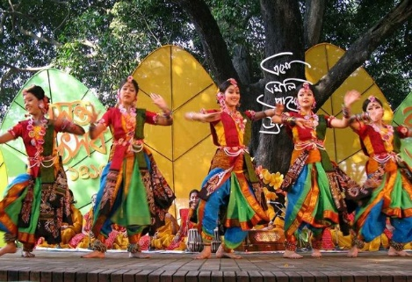
picture -01
picture-2
picture-03
On this day , Newspaper bring out special supplement . There are also special programs on the radio and television .

Slide 12
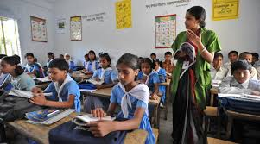
Read the text silently – Page Number-38 , Lesson-06 Section-B
Time : 10 minute

Slide 13
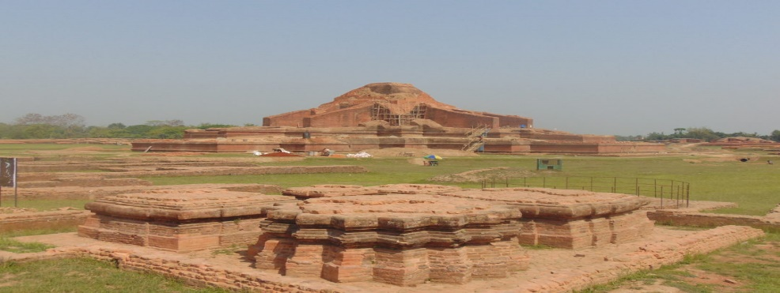
Word meaning
Tradition
heritage
meaning
Pahela Boishakh is a part of Bangalee culture and tradition

Slide 14
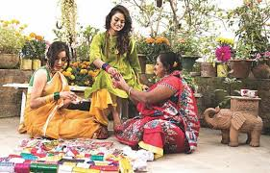
Word meaning
Adorn
decorate
meaning
Women adorn themselves on this day .

Slide 15
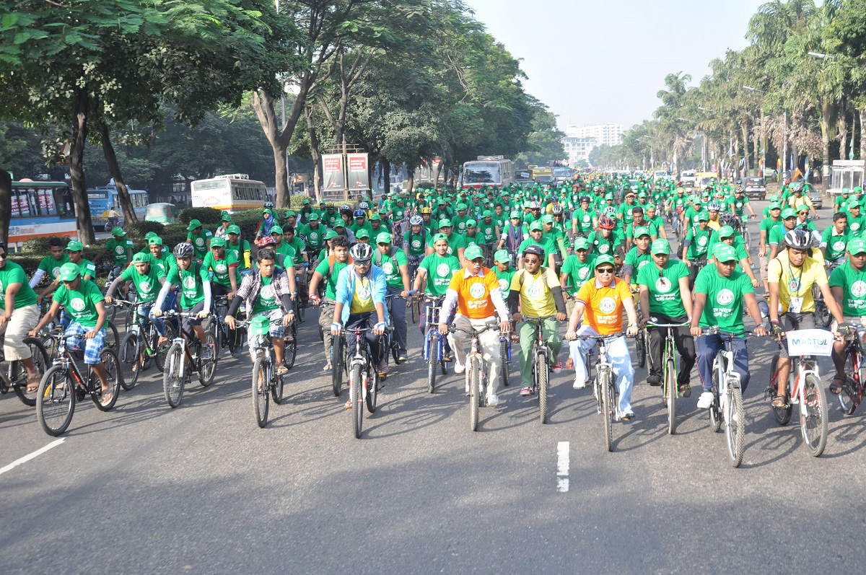
Processions
Rally
meaning
People join the colorful processions .

Slide 16


Irrespective
Man
woman
meaning
Equal
People join the procession irrespective of their caste and creed.

Slide 17
Group work
Complete the passage with suitable words. ( Time : 10 Minute)
The word pahela means the first Boishakh is the (a)....... month of Bangla calendar. The day is observe not (b)…...... in Bangladesh but(c)…........in some other parts of the world. It is celebrated in West Bengal, Asam, and Tripura. It is also (d)…......celebrated in Australia and the UK . In Australia, the largest (e)…..........for bangla new year is the Sydney Boishakhi Mela held (f)…..Sydney Olympic Park. In England, the Bangalees (g)…..celebrate the day with a street (h)…..in London. It is the (i) …..Asian festival in Europe, (j)…… Bangladesh and West Bengal.

Slide 18
Match the answers.
Complete the passage with suitable words.
The word pahela means the first Boishakh is the (a) first month of Bangla calendar. The day is observe not (b)only in Bangladesh but(c)also in some other parts of the world. It is celebrated in West Bengal, Asam, and Tripura. It is also (d) celebrated in Australia and the UK . In Australia, the largest (e)festival for bangla new year is the Sydney Boishakhi Mela held(f)near Sydney Olympic Park. In England, the Bangalees(g)generally celebrate the day with a street(h)show in London. It is the(i)largest Asian festival in Europe, (j)America ,Bangladesh and West Bengal.

Slide 19

Evaluation
Choose the best answer from the alternatives
Q : a) On the occasion of Pahela Boishakh people are in .......
mood .
i. gloomy
ii. reluctant
iii. sad
iv. festive
Q : b) On Pahela Boishakh people eat.....food .
ii. traditional
i. junk
iii. rich
iv. balanced

Slide 20
Q : c) The cultural function at Ramna Batamul is
organised by……….. .
i. Fine Arts
ii. Shilpakala Academy
iii. Chhayanaut
iv. Bangla Academy
Q : d) The day is celebrated……………….
i. internationally
ii. traditionally
iii. gorgeously
iv. lavishly

Slide 21

Home work
Write a paragraph about ‘Pahela Boishakh’.

Slide 22

Thank you very much

