Slide 1
TO
Multimedia Class

Slide 2
TEACHER
LESSON
I
D
E
N
T
I
T
Y
Mohammod Abdul Hannan
Assistant teacher
Chunghor Govt. Primary School
Kulaura, Moulvibazar.
Class:Five,
Unit:14. Lesson: 3 – 4
Lesson title: The hare and tortoise
Time :40 minute

Slide 3
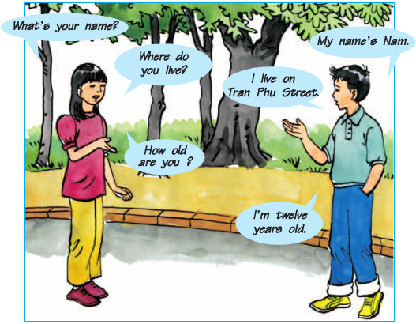
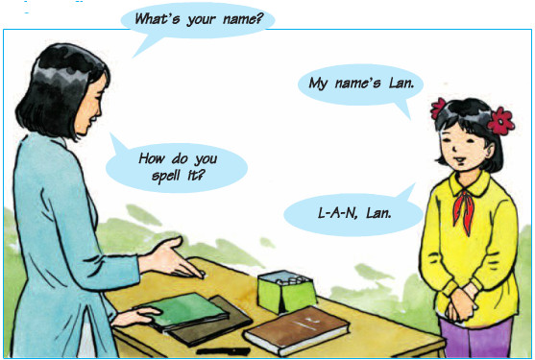
THINK ABOUT THE PICTURES AND TELL ABOUT IT
THEY are Asking QUESTION ‍ and answer ONE ANOTHER

Slide 4
Today’s Lesson
The hare and the tortoise
Part:B

Slide 5
Topic
Turn sentences into question
using WH word

Slide 6
Learning outcomes
Students will be able to…
8.1.1- make sentences using words and phrases.

Slide 7
WH word
বাংলা অর্থ
What = কি
Who = কে
Where = কোথায়
Whom = কাকে
Whose = কার
How = কত / কেমন
/ কিভাবে
When = কখন
Which = কোনটি

Slide 8
Today I shall discuss about the following
two WH words
Who = কে (ব্যক্তিকে বুঝায়) Use for person | What = কি (বস্তু / পেশা / নাম বুঝায়) Use for thing or work/profession/name

Slide 9
What we need to know first
Subject= বাক্যের মধ্যে যে কোন কাজ করে
Verb = যে শব্দ দিয়ে কোন কাজ করা বুঝায়
Verb এর present form = কাজটি বর্তমান সময়ের বুঝায়
Verb এর past form = কাজটি অতীত সময়ের বুঝায়
Main Verb = যে শব্দ দ্বারা সরাসরি কোন কাজ বুঝায় এবং এর নিজস্ব অর্থ আছে
সাহায্যকারী Verb = যে verb main verb এর অর্থ প্রকাশে সাহায্য করে
যেমন- ‍am, is, are, was, were, shall, will, have, has ইত্যাদি
Do verb = Do, Does, Did,
Singular number বলতে একজন ব্যক্তি বা একটিমাত্র বস্তুকে বুঝায়
Plural number বলতে একজনের বেশি ব্যক্তি বা একাধিক বস্তুকে বুঝায়

Slide 10
Person
Let’s know a little bit
Person of 3 kinds
Singular Number
Plural Number
1st person
I, Me, My
We, Our
2nd person
You
Your
3rd person
He, She, It, Rahim
They, Them, Their

Slide 11
Who
Subject
সাহায্যকারী verb
Statement: Jesica is going to Chattagram.
3rd person singular
Question: Who is going to Chattagram?
Subject
verb+s/es
Statement: Andy works with an NGO in Bangladesh.
3rd person singular
Question: Who works with an NGO in Bangladesh?

Slide 12
What
Subject
thing
Statement: They listen to music.
3rd person plural
Question: What do they listen to ?
Subject
সাহায্যকারী verb
thing
Statement: He is reading a book about Bangladesh.
3rd person singular
Question: What is he reading ?
Subject
verb+s/es
noun/নাম
Statement: Biju loves swimming.
3rd person singular
Question: What does Biju love?

Slide 13
Subject
verb এর past form
Statement: The hare loughed and loughed.
3rd person singular
Question: What did the hare do ?
Subject
verb এর present form
Statement: People sing a song for the person.
3rd person plural
Question: What do people do for the person ?

Slide 14
Pair work and Evaluation
Turn the following statements into question
1. The hare went to sleep.
Q:
Who went to sleep?
2. He took a nap during the race.
Q:
What did he take during the race?
3. He is the slowest animal in the forest.
Q:
Who is the slowest animal in the forest?
4. The hare was walking in the forest.
Q:
What was the hare doing in the forest?

Slide 15
Exercise for worked out
H
O
M
E
W O R K
1. Statement: Kazi Nazrul Islam is our national poet.
Question:
2. Statement: Rahat sits next to Hasan in school .
Question:
3. Statement: He started to think deeply about creator .
Question:
4. Statement: Rice , ruti, and bread are made from grain.
Question:
5.Statement: The hare saw the tortoise.
Question:

Slide 16
See you the next class

