Slide 1
WELCOME

Slide 2
Introduction
Sultan Ahmed Miazi
Assistant Teacher (English)
Balia k.B.D.N.Dakhil Madrasah,
Chandpur Sadar,Chandpur.
sultanshapdi@gmail.com
01817106106
ENGLISH FOR TO DAY
Classes—9&10
Unit—Three
Lesson—2
Ss.p.-60
Time:50 minutes
Date-01-05-2020

Slide 3
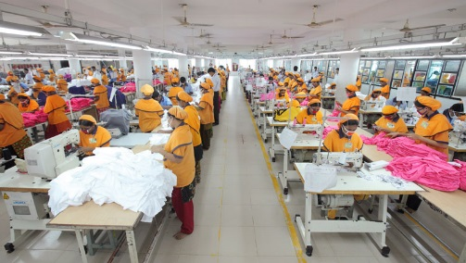
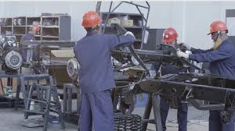
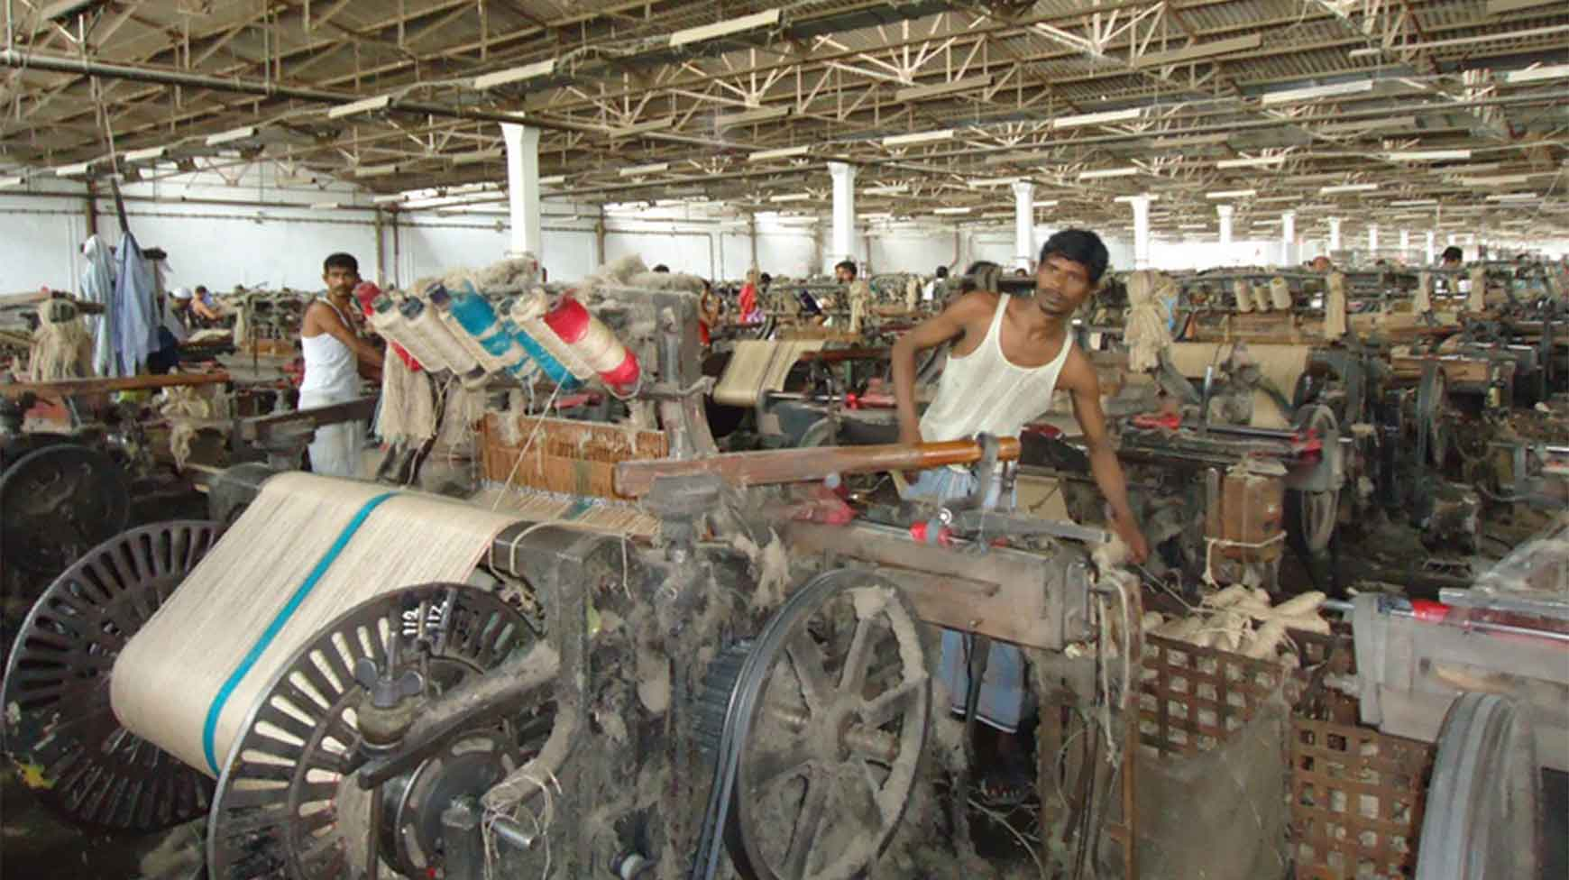
Who are they? What are they doing?
They are workers. They are working in mill- factories.

Slide 4
Topic-MayDay

Slide 5
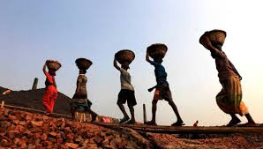
This is hard work in the field.

Slide 6
Learning Outcomes.
By the end of 4he lesson learners will be able to-------
talk about the history of May Day;
find out new words;
ask and answer questions;
-----

Slide 7
Read text section B individually and find out new words.
Suffering injury
Wounded
rally
to call persons together a for common action.
Struggle
to contend with an opposing force.

Slide 8
Read the text again and discuss the answers in pair.
1What does May Day refer to?
Ans. May Day refers to the historical struggle and sacrifices of the working people of a large factory Chicago,USA. They raised protest against fourteen hours and demanded eight hours workday.

Slide 9
2 .How long did the workers have to work in a day before the May 1 strike?
Ans. The workers had to work a long shift fourteen or even more hour a day before May 1 strike.

Slide 10
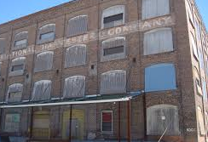
McCormick Harvesting Machine Company in Chicago.
3.Why did the workers in Chicago go on a strike?
Ans. The workers in Chicago went on strike demanding eight—hour workday.

Slide 11
Evaluation
What is the significance of May Day?
How many workers were injured on that day?
What were the casualties on May Ist,1889?

Slide 12
Home work
Write a paragraph on` The life of a worker` in 50 words using clues from the box in section C.

Slide 13
Good Bye

