Slide 1
Welcome to my class

Slide 2
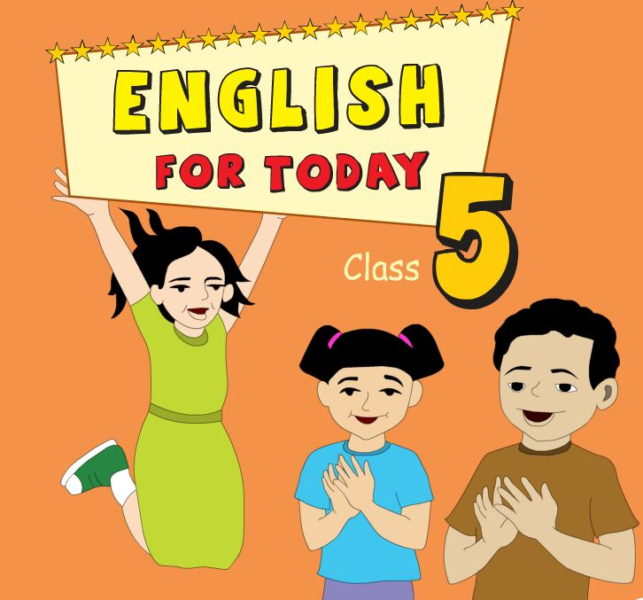
Subject : English
Unit: 10
Lesson: 1-2
Part of lesson: Kishoreganj—home district.
Page:38,39
Raihana Haque
Head teacher
Banshgari one GPS
Bhairab,Kishoreganj

Slide 3
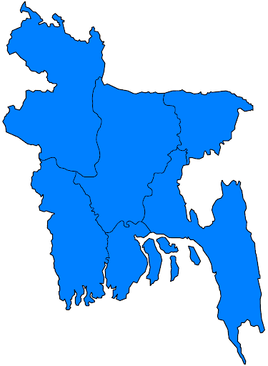
Look at the picture
What have you seen in the picture?
Kishoreganj
Dhaka
Yes, you can remember , because yesterday we read about Mamun’s home district.

Slide 4
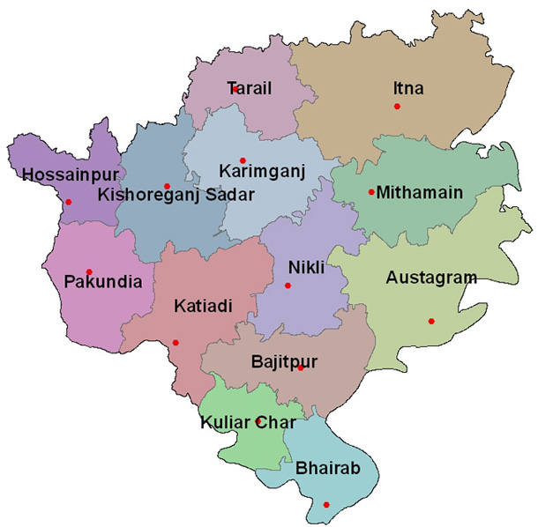
Today we will read the next text….
My home district

Slide 5
Learning outcomes:
Students will be able to….
4.2.1 Understand and enjoy sample stories.
1. 1.2 Say sentences with proper intonations.
1.7.1 read paragraphs , dialogue stories.

Slide 6
Open at page -38
Teachers reading
Look and listen carefully

Slide 7
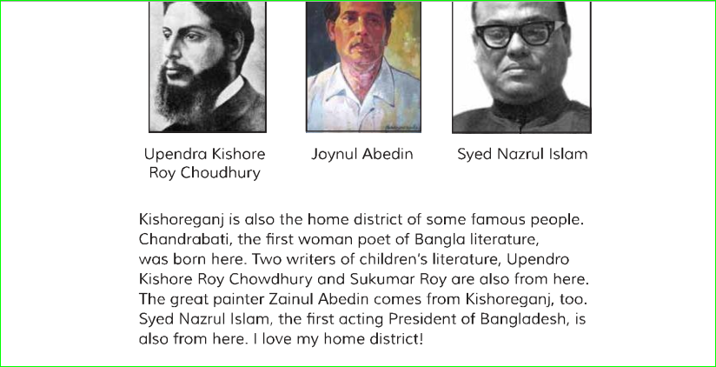
I am playing an audio and you listen and read attaintively .

Slide 8
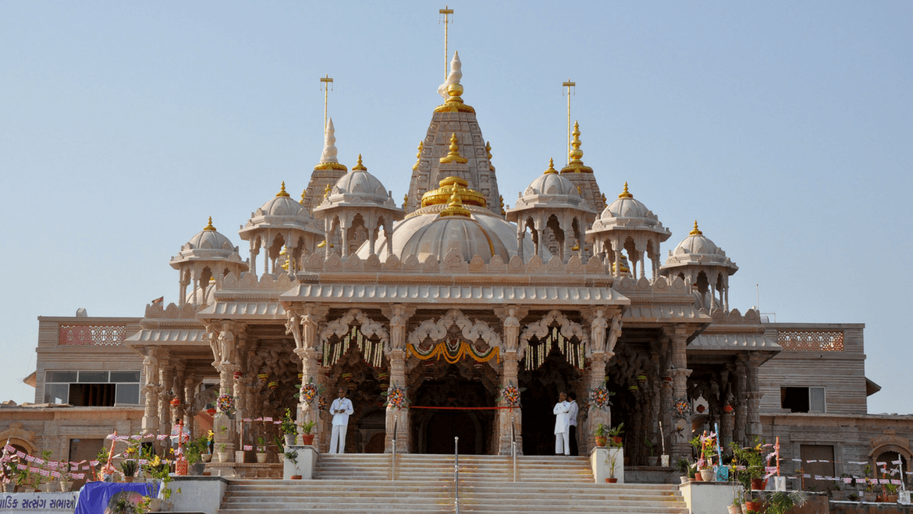
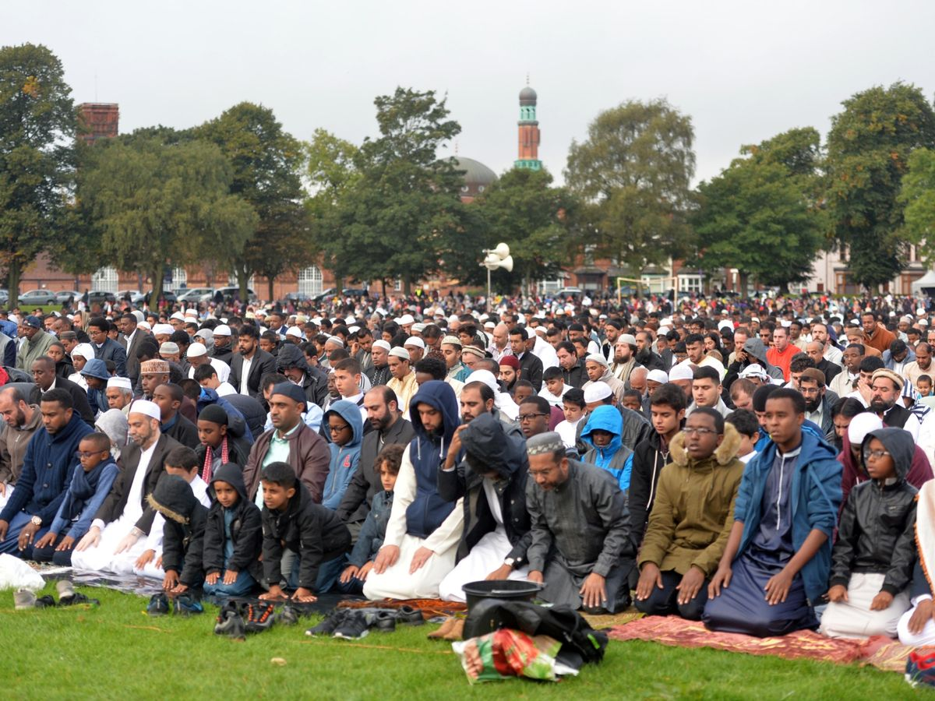
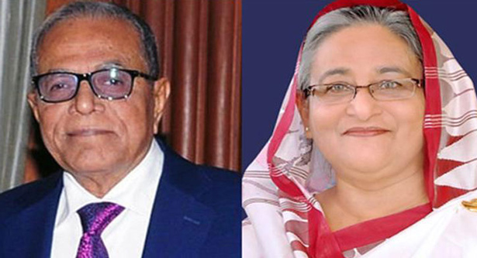
New words
Temple
Place of worship
There is a temple in our village.
Fairground
Muslims Eid celebration in the field
The Muslim's go to the Eid fairground.
Well-known
Very famous
Our prim minister is a well-known person.

Slide 9
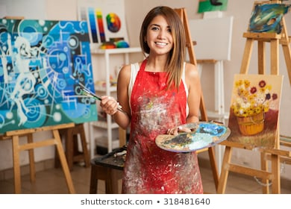
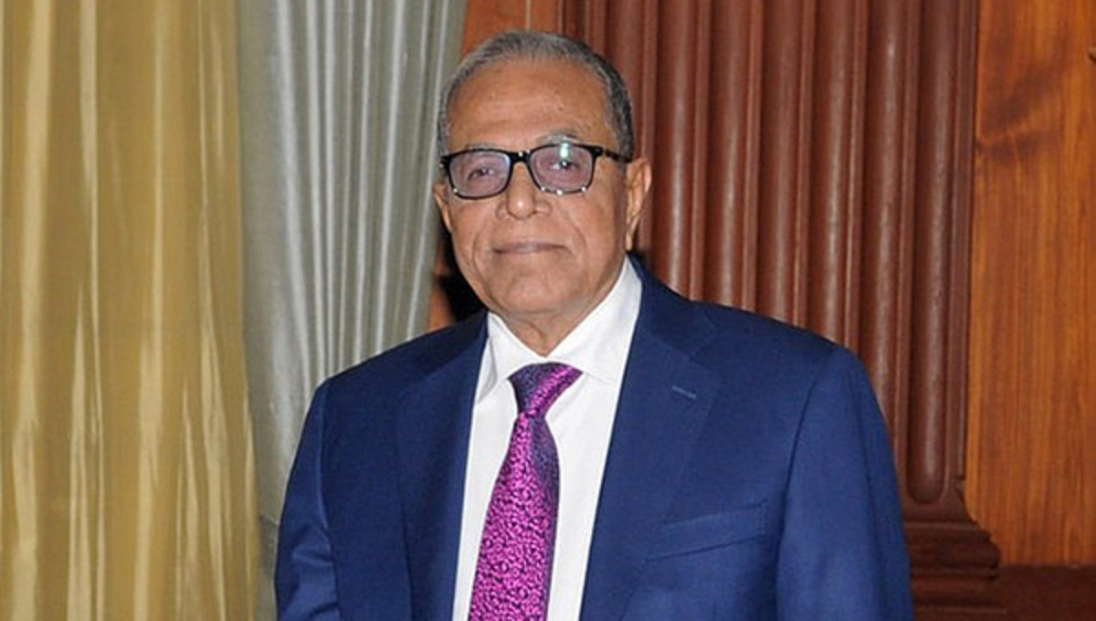
Literature
Printed Works
Chandrabati was the first literature women poet.
Painter
Artist
Zainul abedin was a great painter.
President
Governor
Abdul Hamid is our president.

Slide 10
Look and Say true or false
1. Kishoreganj is a big town.
False
2.The largest Eid fairground is in the Kishoreganj .
True
3.Chandrabati is the 2nd woman poet of Bangla literature.
False
4.The great painter Zainul Abedin born in Kishoreganj.
True

Slide 11
Answer the following questions in short
Now check your answer
1.What is the Kishoreganj famous for?
Ans. Kishoreganj is famous for some important places and persons.
2. Who is the master of painting?
Ans. Zainul Abedin is the master of painting.
3.Who is Chandrabati ?
Ans. Chandrabati is the first women poet of Bangla literature.

Slide 12
Rearrange the jumble sentences
1.Solakia,the. Eid Ground, largest ,is
1. Solakia is the largest Eid Ground .
2. also, in, my, district ,the, mosque ,Pagla, is
2. The Pagla mosque is in my district also.
3.The , Nazrul, Islam, first, president, acting, Syed, was
3. Syed Nazrul Islam was the first acting president .

Slide 13
One day One word
Celebrate
উদযাপন করা
After four years I celebrated my birthday.
Lets listen summary of the text

Slide 14
Home Work
Write five sentences about famous people of your home district .

