Slide 1
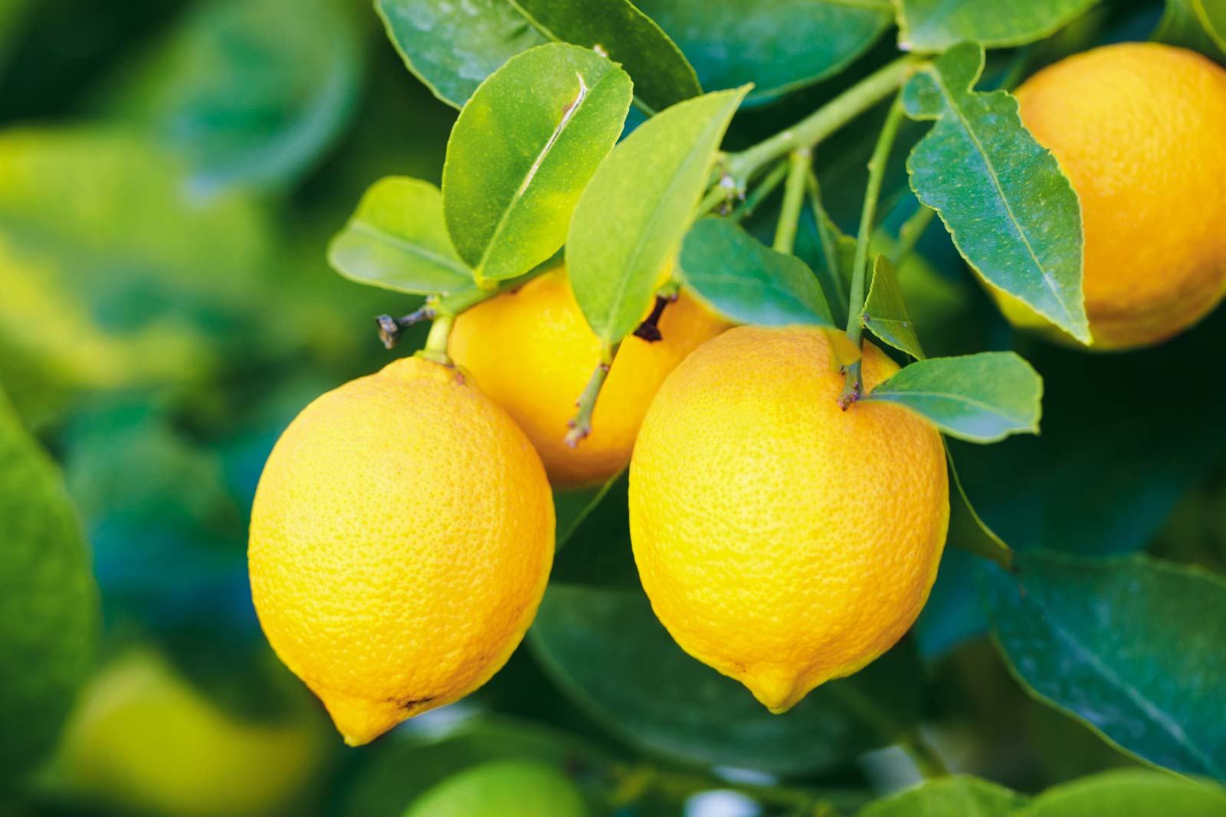
Welcome to My New Class

Slide 2
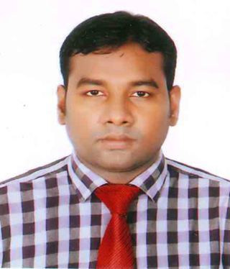

Slide 3
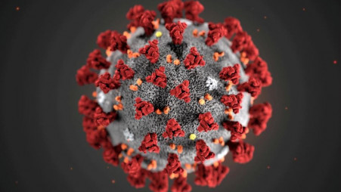
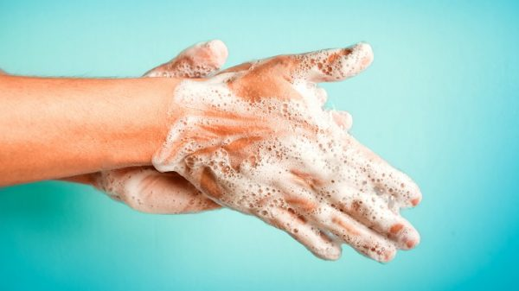
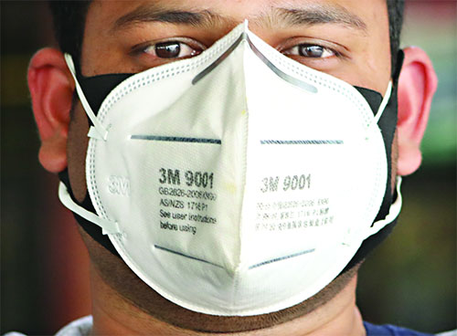
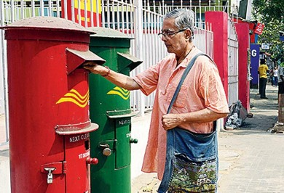
Seeing the picture, guess the topic

Slide 4
Today’s topic is
Letter
Now write a letter to your friend about Corona Virus.
For Class: Ten
Subject: English First Paper

Slide 5
Learning Outcome:
Know about Corona Virus
Save himself & others
Make others conscious of it

Slide 6
14/04/2020
Sandwip, Chattogram
Dear X,
How are you? I hope you are well and so am I. In your last letter you wanted to know about Corona virus. Now I am writing to you about it.
Corona virus is a burning question in our day today’s life. It is the recent terror in the whole world. It has locked down almost all the countries of the world. It is originated in China. It is supposed that this virus is spreaded from bat. It has caused death toll in most of the countries. Bangladesh is not exceptional. It is also effected in our country. Many people died of it and a number of corona virus effected people is increasing day by day. It is high time we should be conscious of it because it is conterminous. We should wear mask when we go out, wash hands with hand-wash, make social distance, stay home and stay safe.
No more today, more when we meet. Convey my salam to your parents and love the youngers. Take care of your health. Stay home and stay safe.
Your loving friend
Y

Slide 7
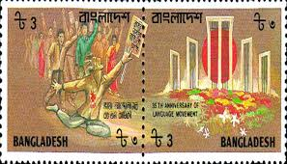
From
Y
Sandwip, Chattogram.
01677285880
To
X
Sadorghat , Chattogram
017211…..

Slide 8
Individual Work
Now write a letter to your friend about corona virus

Slide 9
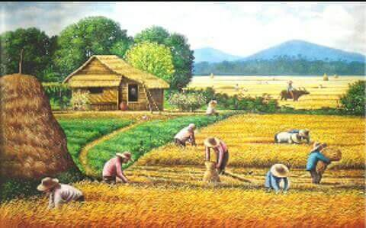
HOME WORK
Now write a letter to your friend about dengue fever.

Slide 10
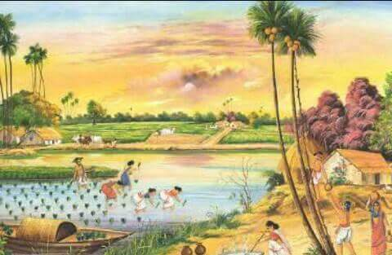
GOODBYE STUDENTS

