Slide 1


Slide 2
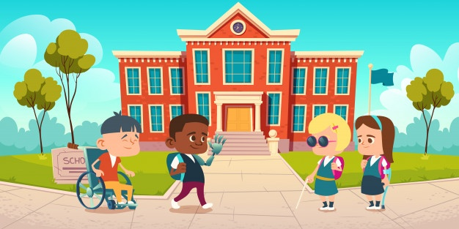

Slide 3
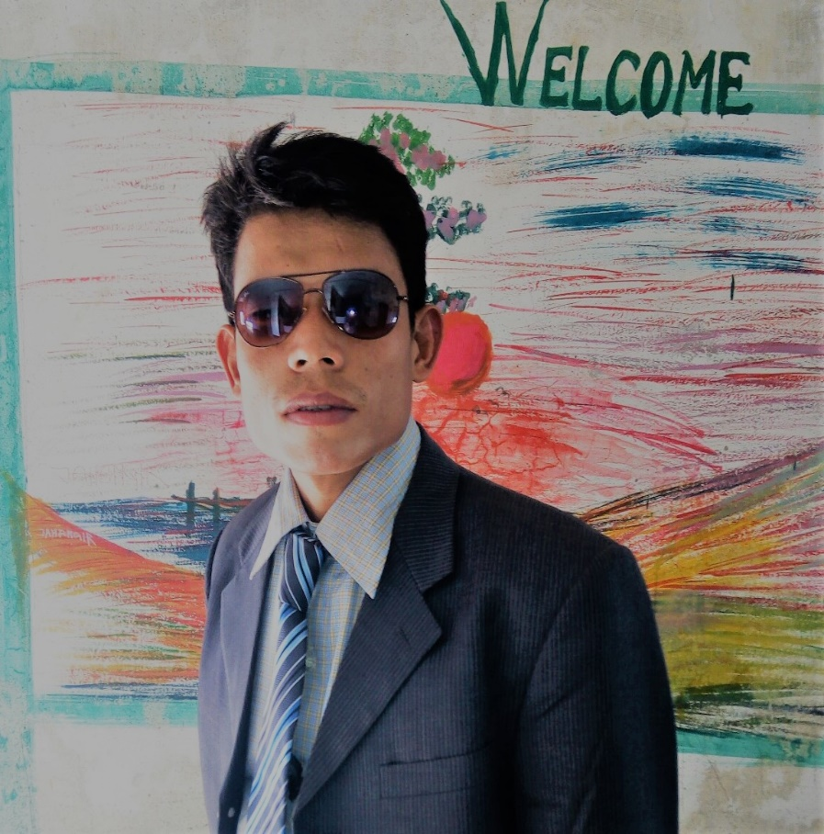
Teacher’s Identity
*Gorden Tripura
* Assistant Teacher
* Pakniar para Gov’t Primary School
* Ruma, Bandarban

Slide 4
SUBJECT : ENGLISH
UNIT : 01
LESSON : 1-3
TITLE: Greetings and Introductions
TIME : 40 MINUTE
INTRODUCTION OF THE CLASS

Slide 5
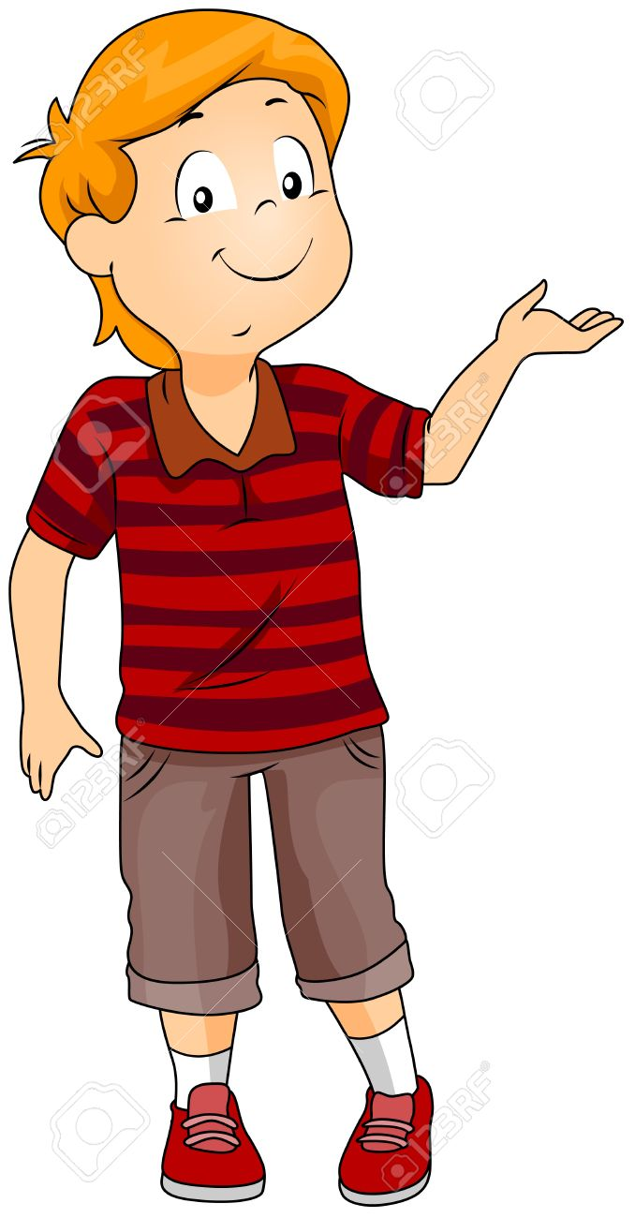
Learning Outcomes:
Listening :1.1.1, become familiar with English sounds by listening to common English words.
Speaking: 2.1.2, say Good morning ,Hi, Hello

Slide 6
Text book
Multi projector
Audio
Cards/posters
Indicator stick
MATERIALS

Slide 7
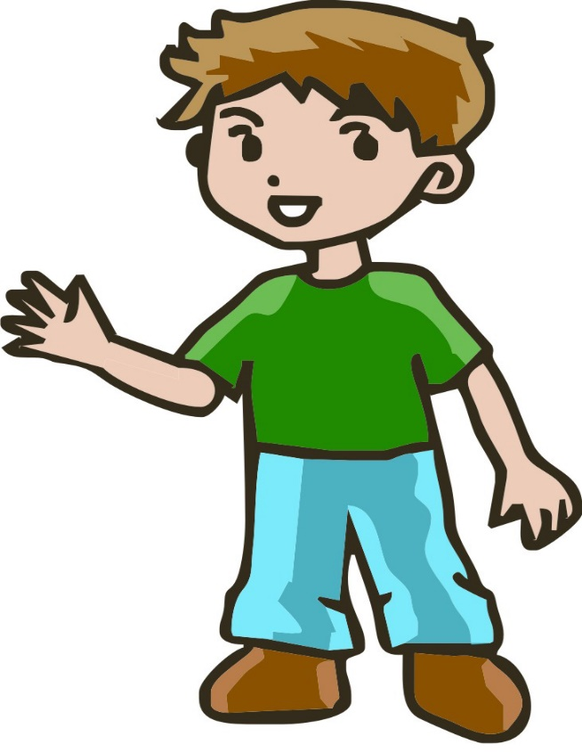
Now we will see some pictures
Hi, Good morning
Shima.
How are you?
Hi ,Good morning.
I am fine.
What about you..?

Slide 8
Let’s ENJOY A VIDEO NOW

Slide 9
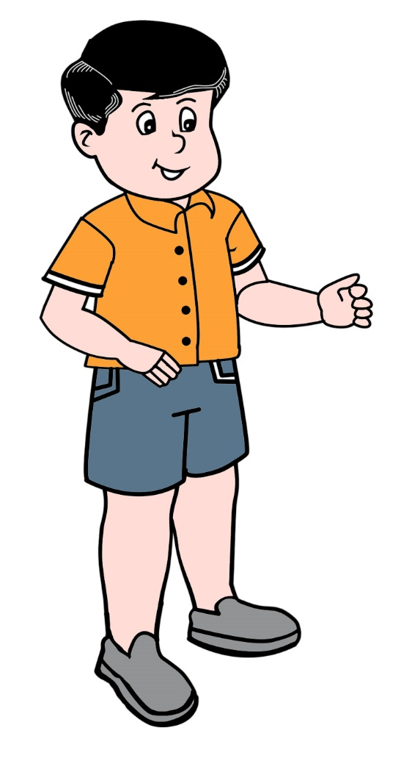
Today Class Topic is : Greetings and Introductions

Slide 10
GROUP :01
  Answer The Questions :
How are you ?
What is your name ?
.What class do you read in ?

Slide 11
GROUP :02
Listen and Say the words
Hello
Good Morning
Good afternoon
How are you ?
Fine
Thank you
Bye

Slide 12
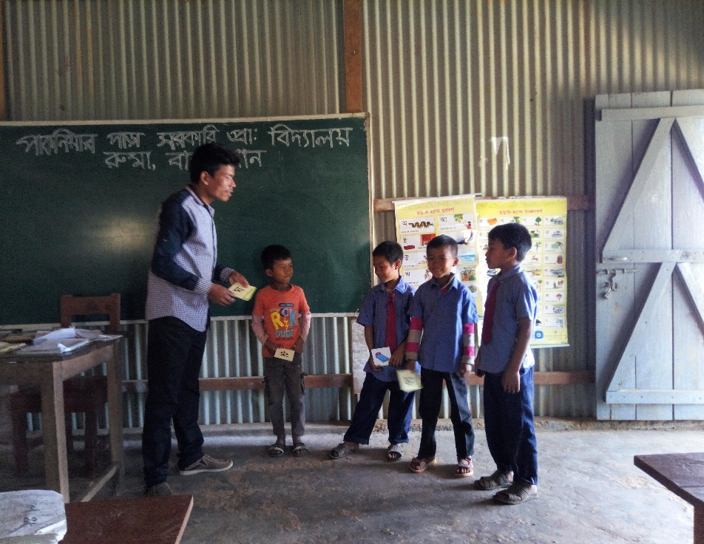
WCW PRACTISE
  Clues
Hi, I am sumon.
Hello ,I am Rafi .
How are you?
I am fine.
And you ?
Fine ,thank you.
Bye

Slide 13
Feedback
        Hi /Hello
        What is your name ?
        How are you ?
        What class do you read?
        Thank you

Slide 14



