Slide 1
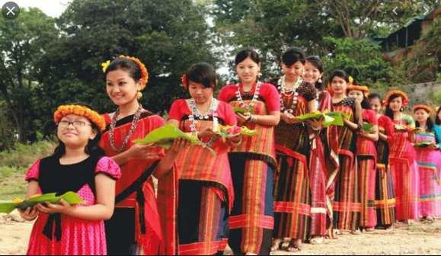
Welcome

Slide 2
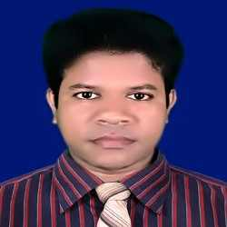
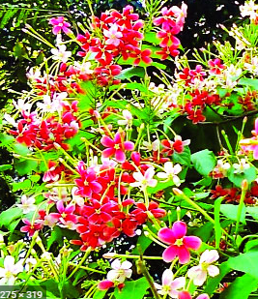
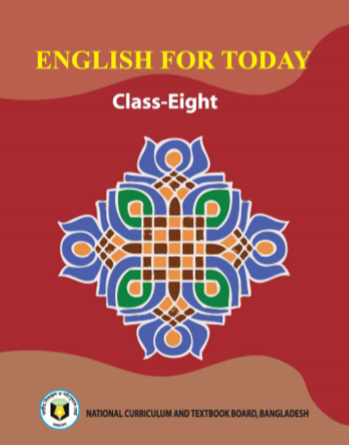
Azizul Fakir
Assistant Teacher
Dighirjan Secondary
School
Nazirpur, Pirojpur
Mobile: 01710745128
Email: azizul.nk@gmail.com
Class Eight
Unit: 1
Lesson: 4
Time: 50 mins.

Slide 3
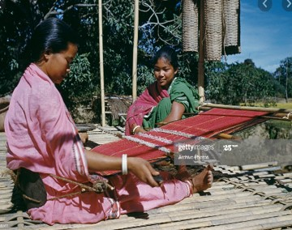
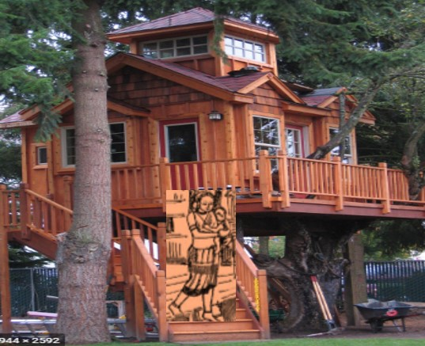
Look at the picture.
What can you see in the picture?
In the left picture, we see tow women. One of them is seen weaving cloth.
And in the right picture?
In this picture, we can see a house with a high wooden platform. And a woman is also seen here with a child on her lap. Possibly they are ethnic women.

Slide 4
Our today’s topic is
Our ethnic friends (2)
Unit: 1
Lesson: 4
Time: 50 mins.

Slide 5
Learning outcomes
After we have studied this lesson, we will be able to
infer meaning from the context.
write answers to the questions.
tick the best answer.
match the correct form column A with column B
fill gaps from listening the CD.

Slide 6
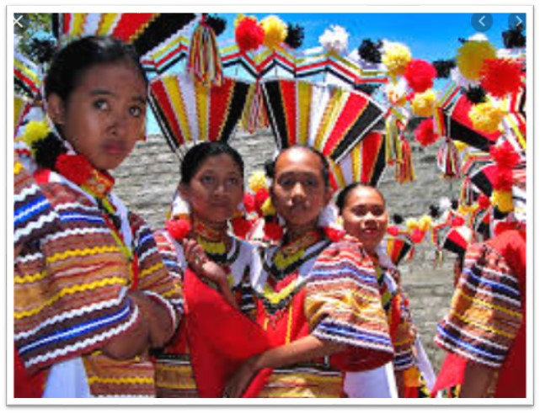
Key words
characteristics
(adj)
Meaning
uniqueness
Most of these ethnic people living in Bangladesh have some common characteristics.

Slide 7
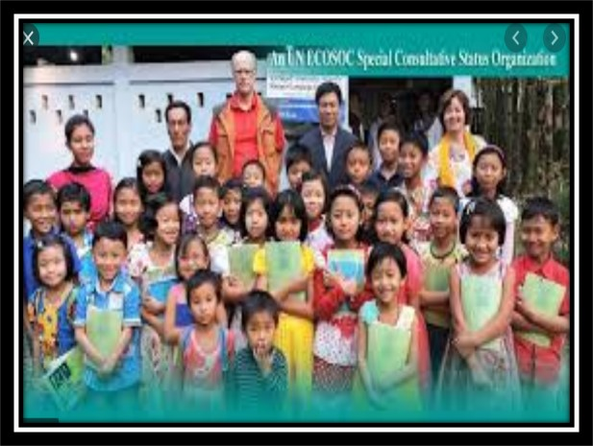
communities
(noun)
Meaning
people with common background
The community of ethnic is minority in Bangladesh

Slide 8
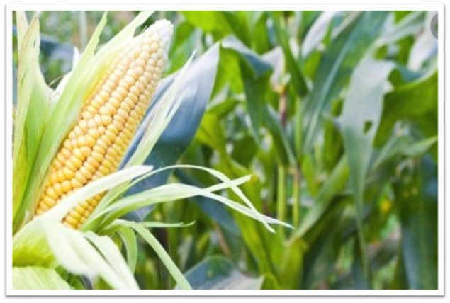
maize
(noun)
Meaning
one kind of corn
Bangladesh grows maize in plenty.

Slide 9
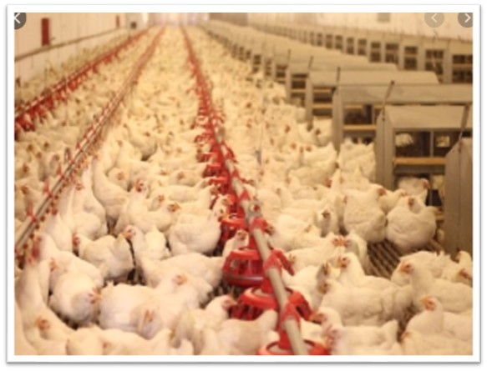
poultry
(noun)
Meaning
domestic fowl
Poultry industries have been damaged in bangladesh.

Slide 10
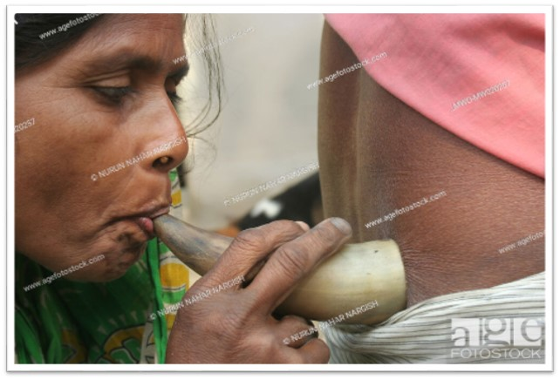
shifting
(noun)
Meaning
transfer
The bedey community are shifting their profession day bay.

Slide 11
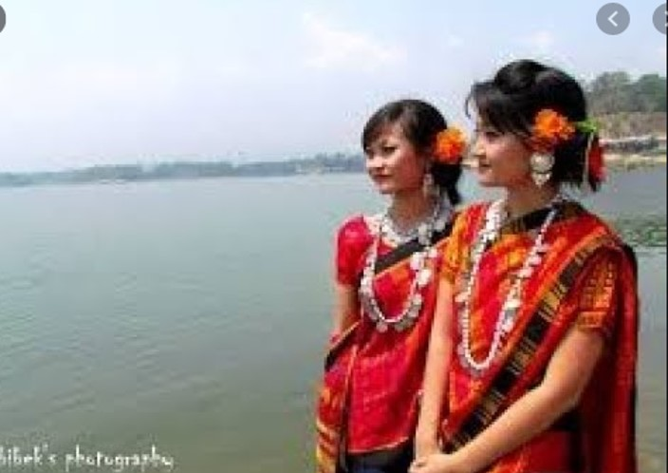
Open at page 06 in your book ‘English for today’ and read the passage carefully and silently.

Slide 12
Most of the ethnic people living Bangladesh have some chrematistics. They have their own lifestyle.
They build their houses on bamboo or widen platforms called ‘machang’. Rice is their staple food. They eat vegetables, maize and fish, poultry and meat. Their kitchen utensils are bamboo, wooden and earthen pots which they make themselves. Men wear lungis and women wear thamis or sarongs and angis. Women wear their own clothes.
Hunting and fishing are their favorite pastimes. They fond of songs, music, dances, theatre and fairs. Traditional musical instruments used are bungles made from buffalo horns, drums and bamboo flutes. Wrestling is a popular sport for them.

Slide 13
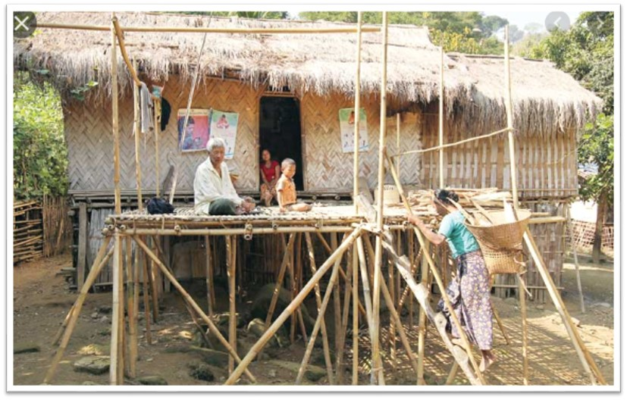
They build their houses on bamboo or wooden platforms called ‘machang’.

Slide 14
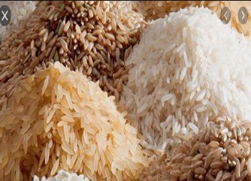
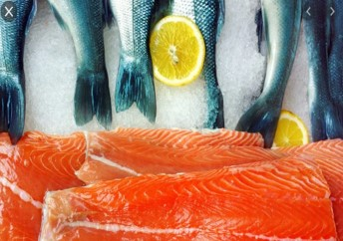
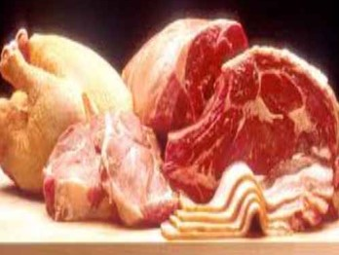
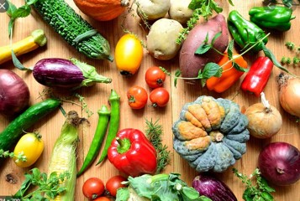
Rice is their staple food. They eat vegetables, maize and fish, poultry and meat.

Slide 15
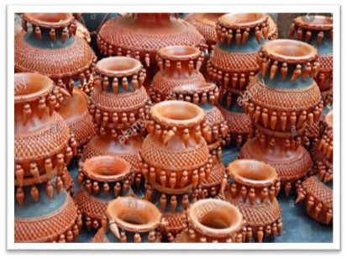
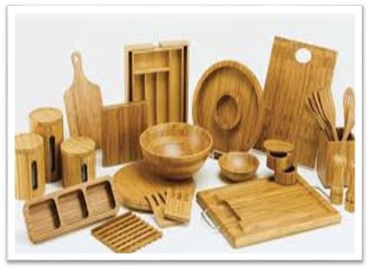
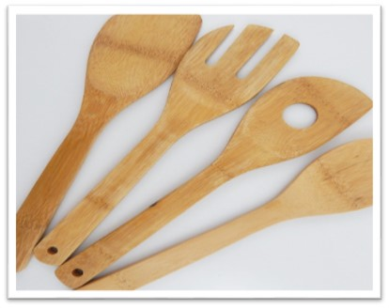
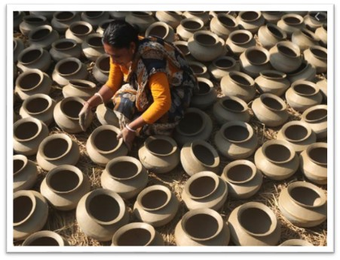
Their kitchen utensils are bamboo, wooden and earthen pots which they make themselves.

Slide 16
Men wear lungis and women wear thamis or sarongs and angis.
Women weave their own clothes.

Slide 17
Hunting and fishing are their favorite pastimes.

Slide 18
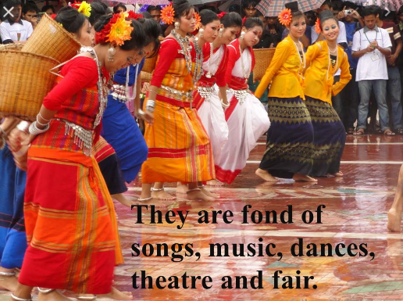

Slide 20
Individual works:
3 mins
Answer the following questions
Q1. What do their women wear?
Q2. What are their favorite pastime?
Correct your answers
Ans1: Their women wear thamis or sarongs and angis.
Ans2: Hunting and fishing are their favorite pastimes.

Slide 21
Find the answers from column B to the questions in
column A and write them in complete sentences.
Pair works:
5 mins
A | B
1. Where do the ethnic people build their houses? | a) traditional musical instrument made form a buffalo horn.
2. What are their favorite pastimes? | b) clay, bamboo and wood.
3. What is bugle? | c) rice.
4. What do the women were? | d) on the wooden or bamboo platforms.
5. What are their kitchen utensils made of? | e) fishing and hunting.
6. What is their staple food? | f) thamis or sarongs and angis.
1+d
2+e
3+a
Correct your answers
4+f
5+b
6+c

Slide 22
Group works:
6 mins
Complete the paragraph. Use the words below to fill in the gaps. There are more words than necessary.
lungi, sport, earthen, machang, weave, wrestling, song, rice, fishing, lifestyles, wooden, bugle.
lifestyles
The tribal people follow their ------------. The platform they build their houses on is called -----------. Men wear ------------. Women ------------ their own clothes. Their staple food is --------------. They are fond of songs, dance, music and -----------. ----------- is their favorite sport.
machang
lungi
weave
rice
fishing
Wrestling

Slide 23
Choose the best answers
Ethnic people have some ---- characteristics.
a) common b) uncommon c) unique d) heinous
2. ‘common’ refers to ----
familiar b) peculiar c) dissimilar d) different
3. ----- usually weave the clothes that they use.
men b) women c) children d) all
4. What does the word ‘characteristic’ mean?
mind b) soul c) attitude d) trait
5. The earthen pots are made by -----
a) leaders b) professionals c) themselves d) children
$$$$
$$$$
$$$$
$$$$
$$$$

Slide 24
Listen to the CD
Evaluation
Now fill the gap
They (a) --- their houses on bamboo or wooden platforms (b) --- ‘machang’. Rice is their staple food. They eat vegetables, maize and fish, (c) --- and meat. Their kitchen utensils are bamboo, wooden and (d) ---pots which they make themselves. Men wear lungis and women wear thamis or sarongs and angis. Women (e) --- their own clothes.

Slide 25
Homework
Imagine you are Sajeed and you have a Marma friend called Masing. Now write a dialogue asking and answering questions about dress, food, songs, sports and pastimes of both of you.

Slide 26
Thank you

