Slide 1
E
c
E
o
L
M
w

Slide 2
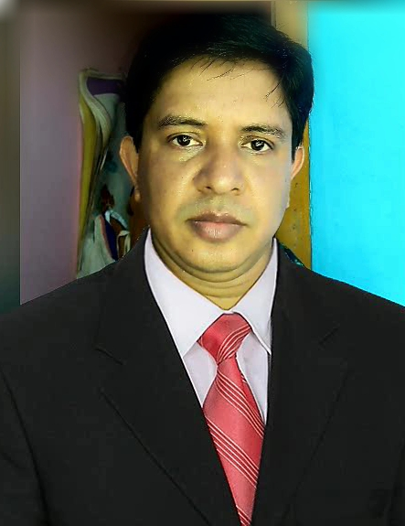
INTRODUCTioN
Subject: English. Class: Four. Unit:15, Lesson: 1-3
(Sagar and his family))
MOHAMMAD IQBQL HOSSAIN
ASSISTANT TEACHER
PARASHURAM MODEL GOVT.PRIMARY SCHOOL
PARASHURAM, FENI.
Md. Iqbal Hossai. Parashuram, Feni 01813132522

Slide 3
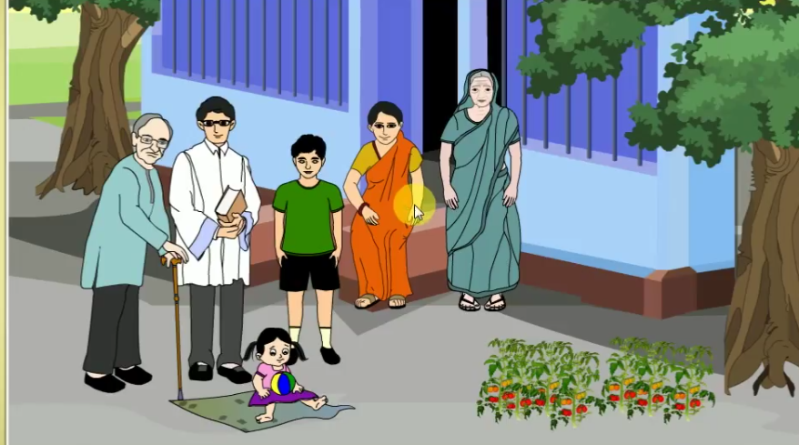
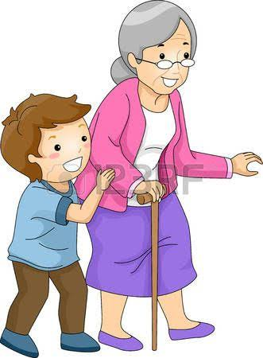
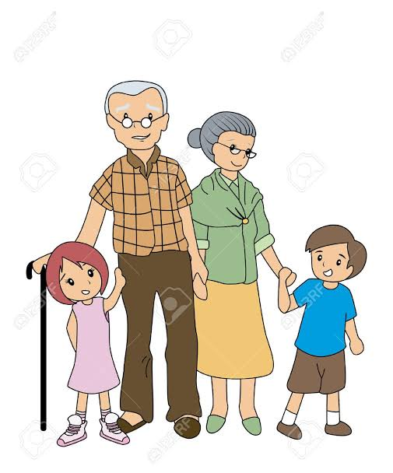
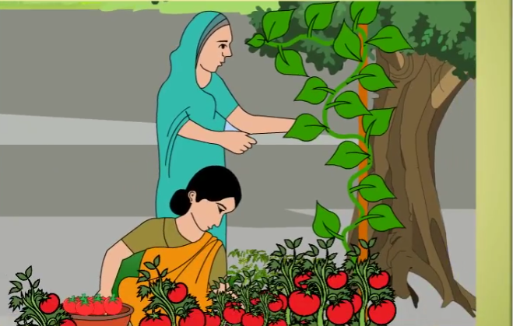
Look at the pictures

Slide 4
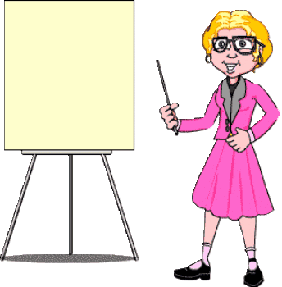
Our Todays Lesson
Sagar and his family
Md. Iqbal Hossai. Parashuram, Feni 01813132522

Slide 5
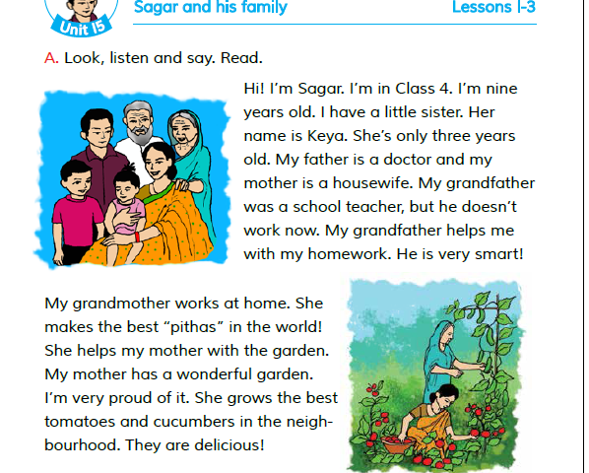
TEACHER’S READING
Md. Iqbal Hossai. Parashuram, Feni 01813132522

Slide 6
Write the meaning of the word and make sentence
Smart
চৌকষ, চটপটে
My brother is very smart!
Md. Iqbal Hossai. Parashuram, Feni 01813132522

Slide 7
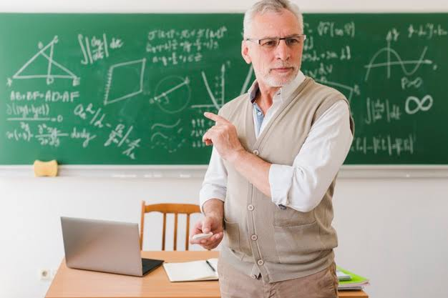
Doctor
What are the men?
A Doctor is a parson who serves the patients
Teacher
A teacher is person whose job is teaching.
Md. Iqbal Hossai. Parashuram, Feni 01813132522

Slide 8
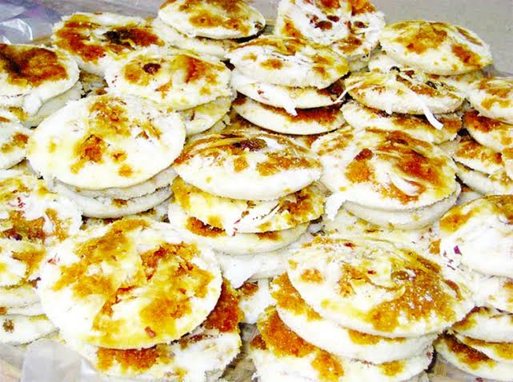
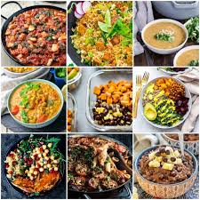
What do you see in the picture?
Pithas
One kind of food
Delicious
Having very pleasant taste

Slide 9
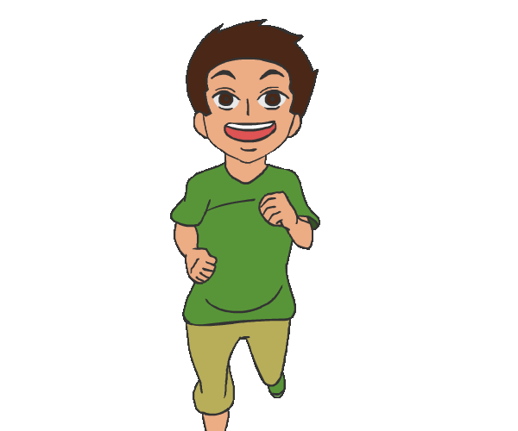
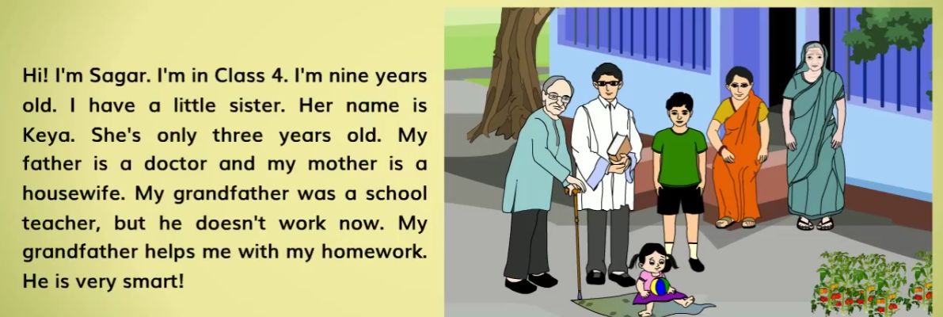
Read the text with group
Md. Iqbal Hossai. Parashuram, Feni 01813132522

Slide 10
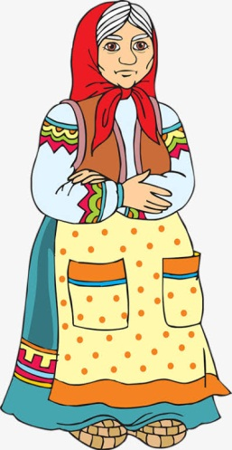
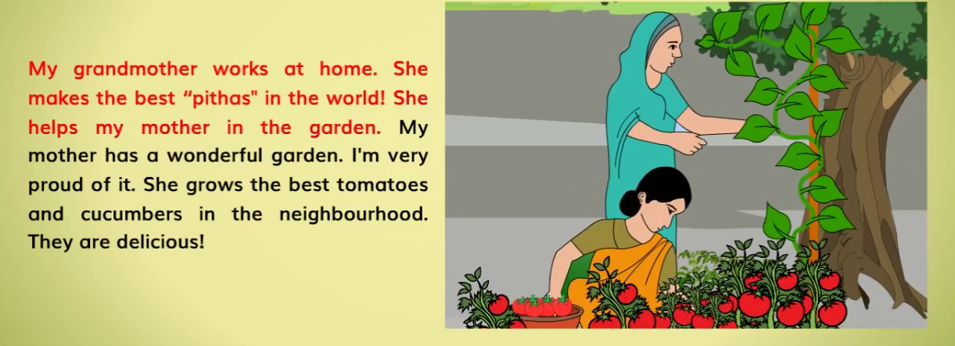
Read the text individually

Slide 11
Match the word with their meaning
a) Parent’s
i) A kind of food that’s usually makes at home
b) Doctor
ii) Having very pleasant taste.
c) Teacher
iii) A person who serves the patients .
d) Delicious
iv) A person whose job is teaching .
e) Pithas
v) father and mother
Md. Iqbal Hossai. Parashuram, Feni 01813132522

Slide 12
Answer the questions on your exercise book
What are Sagar’s parents?
Ans: Sagar’s father is a doctor and his mother is a housewife.
Who is Keya?
Ans: Keya is Sagar’s sister.
Who helps Sagar’s mother with the garden?
Ans: Sagar’s grand mother helps his mother with the garden.
Who make the best ‘pithas’ in the world?
Ans: Sagar’s grand mother makes the best ‘pithas’ in the world
Md. Iqbal Hossai. Parashuram, Feni 01813132522

Slide 13
Home Work
Write a short composition about ‘your family’ at least 5 sentences.
Md. Iqbal Hossai. Parashuram, Feni 01813132522

Slide 14
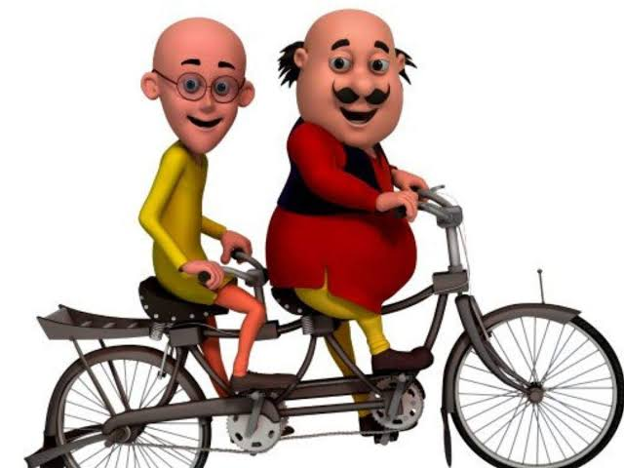
Md. Iqbal Hossai. Parashuram, Feni 01813132522

