Slide 1
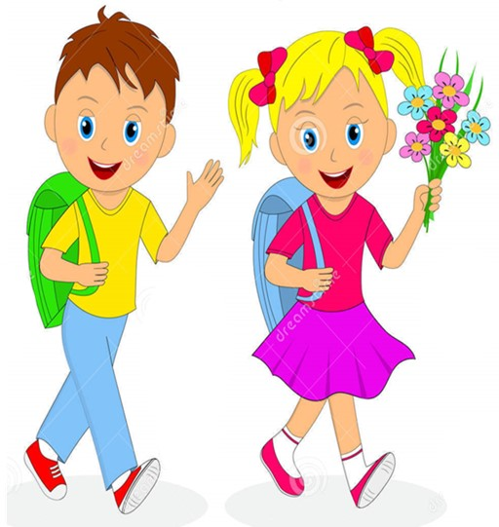

Slide 2
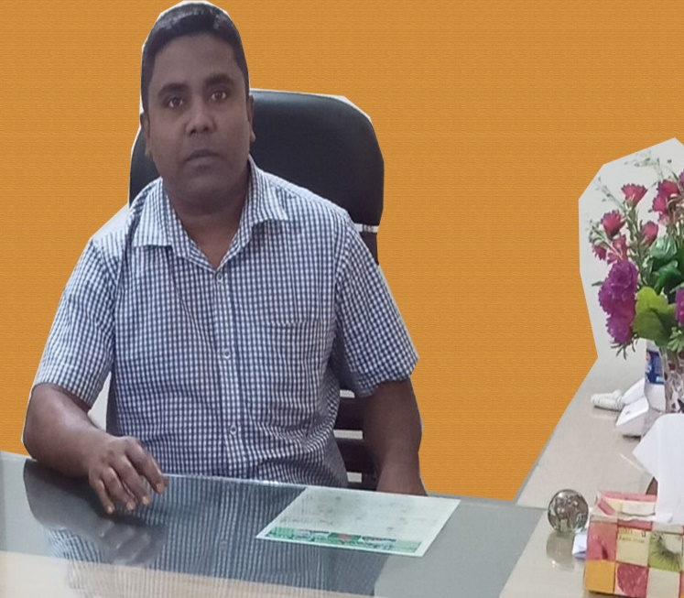
Health is wealth
Sub: English
Class: Two
Lesson : How many -----------?
Parts of the lesson: (Activity-C)
Page No-17
Md. Mushfikur Rahman
ASISSTANT TEACHER
PARGOBINDOPUR GOVT. PRIMARY SCHOOL
BIRAMPUR,DINAJPUR.

Slide 3
Safety environment by greetings song.
Health
is
wealth
WE SHALL OVERCOME
WE SHALL OVERCOME
WE SHALL OVERCOME, SOME DAYS.
We clean our hands with regular soap.
OH, DEEP IN MY HEART
I DO BELIVE THAT
WE SHALL OVERCOME, SOME DAYS.

Slide 4
Our today’s lesson is too--
Health is Wealth
Activity-C
How many--?

Slide 5
LEARNING OUTCOMES
By end of the lesson students will be able to-------
Listening: 3.1.2 understand simple questions and statements about
familiar objects.
Speaking: 3.1.2 ask and answer questions about familiar objects.

Slide 6
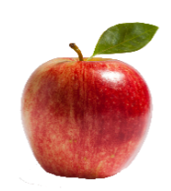
How many apples?
How many apples?
How many apples?
How many apples?
How many apples?
How many apples?
How many apples?

Slide 7
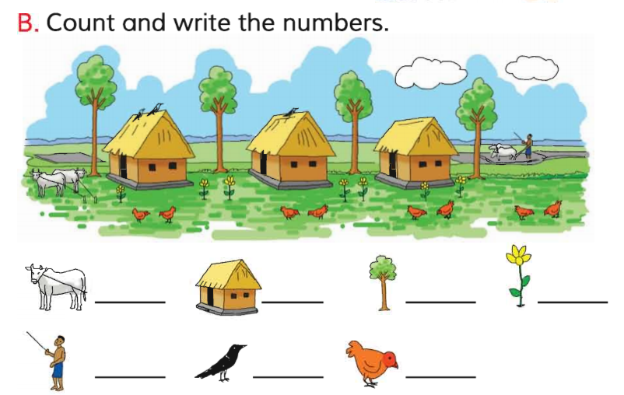
Open your English book at page-17
Ask and answer with how many----------?
How many---------? cows/huts/trees/flowers/mans/crows/hens

Slide 8
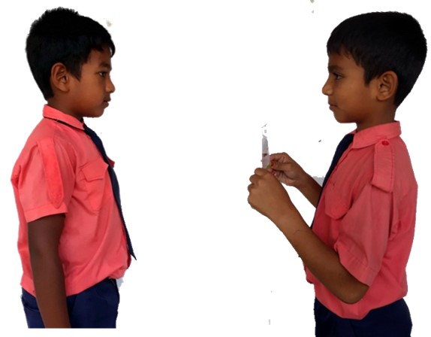
Pair work.
How many -----------?
One more

Slide 9
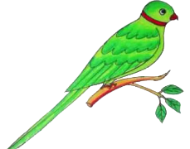
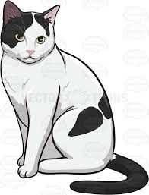
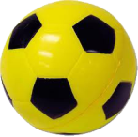
How many----------?
There are 3 umbrellas.
There are 5 flowers.
There are 8 birds.
There are 7 cats.
There are 6 balls.
See again

Slide 10
Read and say.
There are 5 flowers.
There are 7 birds.
There are 6 cats.
There are 4 balls.
4 cows.
3 huts.
4 trees.
3 crows.
8 hens.
There are 7 birds.
There are 5 flowers.

Slide 11
One day one word
dinner
সন্ধ্যা ভোজ।

Slide 12
Find out the letters that are made by the word--------.
d
w
i
a
n
t
n
v
e
x
r
Find out the correct word--------.
dinner
diner
denner
dinnar

Slide 13
Say the missing letter.
dinn-r
din-er
di-ner
d-nner
Write the word to your notebook.
dinner
ডিনার
সন্ধ্যা ভোজ

Slide 14
Home work
Page 12 will be well read and written.

Slide 15
That’s all for today. Goodbye. See you tomorrow.

