Slide 1
Welcome

Slide 2
Good morning students!
Good morning teacher!
How are you?
Fine, thank you.

Slide 3
Introductions
Class: Two
Subject: English
Unit: 01
Lesson: 4-6
Title: Alphabet
Part: A
Time: 40 minutes
Date: 15th April 2020
MD. JAHIRUL ISLAM
Assistant Teacher
Uttar Charkoralia Sahebkandi GPS

Slide 4
Learning outcomes
Completing the session the students will able to
Listening
1.1.1 Become familiar with English sounds by listening to common English words.
Speaking
1.1.1 Repeat after the teacher simple words & phrases with proper sounds & stress.
1.1.2 say simple words & phrases with proper sounds & stress..
Reading
1.2.1 Recognize & read the alphabet both small & capital(non-cursive).
1.3.1 Recognize & read the names of objects having the same initial & final sounds.

Slide 5
Warm up activities
Let’s listen a Rhyme & song

Slide 6
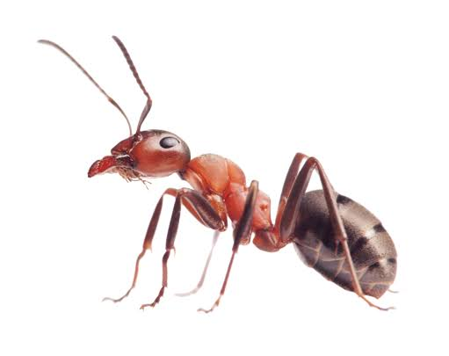
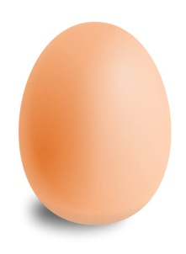
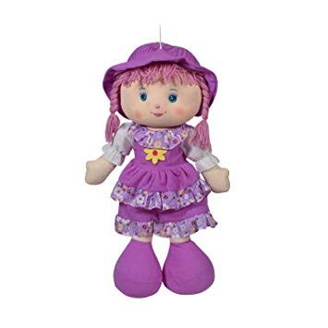
Validate anticipation
What is this?
Ant
Cup
Egg
Bat
Doll
Teacher’s Drilling………..
WCW

Slide 7
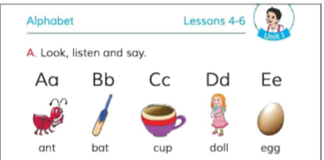
Open page at 3…
See activity A….
Please!
What is this?
Ant
Cup
Egg
Bat
Doll
Teacher’s Drilling………..
WCW
Continue…..

Slide 8
What is the letter name?
What is the letter sound?
Ant
Cup
Egg
Bat
Doll
Teacher’s Drilling………..
WCW
Continue…..

Slide 9
A/A/Ant
C/C/Cup
E/E/Egg
B/B/Bat
D/D/Doll
Pronunciation Practice…
Teacher’s Drilling………..
WCW

Slide 10
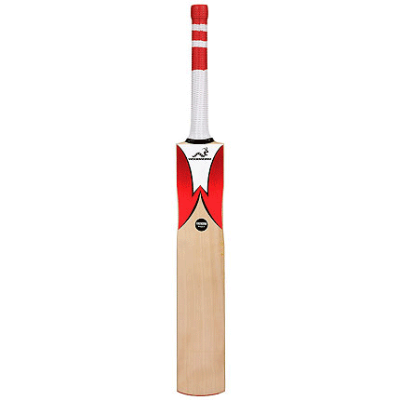
What is this?
This is an A/A/ANT.
What is this?
This is a B/B/BAT.
Student’s Drilling………..
PW
Continue…..

Slide 11
This is an E/E/EGG.
What is this?
Student’s Drilling………..
PW

Slide 12
What is this?
This is a C/C/CUP.
This is a DOLL.
What is this?
Student’s Drilling………..
PW
Continue…..

Slide 13
Evaluation
/a/ for what?
/a/ for ANT.
Teacher’s Evaluation…
WCW
Continue…..

Slide 14
Evaluation
/b/ for what?
/c/ for what?
/b/ for BAT.
/c/ for CUP.
/d/ for what?
/d/ for DOLL.
Teacher’s Evaluation...
WCW

Slide 15
Thank you!
That’s all for today!
Goodbye!

