Slide 1
WELCOME

Slide 2
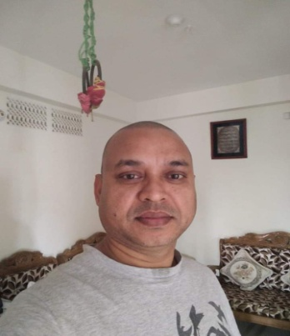
Teachers Introduction
Md. Rafiqul Islam.
Assistant Teacher
kuripara Govt. Primary School.
Sujanagar, Pabna.com
E-mail: ri2663161977@gmail.

Slide 3
Lesson Introduction
Class : five
Subject : English
Lesson: Saikats family
Part of the Lesson :A -B(Listen and read)

Slide 4
Learning Outcomes:
Litening:3.2.1undestand question about family and friends of students.
Speaking:6.1.2Say what other people are doing?
Reading:1.5.1read words, phrases and sentences with proper stress and intonation
Writing:8.1.1make sentences using words and phrases..

Slide 5
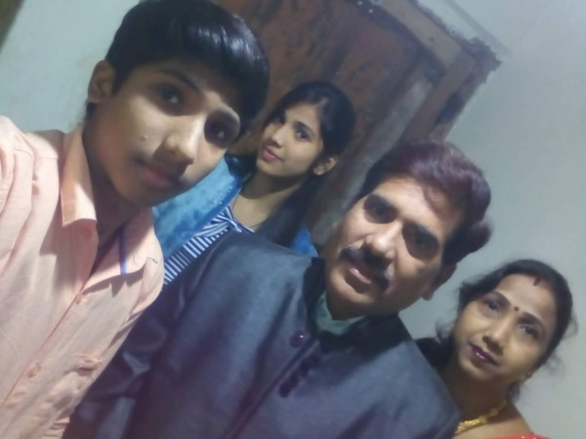
Let’s go see picture

Slide 6
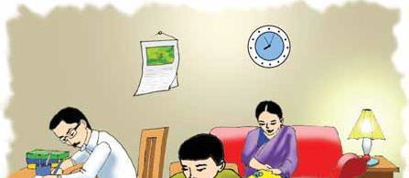
Saikats Family

Slide 7
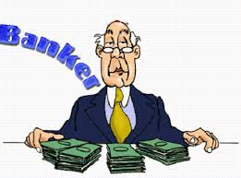
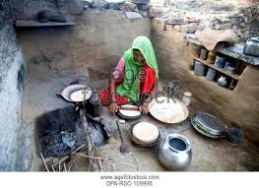
A banker works in bank.
A housewife works at home

Slide 8
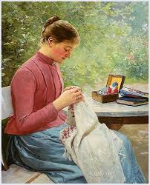
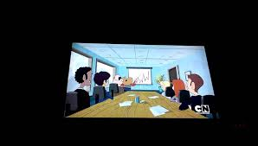
Mrs. Monowara islam is sewing cloth.
Saikat watches TV.

Slide 9
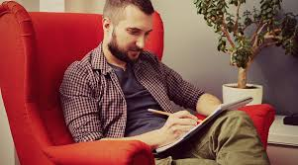
Saikats father writes stories and listen to music in his free time.
Saikats mother enjoys sewing in her free time
Saikats likes to read books about animals in his freetime.
Notes:
Saikats father writes stories and listen to music in his free time.
Saikats mother enjoys sewing in her free time
Saikats likes to read books about animals in his freetime.

Slide 10
banker
housewife sewing
free time
watch
NEW WORDS

Slide 11
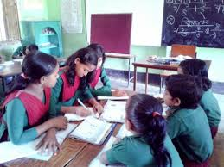
Group work
Group- 1
What do she?
Group-2
What do he?

Slide 12
Pair work
Write True or False:
Saikat is a brilliant student.
Monowara islam is a teacher.

Slide 13
Indivusal work
Answer to the questions:
What is saikat?
Where does saikat live?

Slide 14
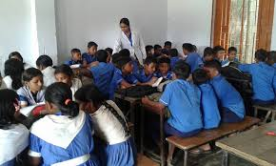
Teachers reading
Notes:
Group work:1.what is saikats father doing?
2.What is saikats mother doing?3.What is saikats doing?

Slide 15
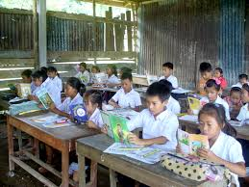
Silent reading by the students
Notes:
Silent reading by the ss

Slide 16
Evolation
What does saikat do?
Where does saikat live?
Why does saikat watch cartoons on TV?

Slide 17
Fed back

Slide 18
Home work
Next day you will write about your mother.

Slide 19
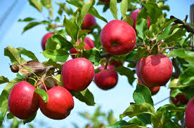
THANK YOU
Notes:
Thanks to all

