Slide 1
Welcome

Slide 2
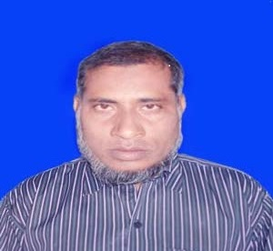
INTRODUCTION
Md.Nazrul Islam
Assistant Teacher
K.K.H.S
Porsha, Naogaon
nazrul.kkhs@gmail.com
English 1st Paper
Class Viii
Topic-Ever Beautiful Shamima
Time-45 mins

Slide 3
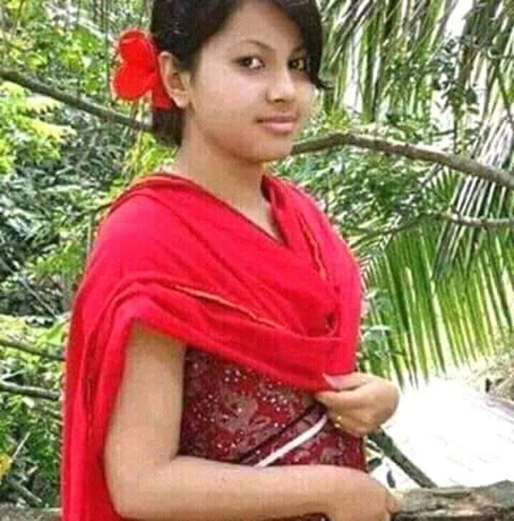
Look at the picture.
How is the girl look like?
Very beautiful
Who is looking very beautiful, what can we say her?
Ever Beautiful

Slide 4
Today Our Topic is
Ever Beautiful SHAMIMA

Slide 5
Learning Outcomes
By the end of the lesson students will be able to…….
Read the passage.
ask and answer questions
describe about Shamima‘s life.

Slide 6
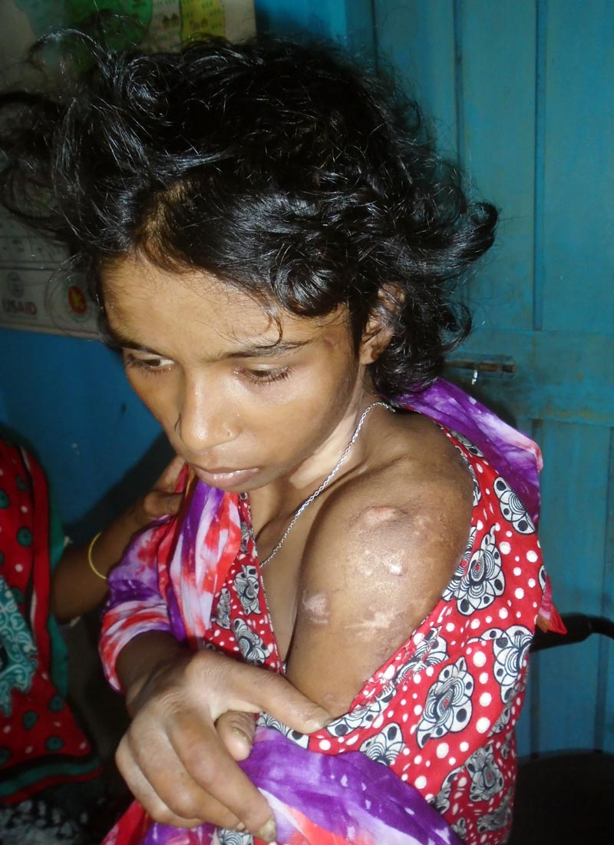
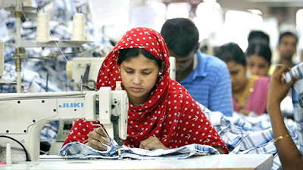
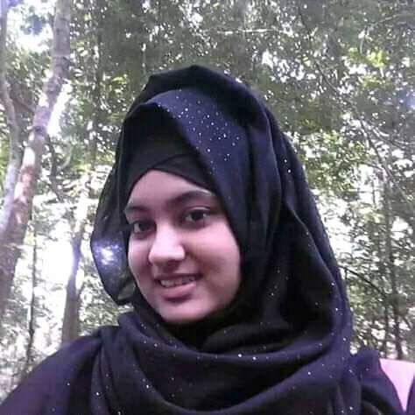
Look at the picture
Think about the picture and describe.

Slide 7
Open at page no.49 and read the text silently:
Find out difficult words.
Notes:
Teachers are requested to use this slide only for those who don’t have text with them.

Slide 8
Misery:
sorrows
Insult :
Not evaluated
Verbaly:
Orally
Vows :
Promise
Ill-fated :
Unlucky
Helpless :
Who needs help

Slide 9
Pair work
Read the passage and answer the following questions.
Ans
1.When did Shamima‘s misery start?
1.At the time of her marriage.
2 . How was her husband?
2.A greedy man
3.How did he abuse her?
3.Verbally & physically.
4.What does she want to be?
4.A designer

Slide 10
Individual work
Choose the best answer from alternatives.
1.The number of female members in her organisation is----
(i) 40 (ii) 23 (iii) 43 (iv) 83
2. Her dream is to help the ------
(i) Helpless (ii) sick. (iii) weak (iv) poor
3.Her husband was a/an---man.
(i) Good (ii) selfish (iii) dishonest (iv) honest
4. She want’s to be ----
(i) Rich (ii) unemployed (iii) dependent (iv) independent

Slide 11
Answers
1 (iii) ---- 43
2. ( i)– helpless
3. (ii) ---selfish
4. (iv) --- independent

Slide 12
Home work
Write a Paragraph about Shamima’s life .

Slide 13
Thank you all

