Slide 1
WELCOME
HOW ARE YOU ?

Slide 2
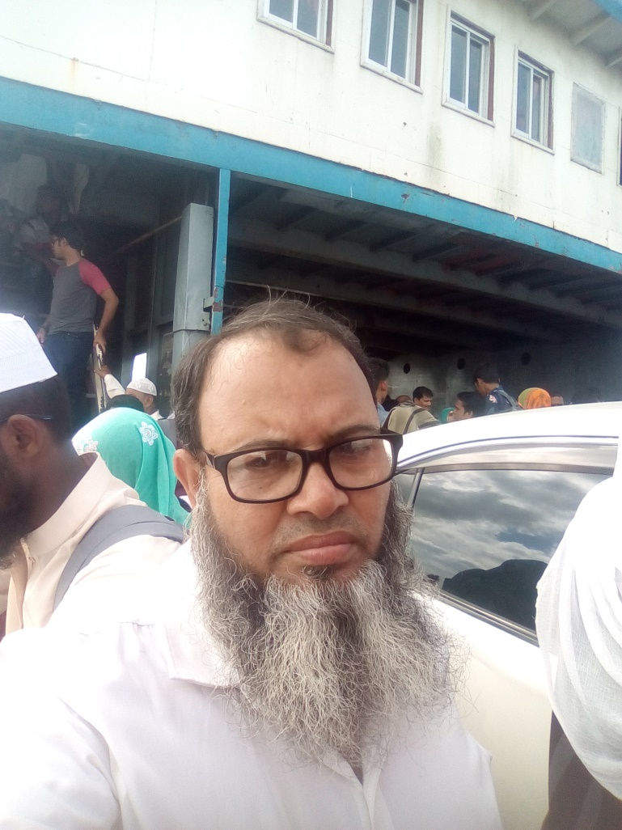
Md. Mahfujul Alam
Head Teacher
Munshinagar High School
Class –Eight
Subject- English 2nd paper
Degree .

Slide 4
Lesson Declaration
Today we’ll discuss about
Transformation of degree

Slide 5
Learning out comes
After the class , Student will be able to
Change positive to superlative
Change positive to comparative
Change superlative to positive
Change superlative to comparative
Change comparative to positive
Change comparative to superlative

Slide 6
শুধু the যুক্ত Superlative কে Positive করতে হলে,
১। সর্ব প্রথম No other একটি লিখতে হয়।
২। Superlative degree এর পরের অংশ লিখতে হয়।
৩। verb টি লিখে একটি as/ so লিখতে হয়।
৪। adjective positive form লিখতে হয়।
৫।আর একটি as লিখে subject লিখতে হয়।
He is the tallest man in the village
No other man in the village
is
as
tall
as
he

Slide 7
One of the যুক্ত Superlative কে Positive করতে হলে,
১। সর্ব প্রথম একটি very few লিখতে হয়।
২। Superlative degree এর পরের অংশ লিখতে হয়।
৩। verb টির plural করে একটি as/ so লিখতে হয়।
৪। adjective positive form লিখতে হয়।
৫। আর একটি as লিখে subject লিখতে হয়।
He is one of the oldest man in the village
Very few man in the village
are
as
old
as
he

Slide 8
শুধু Than যুক্ত Comparative কে Positive করতে হলে,
১। Than বাদ দিয়ে তার পরের অংশ প্রথমে লিখবে।
২। verb টি লিখে not থাকলে বাদ দিবে না থাকলে
যোগ করে একটি as/ so লিখতে
৩। adjective positive form লিখতে হয়।
৫। আর একটি as লিখে subject লিখতে হয়।
Rahim is better than karim
Karim
Is
not
as
good
as
Rahim
A bird does not fly faster than A plane
A plane
flies
as
fast
as
A plane

Slide 9
than any other যুক্ত Comparative কে Positive করতে হলে,
১। No other লিখে, than any other বাদ দিয়ে তার পরের অংশ প্রথমে লিখ।
২। verb টি লিখে একটি as/ so লিখতে
৩। adjective positive form লিখতে হয়।
৫। আর একটি as লিখে subject লিখতে হয়।
Rahim is better than any boy in our school
No other boy in our school
is
as
good
as
Rahim
Dhaka is bigger than any other city in Bangladesh
No other city in Bangladesh
is
as
big
as
Dhaka

Slide 10
Than most other যুক্ত Comparative কে Positive করতে হলে,
১। সর্ব প্রথম একটি very few লিখতে হয়।
২। than any other বাদ দিয়ে তার পরের অংশ লিখবে।
৩। verb টির plural করে একটি as/ so লিখতে হয়।
৪। adjective positive form লিখতে হয়।
৫। আর একটি as লিখে subject লিখতে হয়।
He is greater than most other men in the village
Very few men in the village
are
as
great
as
he
Gold is more precious than most other metals in the world
Very few metals in the world
are
as
precious
as
gold

Slide 11
Than any other যুক্ত Comparative কে Superlative করতে হলে,
১।Subject verb যাহা আছে তাই থাকবে ।
২। একটি the যোগ করে adjective এর superlative form লিখবে।
৩। Than any other বাদ দিয়ে বাকি অংশ লিখবে।
Rahim is better than any boy in our school
Rahim is
the
best
boy
in our school
Dhaka is bigger than any other city in Bangladesh
Dhaka is
the
biggest
city
in
Bangladesh

Slide 12
Than most other যুক্ত Comparative কে superlative করতে হলে,
১।Subject verb যাহা আছে তাই লিখে একটি one of the যোগ করবে।
২। ইহার পর adjective এর superlative form লিখবে।
৩। Than most other বাদ দিয়ে বাকি অংশ লিখবে।
Rahim is better than most boy in our school
Rahim is on of the
best
boy
in our school
Dhaka is bigger than most other city in Bangladesh
Dhaka is
one of the
biggest
city
in
Bangladesh

Slide 13
শুধু the যুক্ত Superlative কে Comparative করতে হলে,
১।Subject verb যাহা আছে তাই লিখেবে এবং the বাদ দিবে।
২। ইহার পর adjective এর Comparative form লিখবে।
৩। Than any other যোগ করে বাকি অংশ লিখবে।
Rahim is better than most boy in our school
Rahim is on of the
Best
boy
in our school
Dhaka is bigger than most other city in Bangladesh
Dhaka is
one of the
biggest
city
in
Bangladesh

Slide 14
No other যুক্ত Superlative কে Positive করতে হলে,
১।শেষের as বাদ দিয়ে তার পরের অংশ প্রথমে লিখ।
২। verb টি লিখে একটি the লিখতে হয়।
৩। adjective Superlative form লিখতে হয়।
৫। No other বাদ দিয়ে পরের অংশ লিখতে হয়।
No other man is as happy as a successful man
A successful man
is
the
happiest
man
No other person is as hated as a corrupted man
A corrupted man
is
the
most hated
person

Slide 15
Very few যুক্ত Superlative কে Positive করতে হলে,
১।শেষের as বাদ দিয়ে তার পরের অংশ প্রথমে লিখ।
২। verbটি singular করে একটি one of the লিখতে হয়।
৩। adjective Superlative form লিখতে হয়।
৫। Very few বাদ দিয়ে পরের অংশ লিখতে হয়।
Very few women are as lazy as she
She
is
On of the
laziest
women
Very few animals are as ferocious as Tiger
Tiger
is
One of the
most ferocious
animals

Slide 16
Evaluation
Corruption is one of the worst evils (positive)
Very few evils are as bad as corruption
My jungle hut is one of the most peaceful places in the world (positive)
Very few places in the world are as peaceful as my jungle hut
Flood is one of the most dangerous natural disasters (comparative )
Flood is more dangerous than most other natural disasters
Very few things are as useful as Television (superlative )
Television is one of the most useful as things
Akber is greater than most other kings of India (positive )
Very few kings of India are as great as Akber
No other sea-port is as big as chittagong (comparative )
Chittagong is the biggest sea-port

Slide 17
Homework
The rose is the best of all flower. (positive.)
It is lovelier than all other flowers (superlative) .
No other student is as bad as a failed student.(superlative)
No other city is as risky as Dhaka.(comparative.)
Slavery is not as inhuman as it.(comparative.)

Slide 18
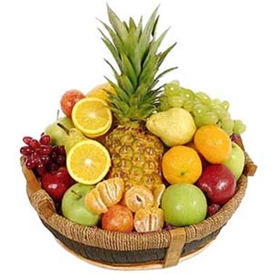
Thanks for Everybody

