Slide 1
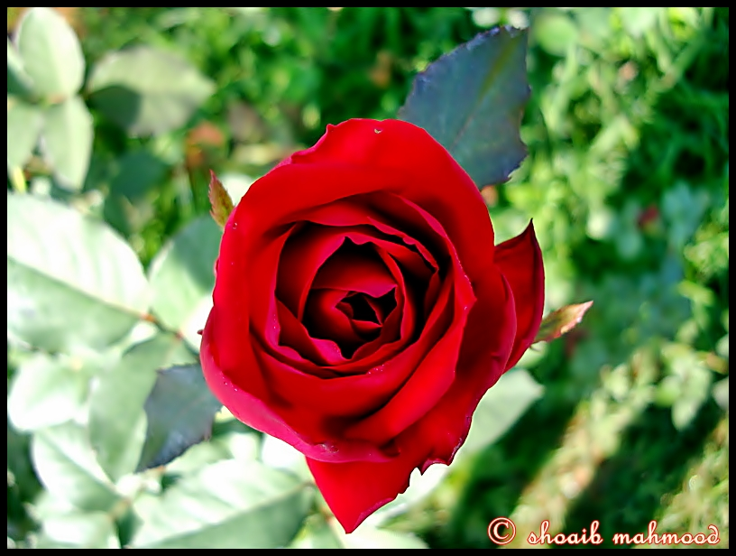
Welcome

Slide 2
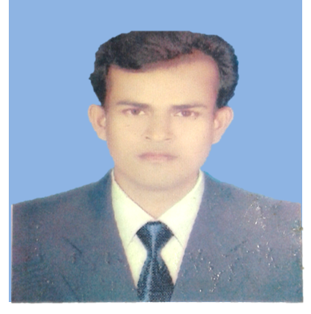
Identy of Teacher
Identy of Lesson
Muhammad Sadekuzzaman
Assistant Teacher
Vadera Govt. Primary School
Tarail, Kishoregonj
Class: Four
Subject: English
Unite:14
Lesson: Mita’s Day
Time:45 min
Date: 25/05/2019

Slide 3
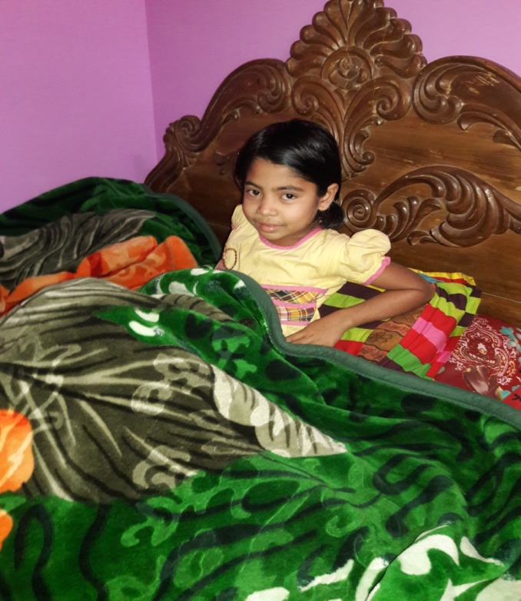
Look at the picture & think alone.
Here you can see apicture . She is Mita.

Slide 4
Today’s lesson is -
Mita’s Day

Slide 5
Learning outcomes
Students will be able to
Listening:
1.1.1 recognize sound difference in the context of words.
Speaking:
1.1.1 say words, phrases and sentences with proper sounds and stress.
Reading:
1.5.1 read words, phrases and sentences in the text with proper pronunciation, stress and intonation .

Slide 6
Look at the picture & say what do you see.
Mita is in class four. She gets up at six o’clock.

Slide 7
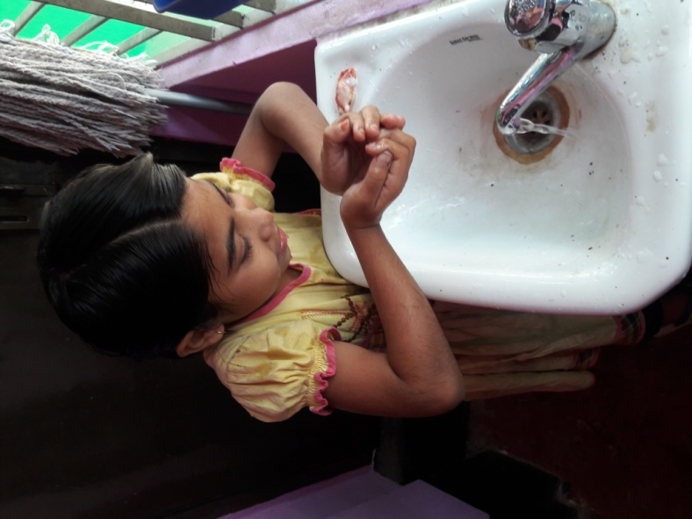
Look at the picture & say
She washes her face.

Slide 8
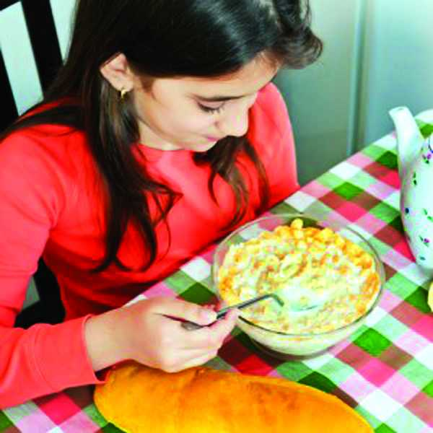
Look at the picture &say
She has breakfast at seven o’clock.

Slide 9
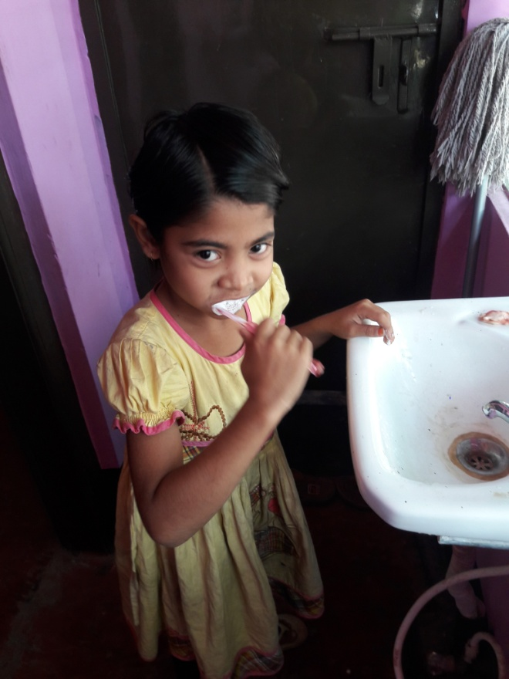
Look at the picture.
Then she brushes her teeth.

Slide 10
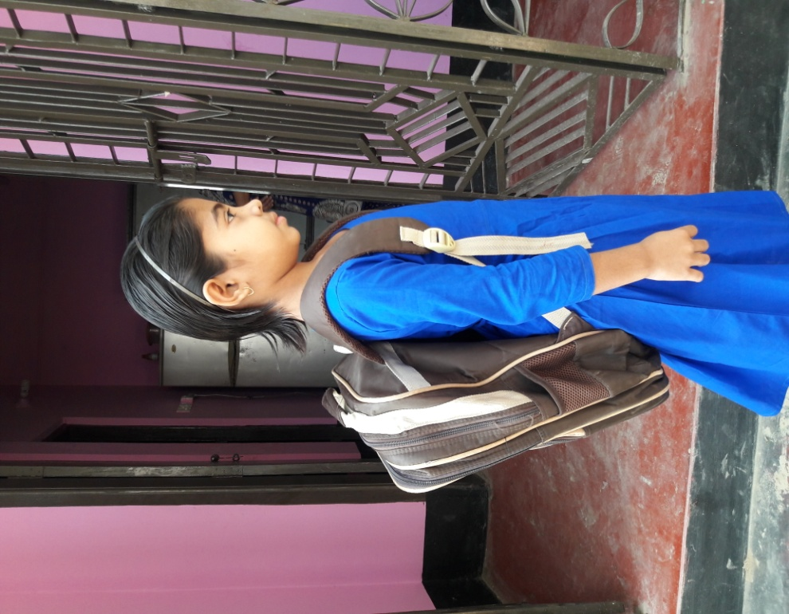
Look at the picture
She goes to school at nine o’clock

Slide 11
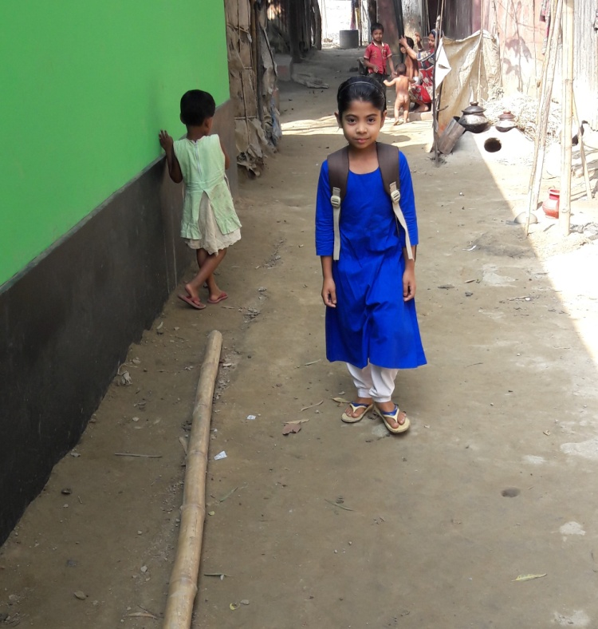
Look at the picture.
Mita returns home at five o’clock.

Slide 12
Open your EFT Book.

Slide 13
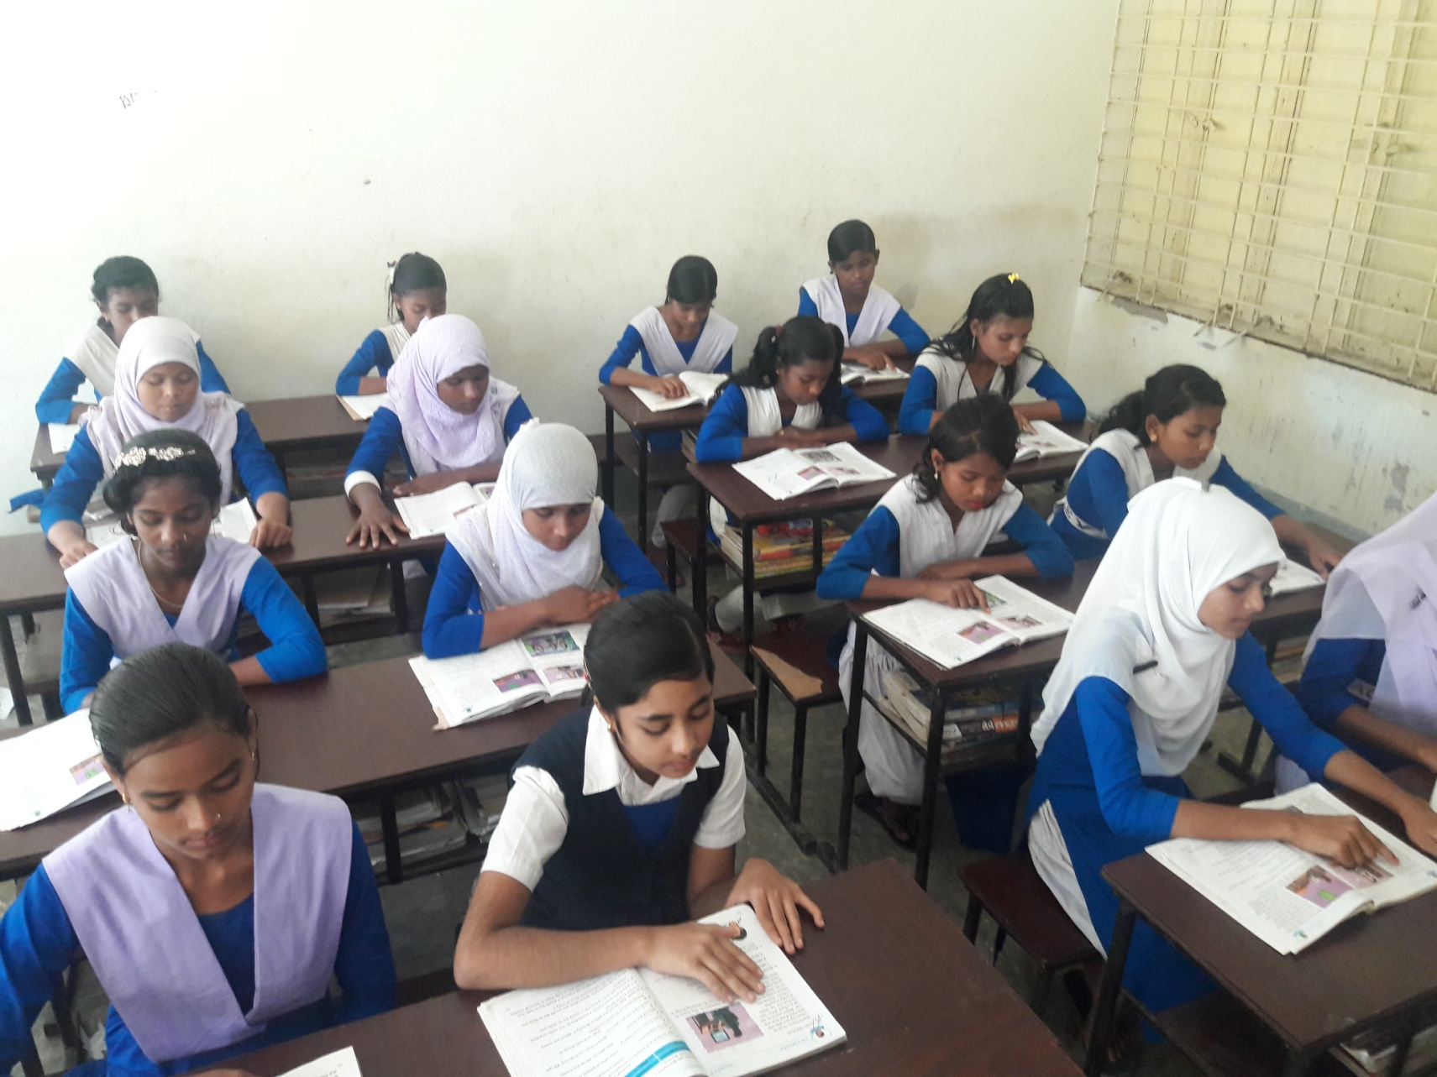
Dear students, read the text again and again.

Slide 14
Match the words
Breakfast
Early eating
Brush teeth
Clean teeth
Get up
Wake up

Slide 15
Give answers following the questions in group.
1. Who is Mita ?
1. Ans. Mita is a student.
2. When does Mita get up ?
2. Ans. Mita gets up at six o’clock.

Slide 16
Fill in the gaps the following sentences lonely.
1. Mita is a class………….
four
2. She returns home at …………...
five o’clock

Slide 17
Evaluation
Now we play a bango game.
wash
teeth
school
face
return

Slide 18
Home Work
Write Mita’s daily activities.

Slide 19
Thank You.

