Slide 1
WELCOME
ROSY GREETINGS FOR YOU
HOW ARE YOU ?

Slide 2
IDENTITY
HASANUR KAMAL
LECTURER (ENGLISH)
RAJOIR NESARIA FAZIL (DEGREE) MADRASAH
KALIKABARIHAT
MORRELGONJ,BAGERHAT
Cont.- 01710-029444

Slide 3
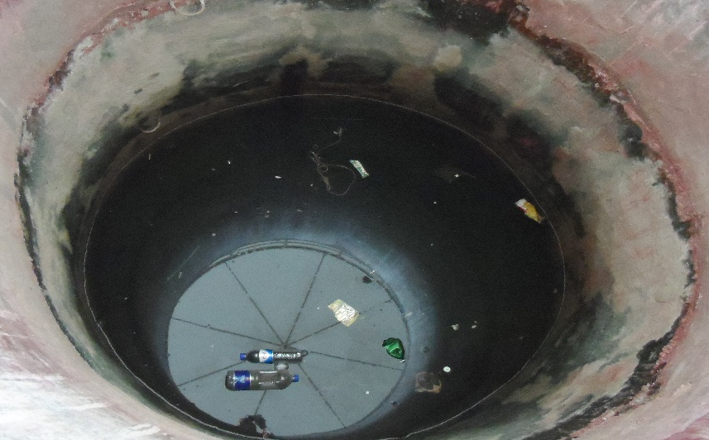
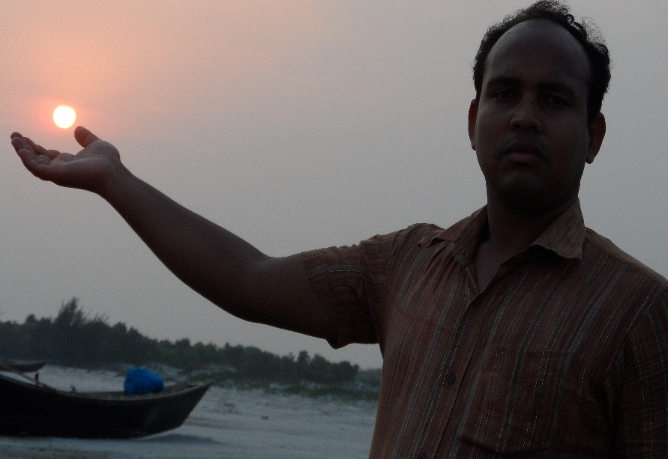
Notes:
PRACTICE MAKES A MAN PERFECT

Slide 4
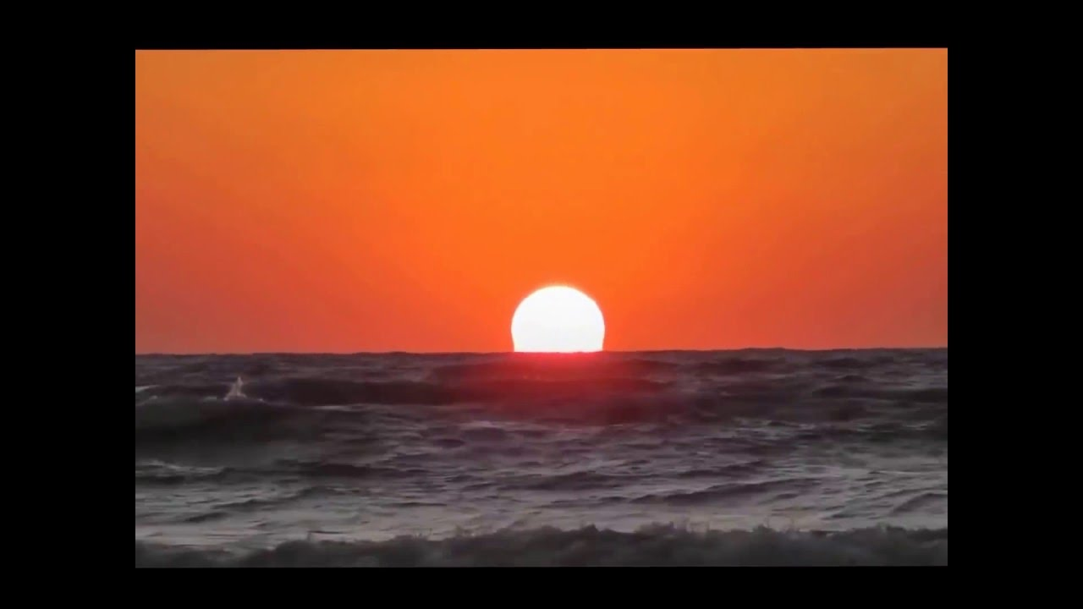
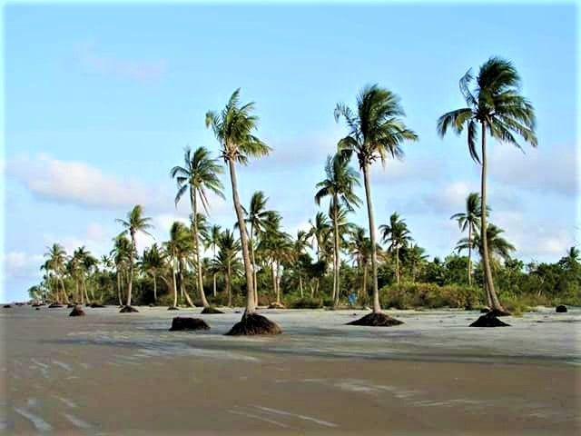
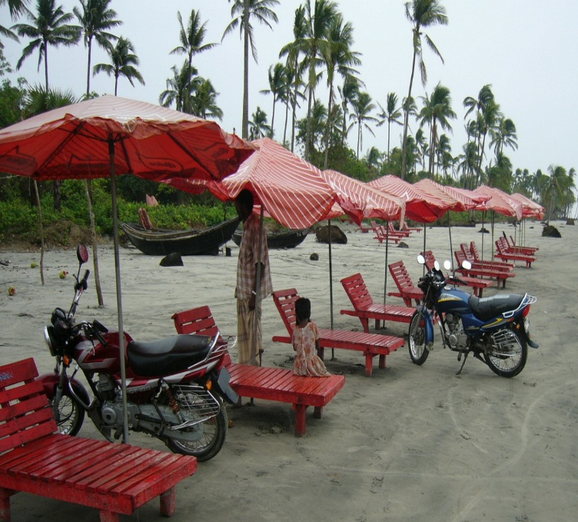
Can you guess something about previous pictures ?
Let us see more pictures

Slide 5
Lesson declaration
Our today’s Lesson is -----
KUAKATA
(THE DAUGHTER OF THE SEA)
UNIT – 12
LESSON - 05

Slide 6
LEARNING OUTCOmES
After the lesson the ss will be able to ------
Tell about “KUAKATA”
Make a paragraph about “ KUAKATA”
Write meaning of some important words
Speak about the location of “KUAKATA”

Slide 7
Let us enjoy a video

Slide 8
Word meaning
Excellent
Wonderful
Distinctive
Unique
Adorable
Attractive
Shimmering
Glimmering

Slide 9
Read the text silently
Kuakata,locally known as Sagar Kannya (Daughter Of the Sea ) is a rare scenic spot located on the southernmost tip of Bangladesh.Kuakata in Latachapali union Under Kalapara Police Station of Patuakhali District is about 30 km in length and 6 km in breadth. It is 70 km from Patukhali district headquarters and 320 km from Dhaka. An excellent combination of the picturesque natural beauty,sandy beaches, blue sky and the shimmering expanse of water of Bay of Bengal.

Slide 10
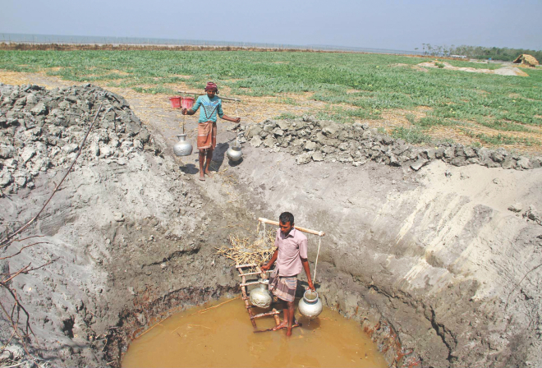
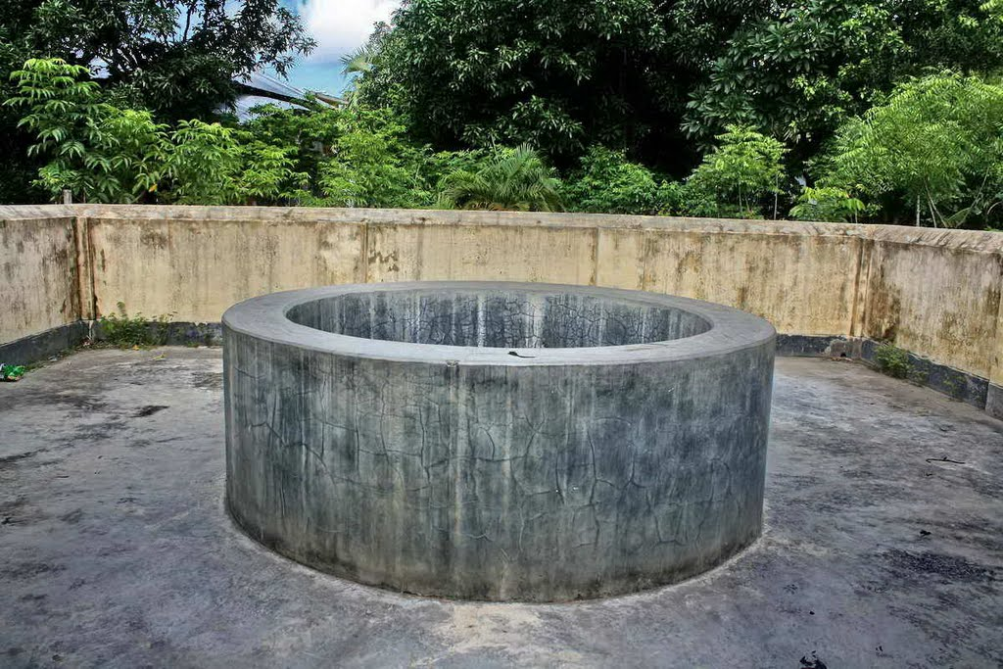
The word “KUA” derives from Bangla which indicates well. “KATA” is a Bangla word which indicates dig
Rakhaine settlers had given this name as “ KUAKATA”

Slide 11
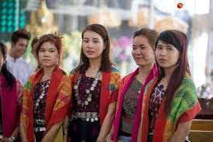
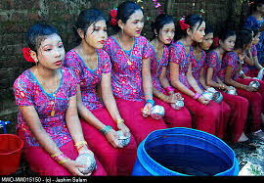
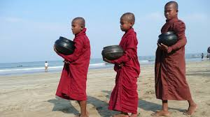
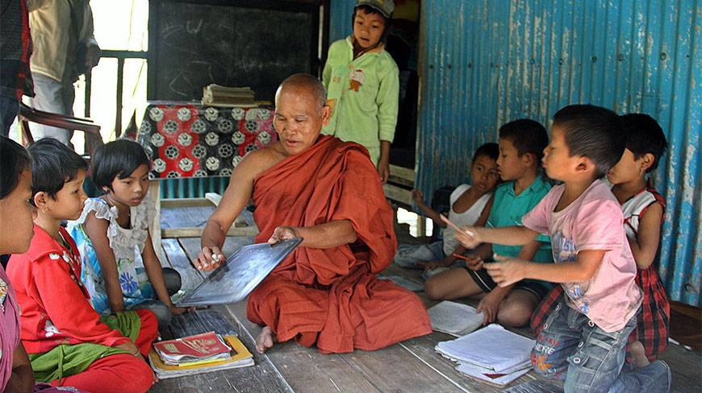

Slide 12
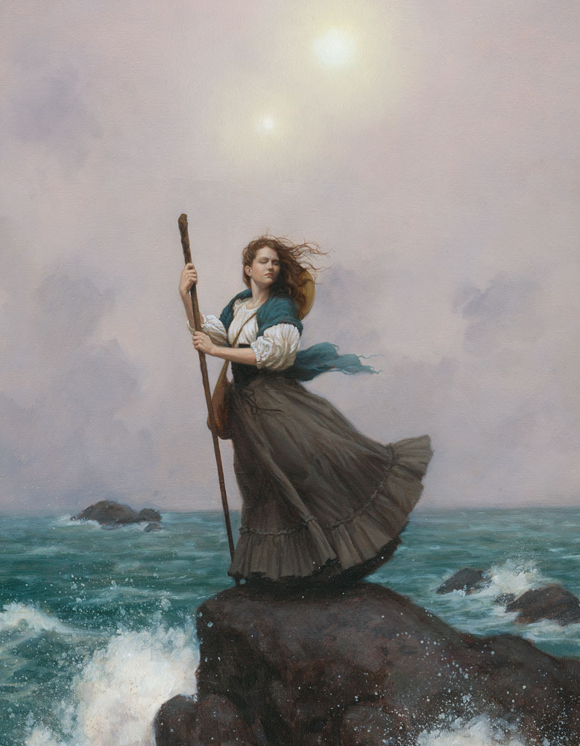
KUAKATA
Locally known as “SAGAR KANNA”

Slide 13
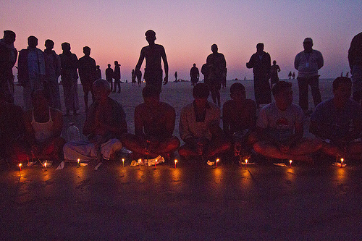
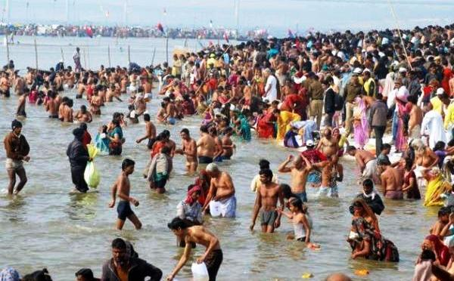
Kuakata is also a holy land for the Hindus and Buddists.Each year thousand of devotees come here to attend the festivals Rash Purnima and Maghi Purnima. Pilgrims take holy bath and enjoy going to the traditional fairs.

Slide 14
A Rakhain woman is doing her traditional work

Slide 15
Group Works
1.How long is KUAKATA from Patuakhali district ?
2. From which word KUAKATA has come ?
3. What is the another name of “KUAKATA” ?

Slide 16
HOME WORK
Write a paragraph on “KUAKATA”

Slide 17
THE END.

