Slide 1
Welcome to my class

Slide 2
Teacher’s Introduction
PARVIN AKTER
Lecturer, English
Rampur Ideal
Alim Madrasah,
Sadar, Chandpur.
Mobile : 01718295712
E-mail: parvinakter1335@gmail.com

Slide 3
Class : Eight
Sub : English 2nd paper
Title : Preposition
Time : 45 minutes
Lesson Introduction

Slide 4
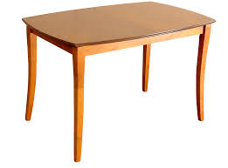
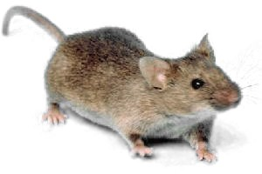
Look at the pictures
The rat is on the table.
The rat is under the table.

Slide 5
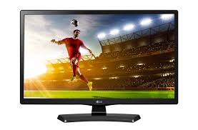
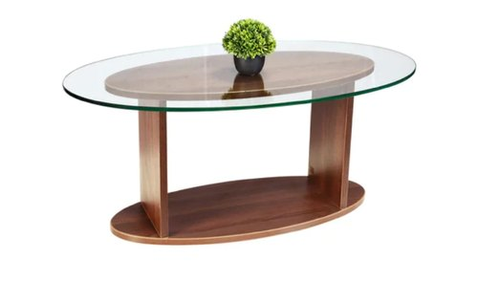
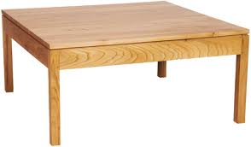
Look at the pictures
There is a TV in the picture.
The plant is on the table.
The football is under the table.

Slide 6
Can you guess what is our today’s lesson....

Slide 7
Today’s Lesson
Preposition (Part-1)

Slide 8
LEARNING OUTCOMES
*After the lesson the learners will be able to..
say definition of preposition.
say kinds of preposition.
use of preposition.
Fill in the gaps with preposition.

Slide 9
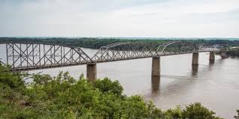
The bridge is over the river.
The sky is above our head.

Slide 10
Definition of preposition

Slide 11
Kinds of preposition
Simple preposition
Double preposition
Compound preposition
Phrase preposition
Participle preposition
Disguised preposition
Detached preposition

Slide 12
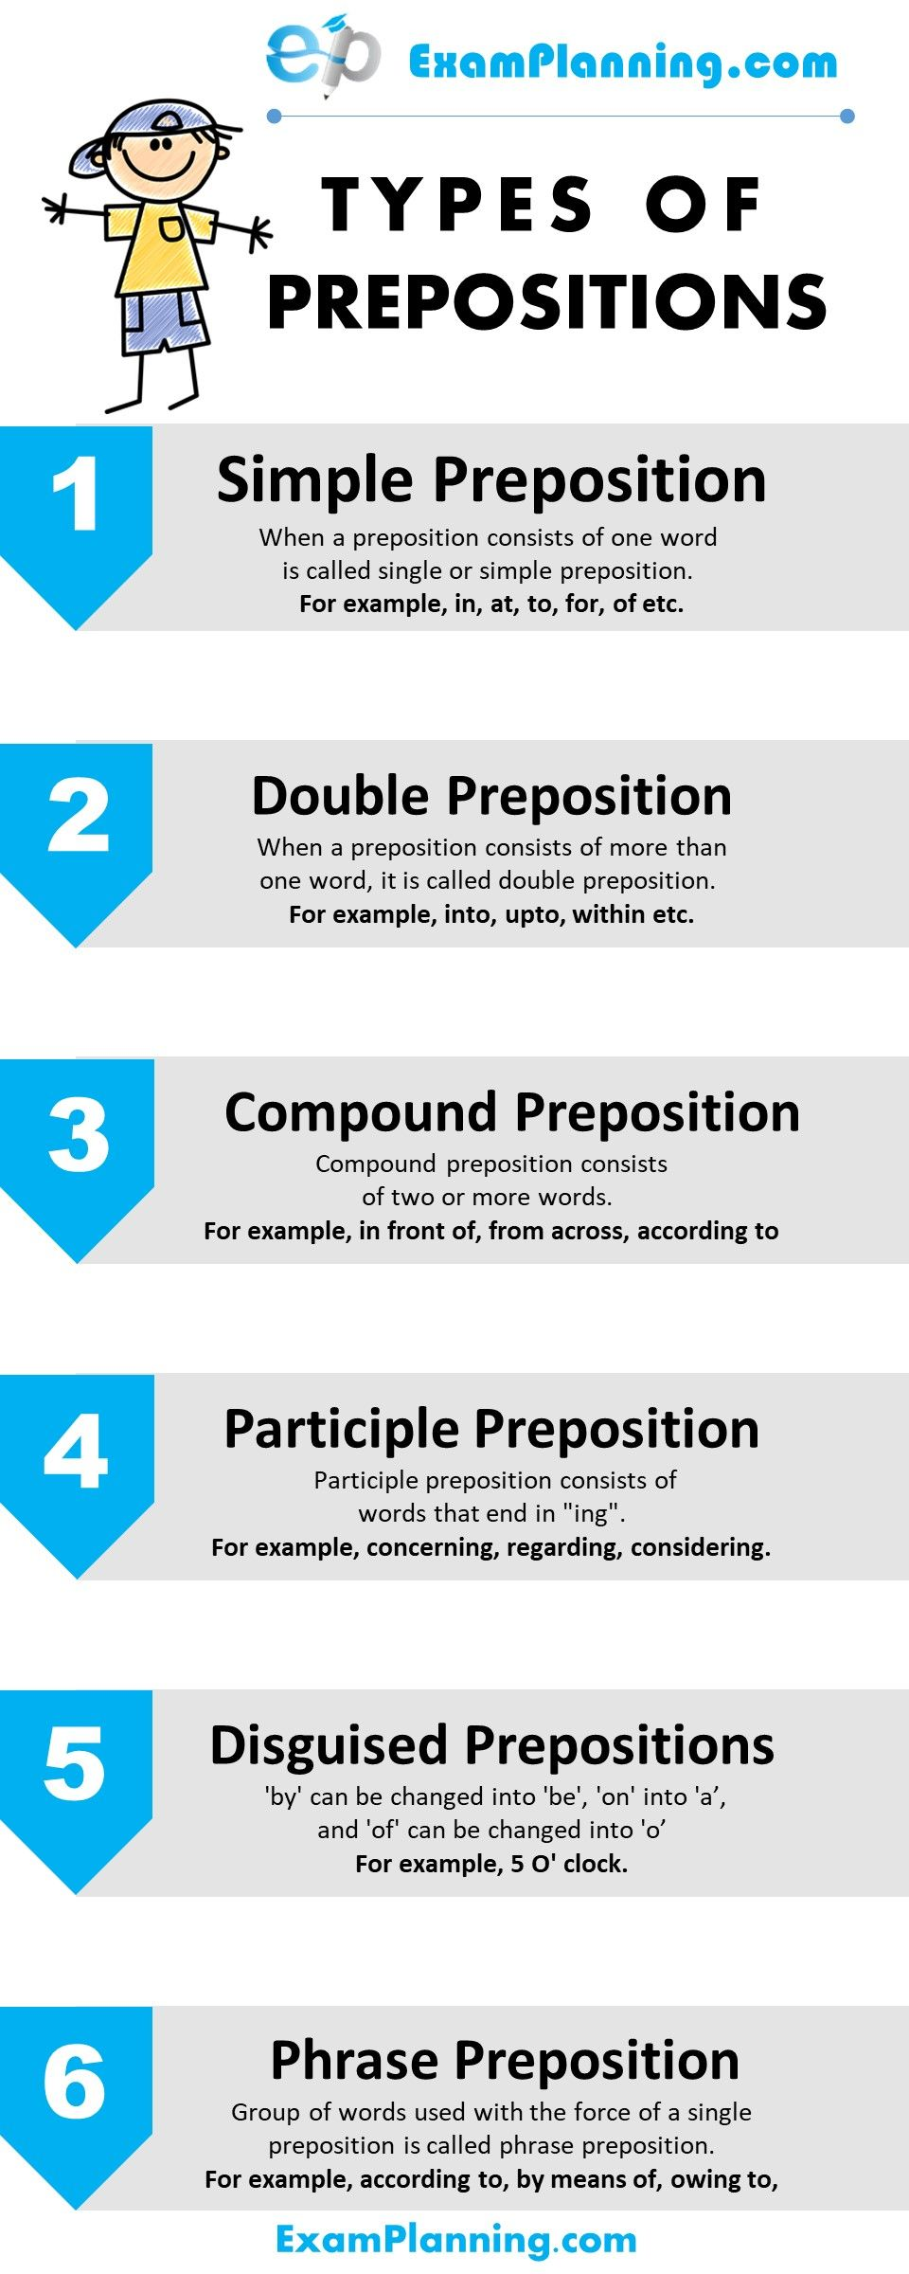

Slide 13
Individual Work
What is Preposition?

Slide 14
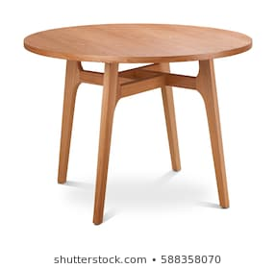
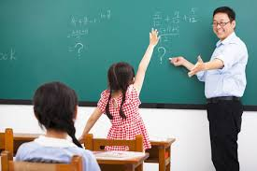
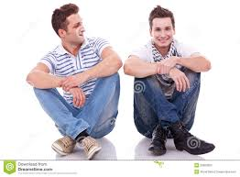
Examples of prepositions
Simple
The book is on the table.
Double
The teacher came into the class.
Compound
The man sat beside his friend.
Phrase
Please give me a pen instead of a pencil.

Slide 15
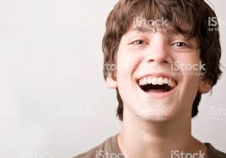
participle
Considering his age, he was release from jail.
Disguised
It is 4 O, clock
Detached
Why are you laughing for?

Slide 16
*Fill in the gaps with suitable prepositions..
My Dear Azad,
I am happy to learn that you have done very well (a) ____ the last exam. Today I wish (b) ____ add charm and beauty (c) ____ your brilliant success. I had a long-cherished desire to organize a picnic (d) ____ a suitable place rich (e) ____ natural beauty. Sagardari is our selected place (f) ____ the picnic. We will start (g) ____ January 12 at 10 am. Our picnic party will be a meaning (h) ____ the company (i) our reverend and amiable teacher, Mr Akram Hossain. Don’t fail to turn (j)____ in time.
Yours ever
Heron
.
Pair work

Slide 17
Match the Answers
a) in; b) to; c)to; d)at; e)in; f)for; g) on; h)by; i) of; j) up

Slide 18
Group work
Find out the preposition from the sentences
I was there in Autumn. I wanted quiet isolation, to do some troublesome writing. I wanted mountain air to blow out Malaria from too long time in the sub-tropics. I was homesick, too, for the flaming of maples.

Slide 19
Evaluation
Make ten sentences with following preposition.
With, out , of, inside, over, up, by, in, on , in front of.

Slide 20
How many kinds of preposition are there ?
Write their names with at least one examples.
Home work

