Slide 1
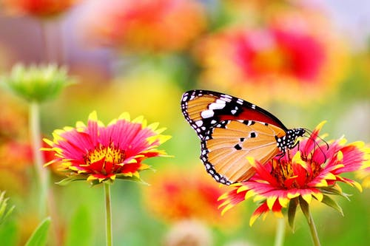

Slide 2
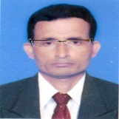
Manik Chandra Majumder
Senior Teacher (English)
Gazirhat High School
Senbag, Noakhali
Mobile No: 01717155169
Email: manikmajumder01@gmail.com
Class : 6
Subject : English 1st paper
Date : 00/00/2020

Slide 3
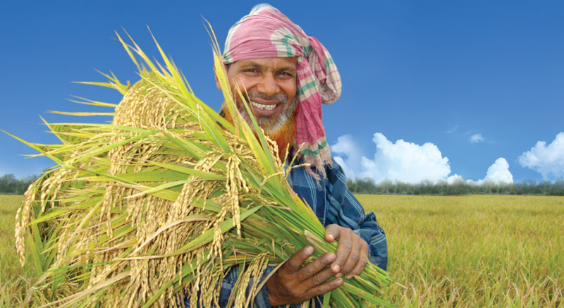
Dear students, Look at pictures and tell the name of occupations.
This is a farmer.
He is a very important and familiar figure in our society. He grows rice, jute, sugarcane, vegetable etc. He is the provider of our food.
Notes:
Teacher should mention about occupations.

Slide 4
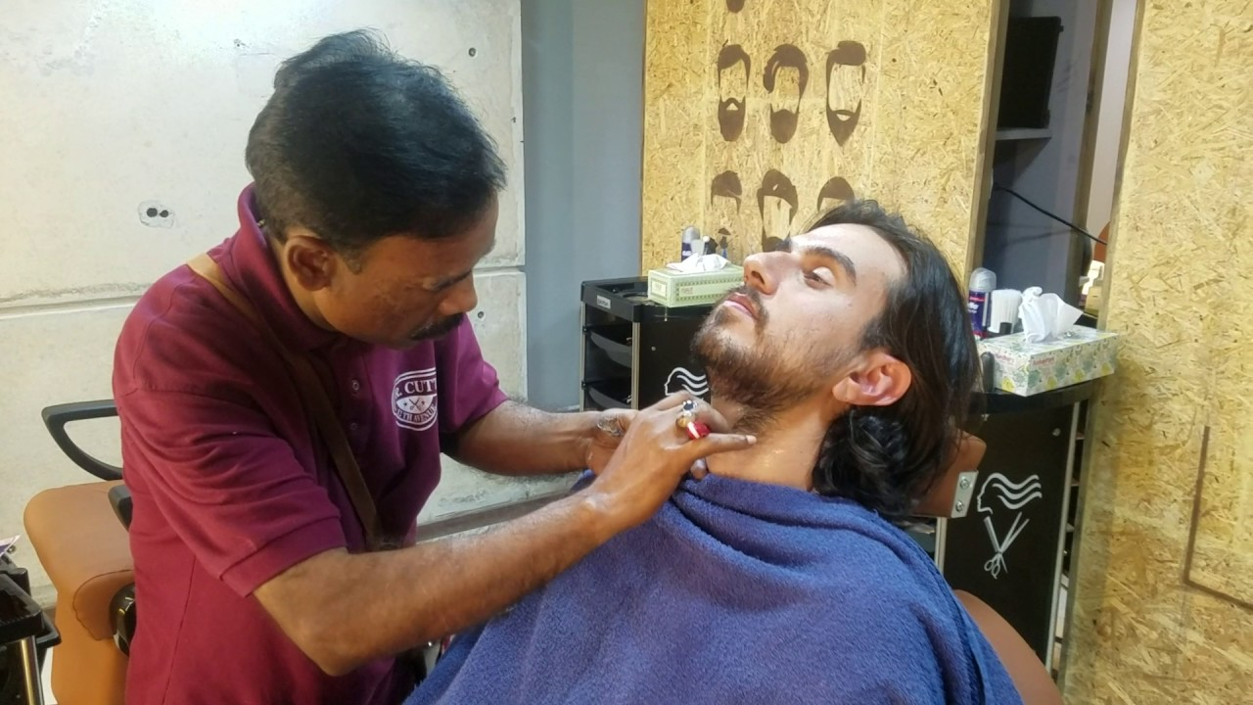
This is a barber/hair dresser.
He is also a familiar figure in our society. He cuts and styles our hair.
Notes:
Teacher should mention about occupations.

Slide 5
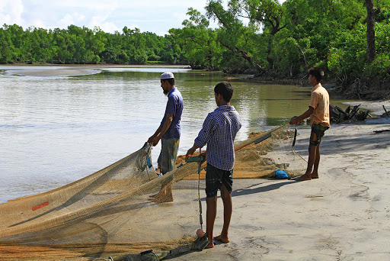
They are fishermen.
They are also very important persons in our society. They catch fishes from ponds, rivers, lakes, seas etc. and sell fishes. They live close to river, lake and costal areas.
Notes:
Teacher should mention about occupations.

Slide 6
Farmer
Barber/ Hair dresser
Fishermen
All these persons are very common to our society. They play very important role in our society. So we should offer thanks for their work.

Slide 7
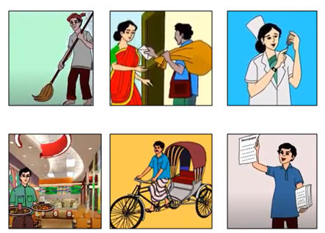
Our today’s lesson is ---
Thanks for your work
Lesson : Five
Page : 16

Slide 8
Learning outcomes
After we have studied this lesson, we will be
able to -----
a) ask and answer questions,
b) talk about different occupations,
c) listen for specific information,
d) read and understand text,
e) describe a particular occupation in writing.

Slide 9
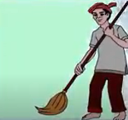
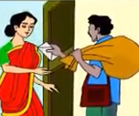
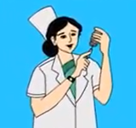
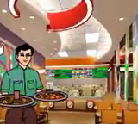
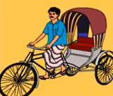
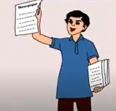
Look and say. Use suitable words from the box to describe the profession of each person below.
newspaper hawker
nurse
cleaner
rickshaw-puller
waiter
postman

Slide 10
Look at the people and think about the following questions.
What do they do?
How do their works help us ?
A cleaner is an important person in our society. He cleans offices, roads, hospitals etc. and makes our environment hygiene. Without his work our society will turn into a big dustbin. So we should respect him.
A nurse works in hospitals and clinics. Whenever we become sick and admit into hospital nurses serve us. Their work is very important for our society. So we should respect them.
A cleaner
A nurse
Notes:
At first Teacher will describe their work. After that student will try.

Slide 11
Look at the people and think about the following questions.
What do they do?
How do their works help us ?
A rickshaw-puller pulls rickshaw on roads and streets. They carries passengers and goods one place to another. Their work is very important for our society. So we should respect them.
A waiter works in hotels and restaurants. He serves us foods and drinks. He is familiar person in our society. His work is very important for our society.
A waiter
A rickshaw-puller
Notes:
At first Teacher will describe their work. After that student will try.

Slide 12
Look at the people and think about the following questions.
What do they do?
How do their works help us ?
A newspaper hawker is very familiar and important person in our society. He gives us newspaper every morning. So we should respect him.
A postman is a low paid government servant of postal department. He delivers letters, parcels, money orders to us. He is very familiar and important person in our society. So I would like t thank him.
Newspaper hawker
postman

Slide 13
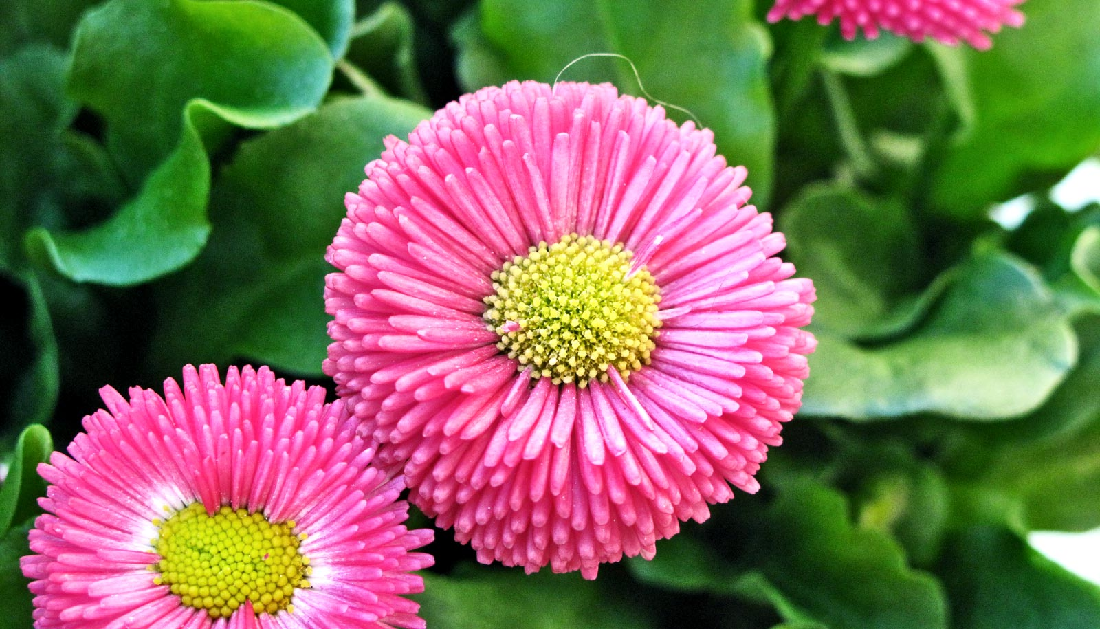
Dear students, We have talked about some professions Now you have to write short note about A Day Labourer .

Slide 14
Choose appropriate words from the box to complete the dialogue below. Then act out the dialogue in pairs.
letters
restaurant
streets
place
morning
A
What does a cleaner do?
What does a rickshaw puller do?
What does a newspaper hawker do?
What does a postman do?
What does a waiter do?
B
A hawker gives us newspaper every -----------------.
A cleaner cleans our houses, office and------------ etc.
A postman delivers ------------ and other items to us.
A waiter serves food at the ------------------.
A rickshaw puller takes us from one --------- to another.

Slide 15
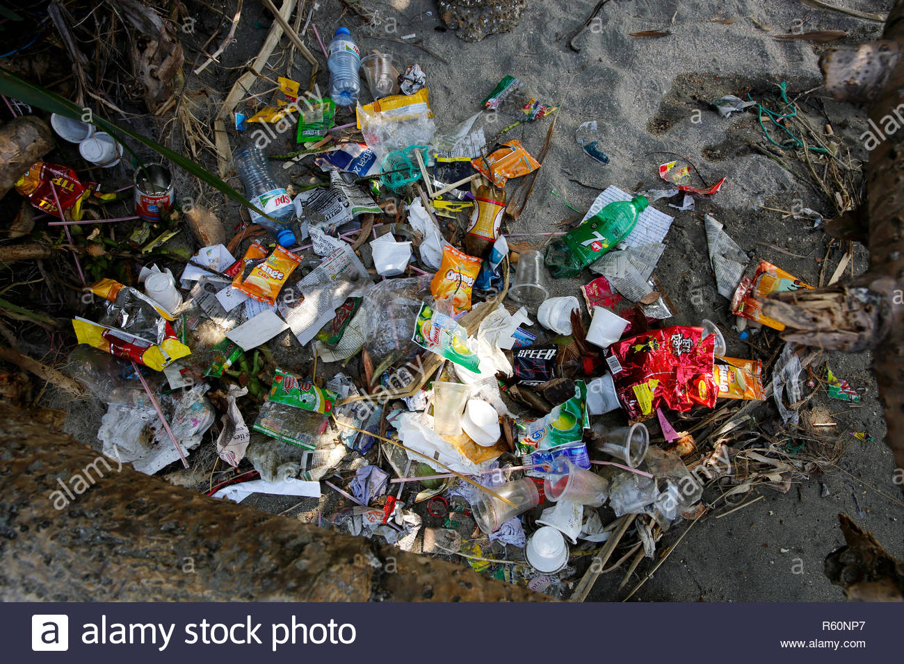
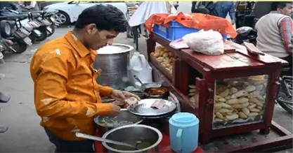
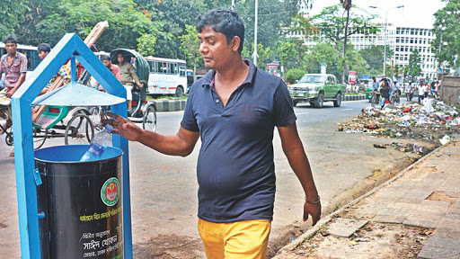
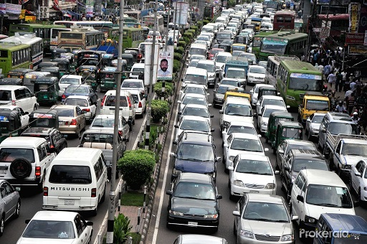
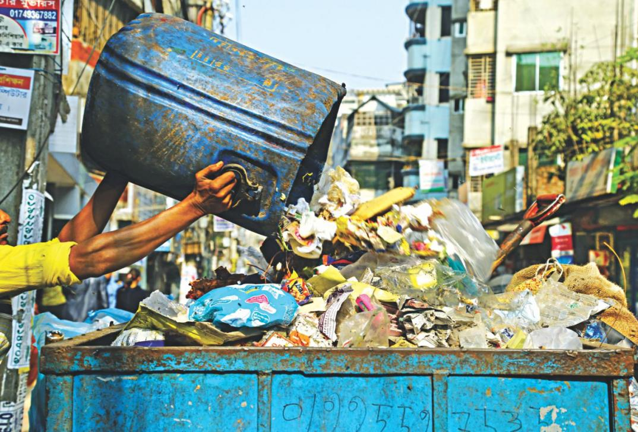
Vocabulary and sentence making
Click the word
Meaning: a container of garbage
Meaning: Roads of towns and city
Meaning: Garbage, Trash.
Meaning: Get up, Rise up.
Meaning: Gather, Assemble, Pick-up
Collect
Rubbish
Wake up
Street
unhygienic
Dustbin
People throw rubbish here and there.
Rina wakes up early in the morning.
The streets of Dhaka and Chottragram are busy.
We should throw rubbish into dustbin.
Road side foods are unhygienic.
Bulbul collects rubbish from Sankar area.
Notes:
Teacher will show picture and sentence which will help ss to guess meaning

Slide 16
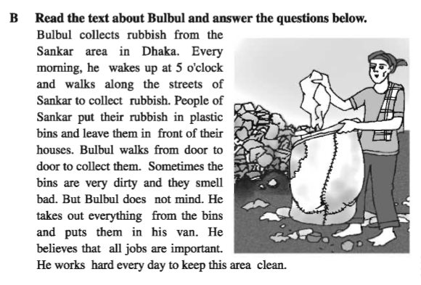
B Read the text about Bulbul and underline the verbs

Slide 17
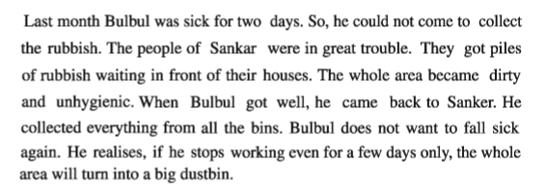

Slide 18
Now dear students, find out the verb from the text. If the verb is in present tense, write down in past tense of the same and vise versa.
Present Tense | Past Tense
Present Tense | Past Tense
Collect
Collected
Be (am, is, are)
Was/were
wake
woke
get
got
walk
walked
become
became
put
put
come
came
leave
left
want
wanted
smell
smelt
fall
fell
mind
minded
realise
realised
take
took
stop
stopped
believe
believed
turn
turned
work
worked
can
could

Slide 19
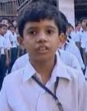
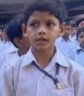
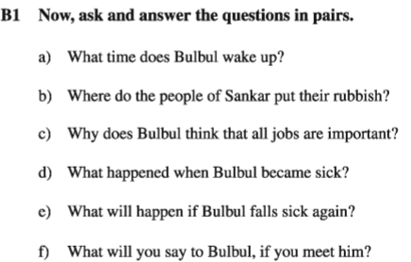
Now ask and answer the questions below in pairs.

Slide 20
Select the correct answer with
Bulbul works at Sankar / Motijheel / Mohakhali area in Dhaka.
He picks up coins / garbage / stamps from Sankar area.
He gets up from bed at 7/ 6 / 5 O’clock.
He believes all professions are important / less important / hated.
Last month Bulbul became sick for 2 days / 3 days / 4 days.

Slide 21
Write a short paragraph about
A farmer.

Slide 22
